Slide 1
The Compensation Effect of Civic Education
How School Classes Make Up for Missing Parental Political Socialization
Anja Neundorf (Nottingham)
Richard G. Niemi (Rochester)
Kaat Smets (Royal Holloway)
Prepared for presentation at the joint LLAKES research conference
‘The crisis for contemporary youth: opportunities and civic values in comparative, longitudinal and inter-generational perspective ’,
UCL Institute of Education, London, June 4-5, 2015.

Slide 2
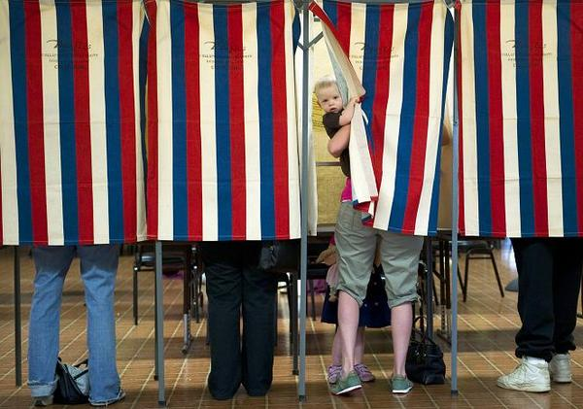
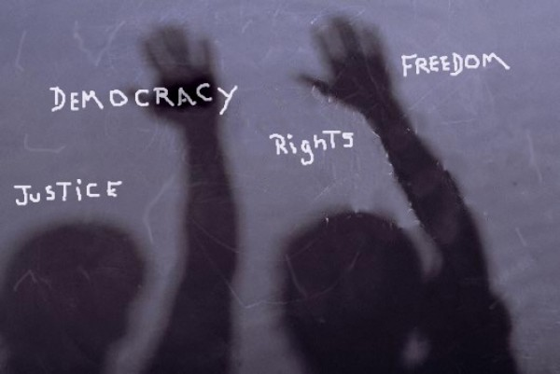
Parental socialization
Civic education

Slide 3
Research questions
Can civic education compensate for lacking parental political socialization?
Which aspects of the civic education curriculum and parental socialization matter?

Slide 4
Data
Belgian Political Panel Study
Adolescents and young adults (15-21 years)
Three waves (2006 - 2011)
Sample size:
    Wave 1 -> 6,330
    Wave 2 -> 4,235
    Wave 3 -> 3,025

Slide 5
Civic education:
Formal civic education
Open class room climate
Active learning strategies (visits, group work, volunteering)
Political engagement
of young people:
Read, watch, listen to news
Political interest
Discuss politics
Compensation effect
Control variables
Age
Gender
Educational goal
Region
Parental socialization:
Parental SES (books at home, educational level)
Discussion (frequency, parents primary source)
Notes:
Since all civic education and parental socialization variables are measured from less to more, in principle we expect a positive relationship between each of the measures and our dependent variable.
The political engagement index gauges the extent to which respondents follow societal issues and politics and is based on three questions: one asking how often a respondent reads, watches or listens to the news (also on the internet), a second measuring how interested the respondent is in societal issues and politics, and a third assessing how often the respondent discusses politics or problems in society when (s)he is with good friends.
Formal civic education refers to inclusion of socio-political issues and institutions in class and is measured through a number of questions on how often on a scale from 1 ‘never’ to 4 ‘often’ the following topics were discussed in class: 1.) the way parliament works; 2.) the United Nations; 3.) the European Union; 4.) federalism; 5.) elections; and 6.) recent political events.
Open classroom climate is measured on a scale from 1 ‘totally disagree’ to 4 ‘totally agree’ and taps whether students: 1.) felt encouraged to develop their own opinions; 2.) felt free to express their own opinion in class, even when it deviates from the majority; and 3.) were under the impression that their teacher provided several views on topics in class.
The presence of active learning strategies, lastly, is measured through three different indicators. The first records overtly political contacts – i.e., whether pupils visited the parliament or town hall as part of their civic education course and whether any politicians or important people in society came to give a talk in class. The second measure of active learning strategies measures how often students had to engage in group work for which they received a joint grade in the past year (1 = never, 4 = often). The third and last indicator of active learning strategies measures on a scale from 0 ‘no’ to 3 ‘more than 20 hours’ whether and how much voluntary work students were obliged to do by their school.

Slide 6
Descriptive illustration of
compensation effect
Figure2

Slide 7
Latent growth curve modeling
Notes:
Three question: What is the average trajectory of political engagement over time in our sample of adolescents and young adults? Is there significant individual level variance in the intercepts and slopes, i.e., in the observed starting levels of political engagement and the subsequent growth as respondents age? And most importantly, to what extent do parental socialization and civic education explain these individual differences?
Average starting point: 1.23 on a scale from 1 ‘never ‘never read or watch the news/not interested/never discusses politics’ to 5 ‘reads or watches the news daily/very interested/always discusses politics’
Average growth: .09

Slide 8
 | Starting levels of political engagement | Development of political engagement
Civic education
Formal civic education | +
Open class room climate
Active learning: volunteering |  | −
Active learning: visits
Active learning: group projects | − | +
Parental socialization
Number of books at home | +
Pol. info mainly from parents | −
Pol. discussion with parents | + | −
Parental education
Compensation effect
Formal civic education * No. books at home | n.a. | −
Formal civic education * Pol. discussion | n.a. | −

Slide 9
Conclusion and discussion
Civic education boosts initial levels of political engagement.
Political engagement is relatively stable from an early age onwards.
Civic education classes can compensate for lacking parental socialization.

