Slide 1
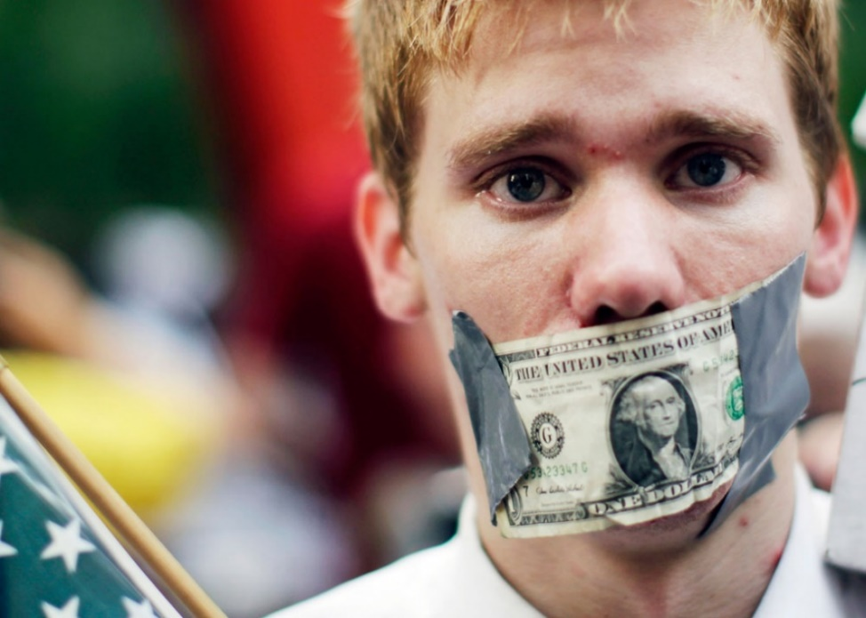
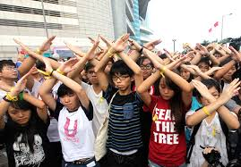
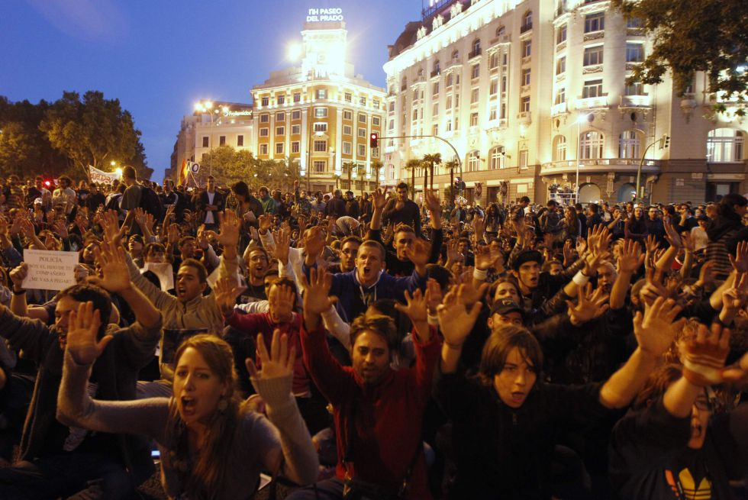
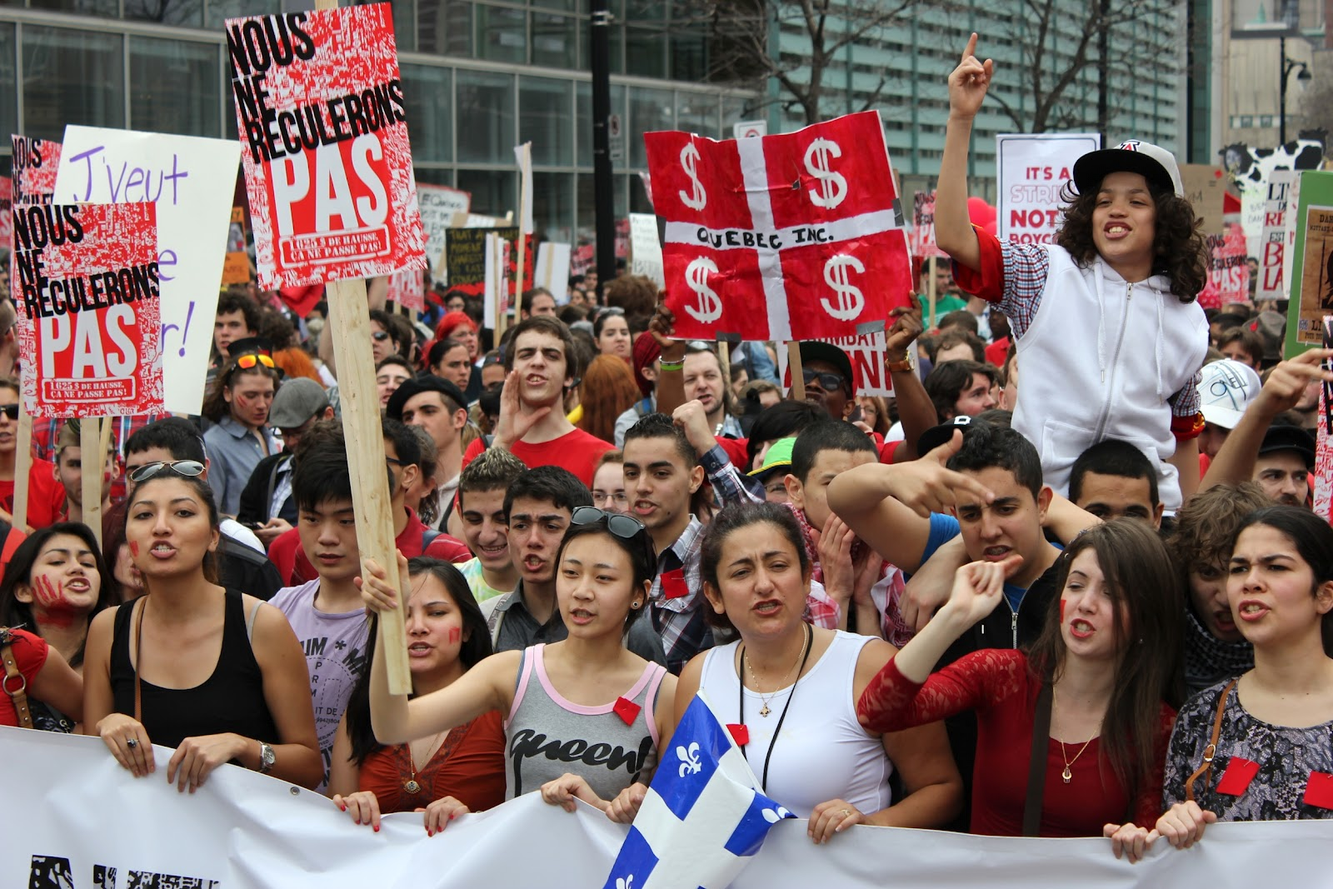
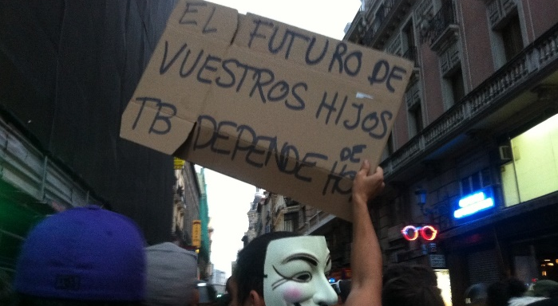
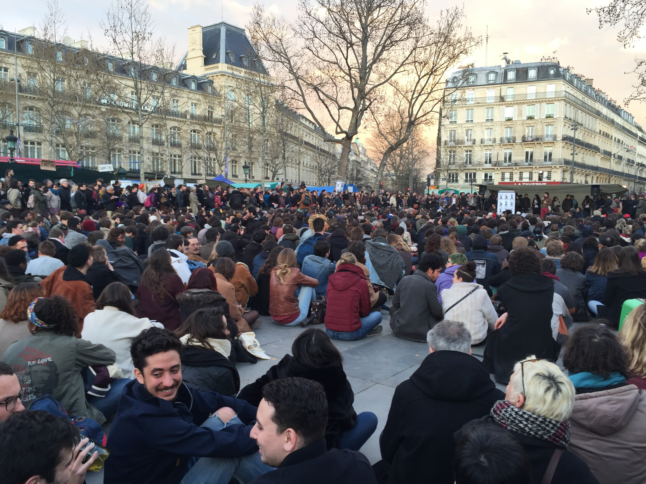
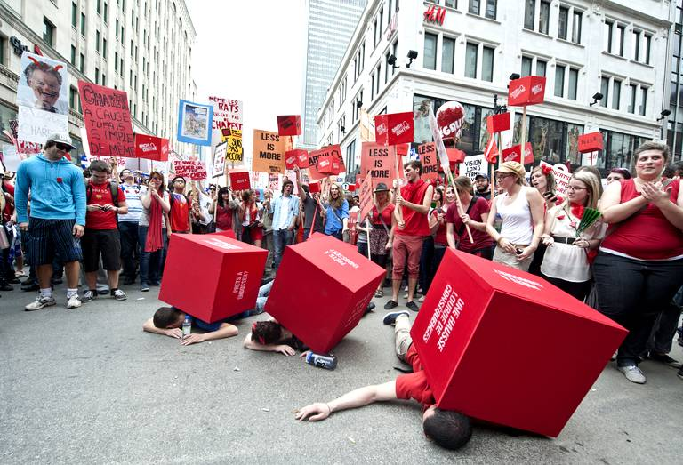
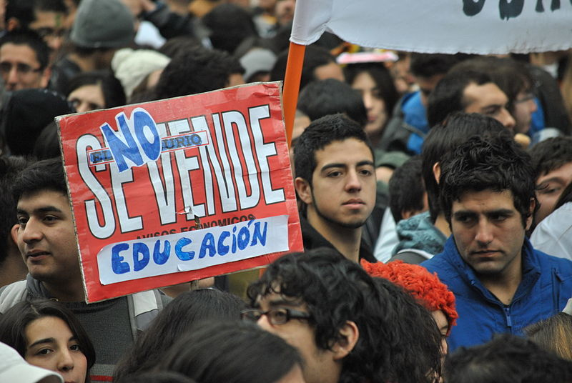
Global Angers ? Becoming Adult in a Neoliberal World
Cécile Van de Velde
Canada Research Chair in Social Inequalities and Life Course
Professor of Sociology in the University of Montreal

Slide 2
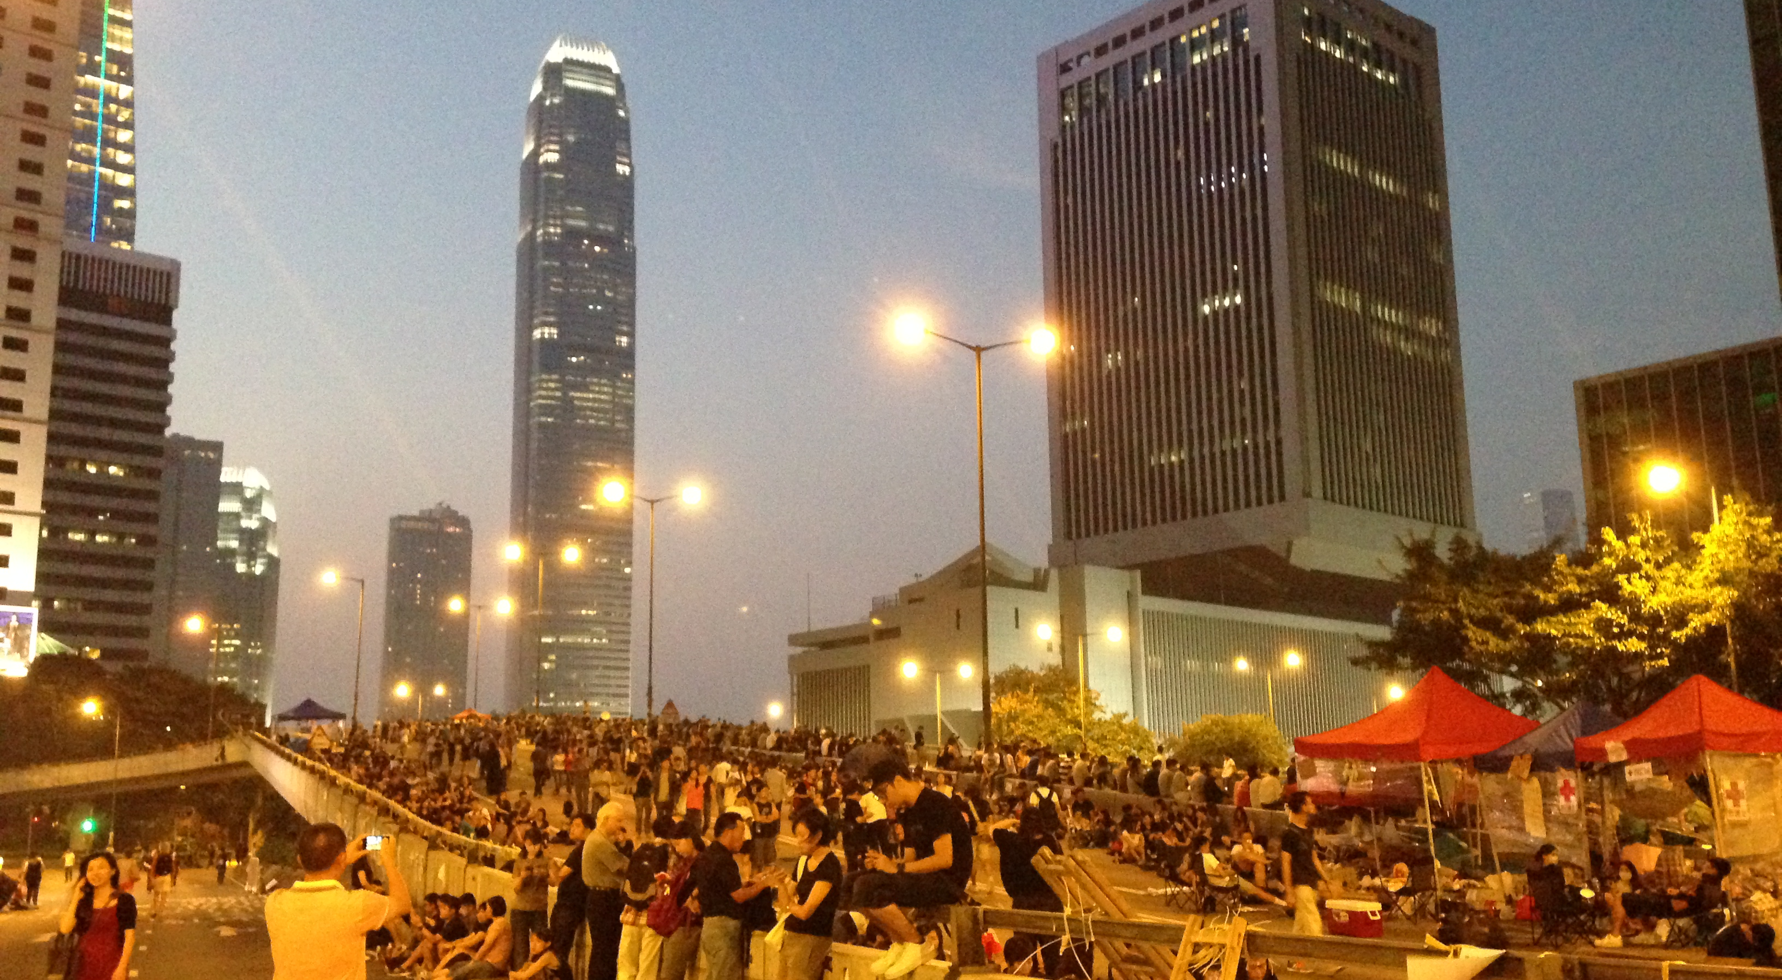
Five Protests…

Slide 3
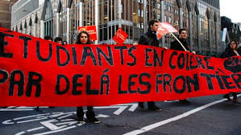
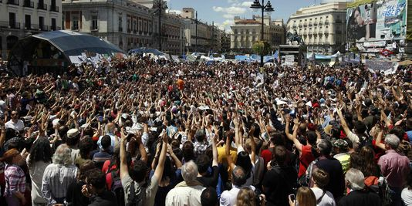
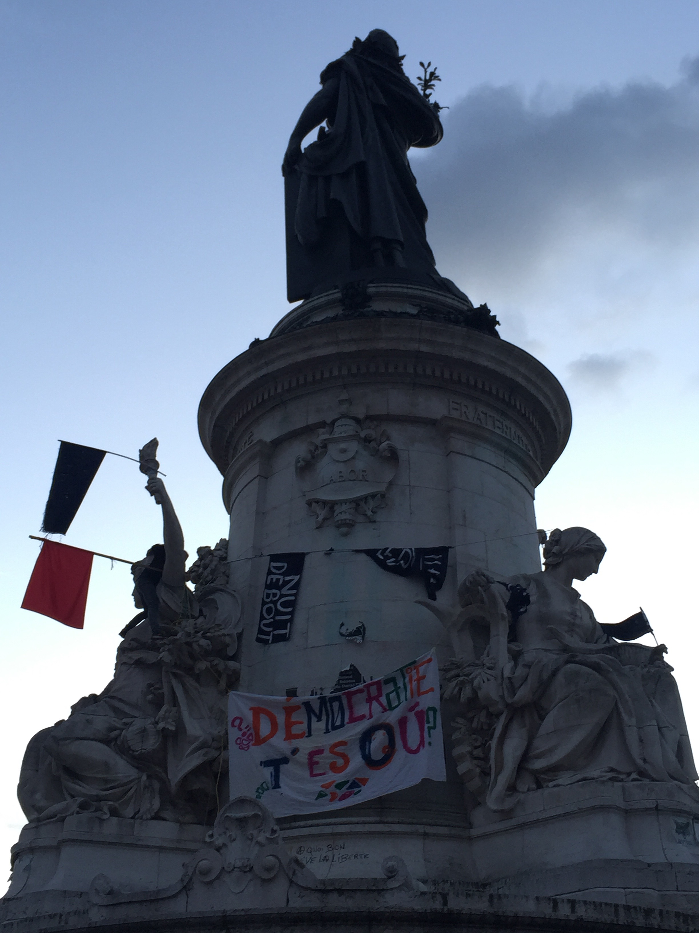
… But one Global Generation?

Slide 4
Becoming Adult in a Neoliberal World
Generations and Social Classes : a Comparative Approach
Montreal, Madrid, Santiago, Hong Kong, Paris
Data and Analysis:
Observations and collection of slogans in the protests (more than 1300) + textual analysis
More than 130 interviews of young people (18 to 30) from different classes in each city

Slide 5
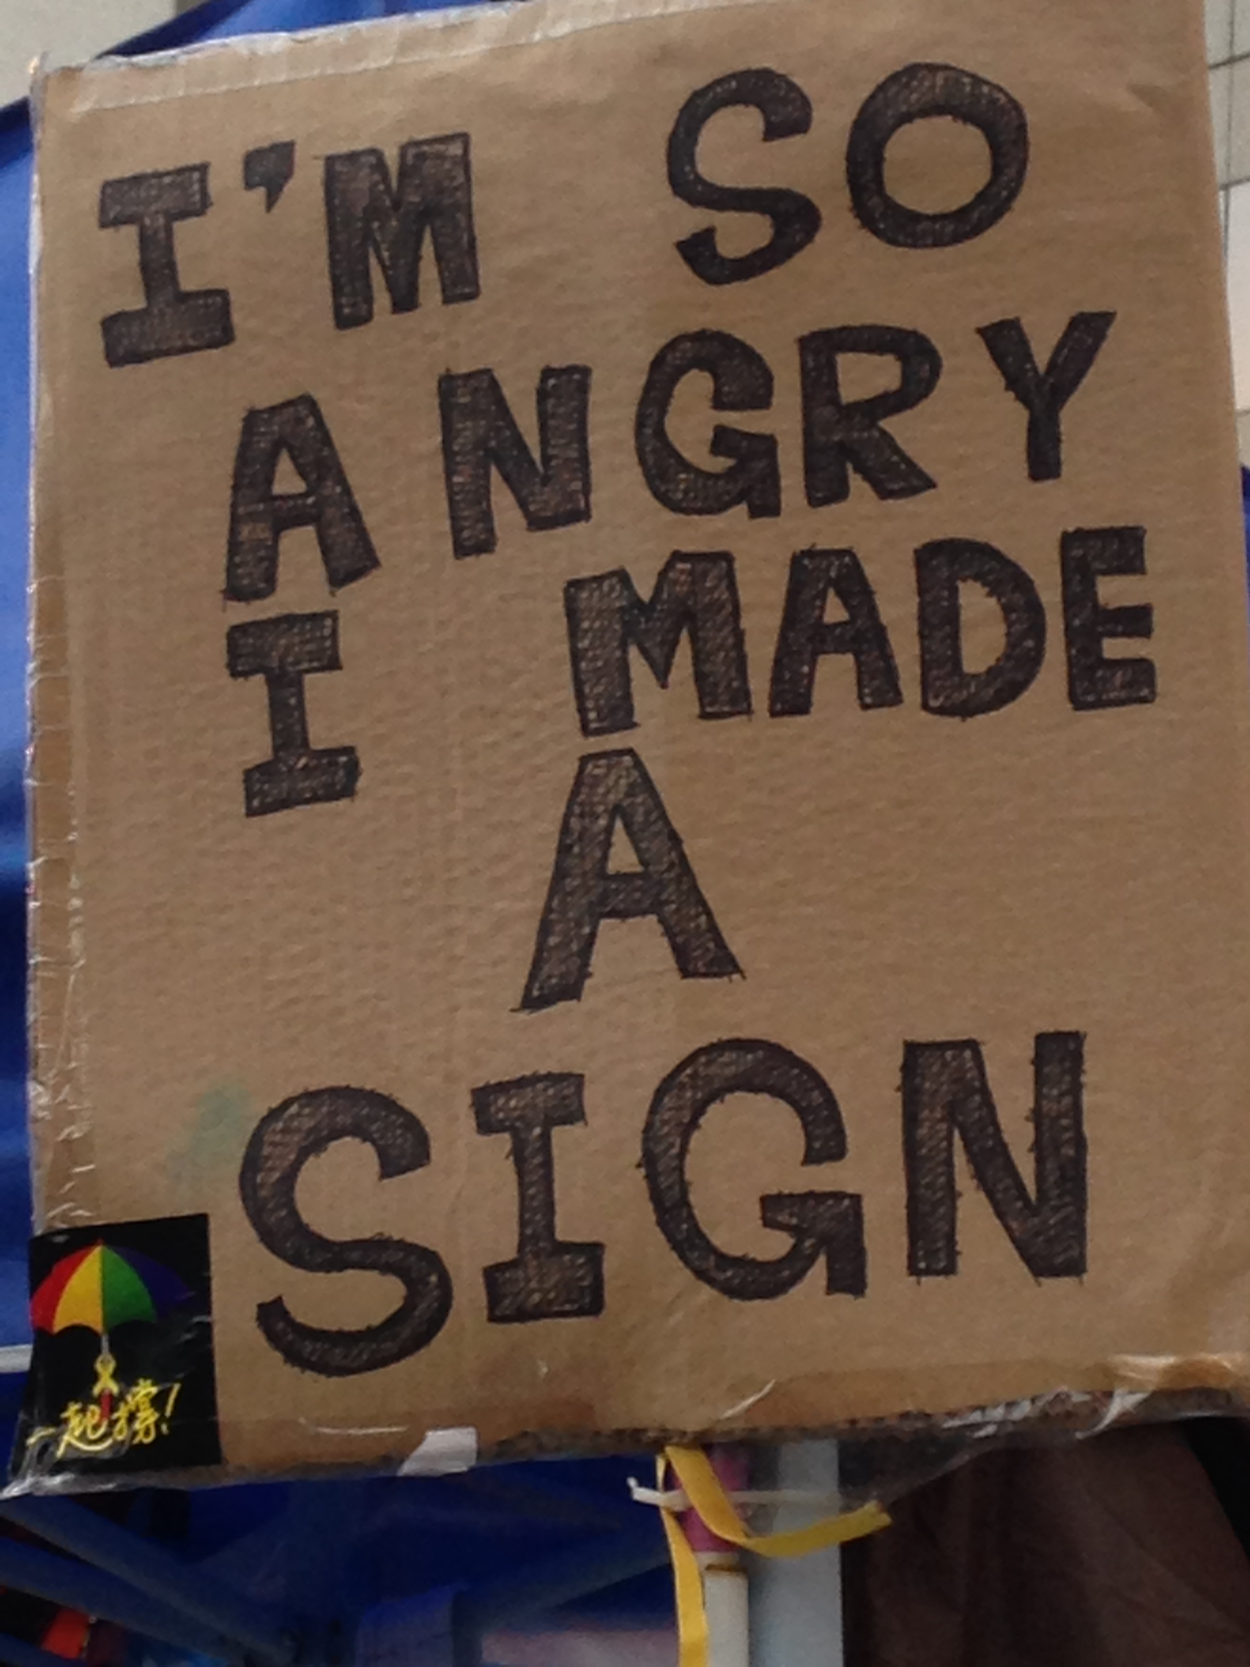
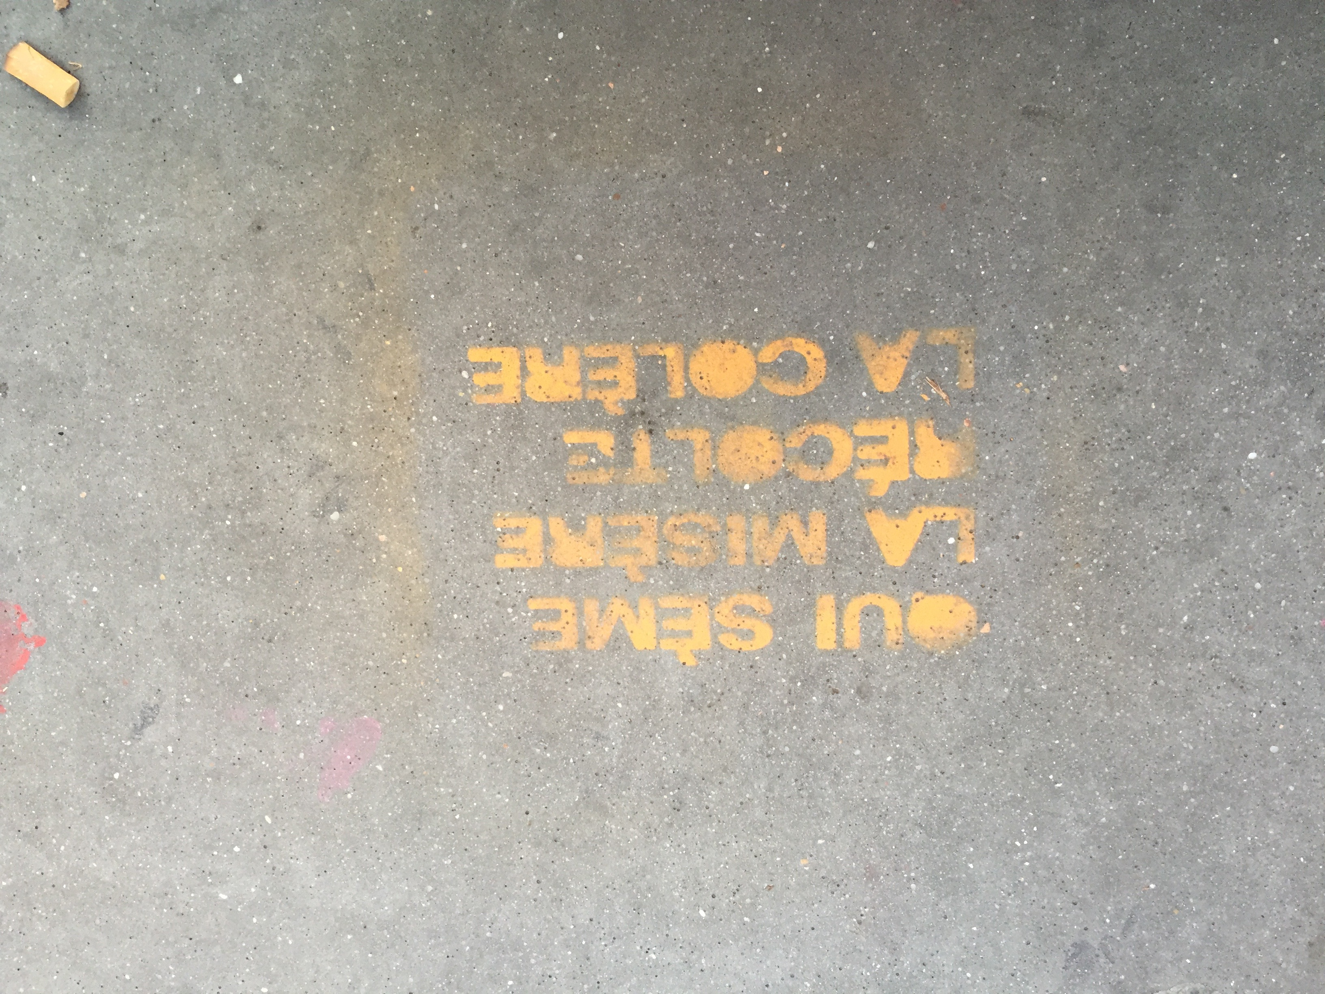
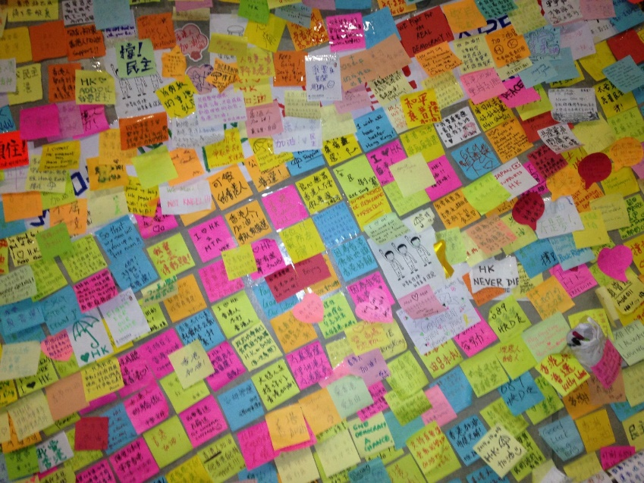
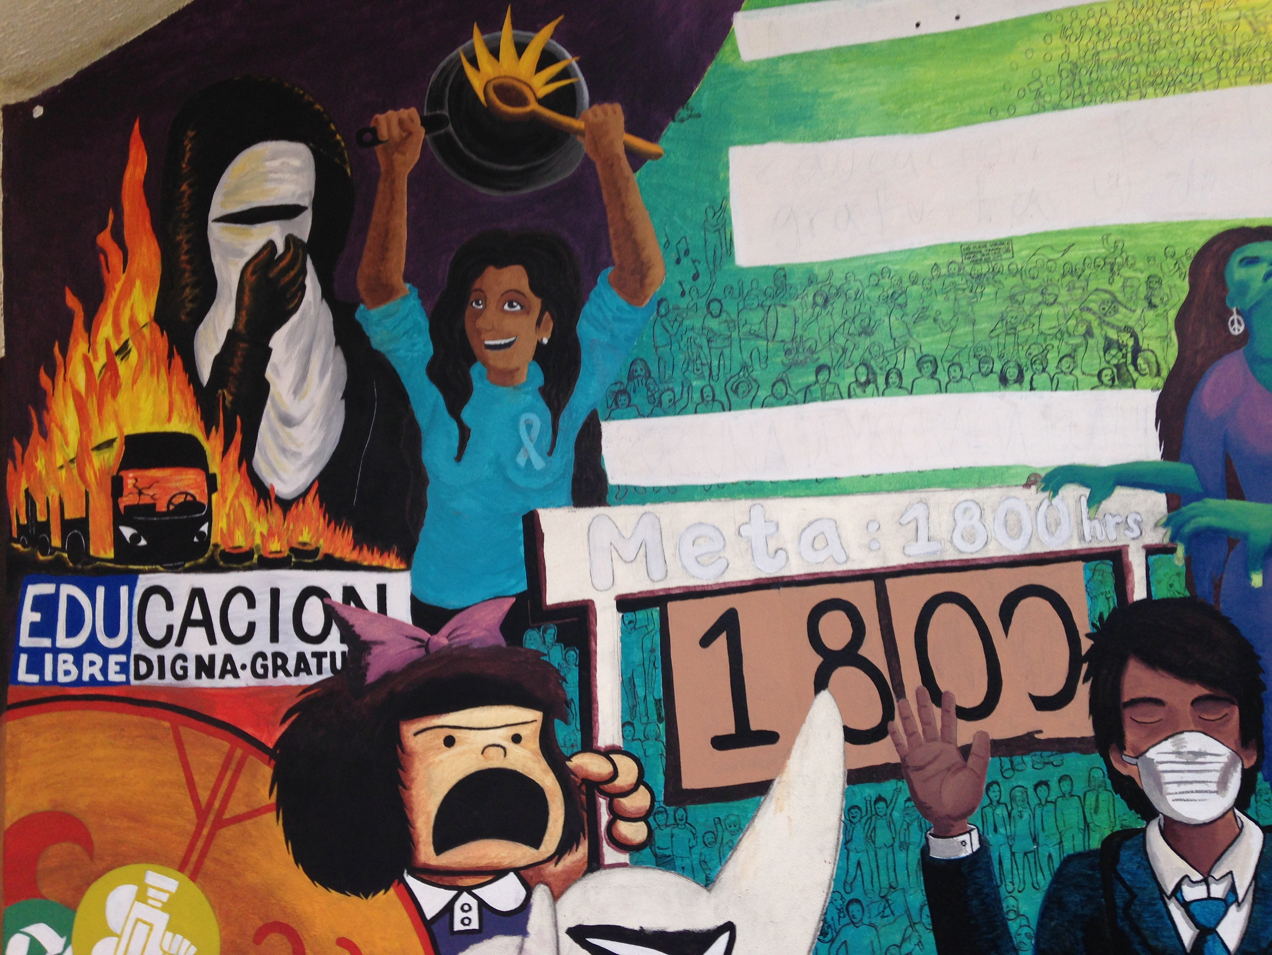
The « Words » of Anger
The Challenge of Comparison
Anger, I Write your Name

Slide 6
« My life, Your Debt, Our Democracy »

Slide 7
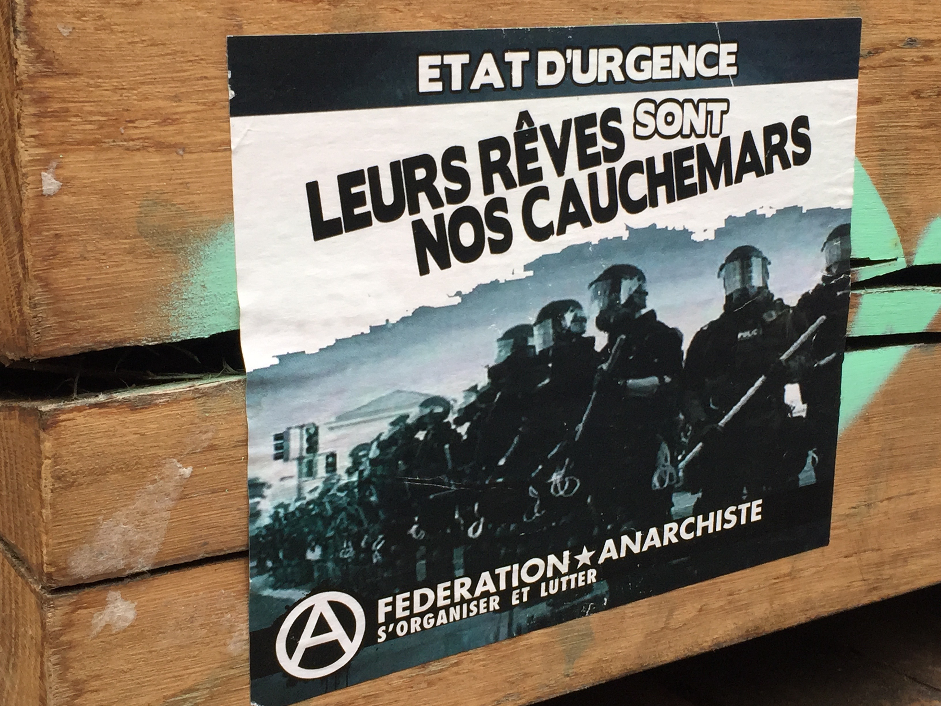
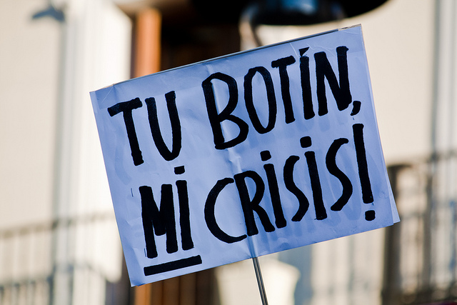
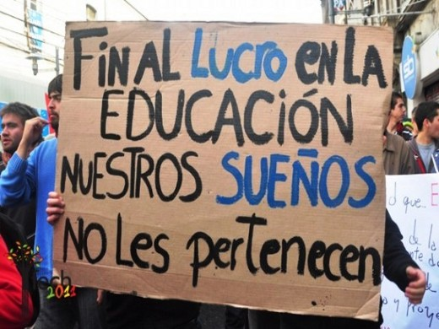
A Split between « Us » and « Them »
They do not represent us
They are painted of democracy but they're made of dictatorship
Their dreams are our nightmares
They will not controll us, we will be victorious
We won’t pay your debt.
I am in debt, you're in debt, we go into debt, you enjoy, they enrich banks ..
If you don’t let us dream, we do not let you sleep.
My nights are more beautiful than your days
I am not antisystem, the system is anti me

Slide 8
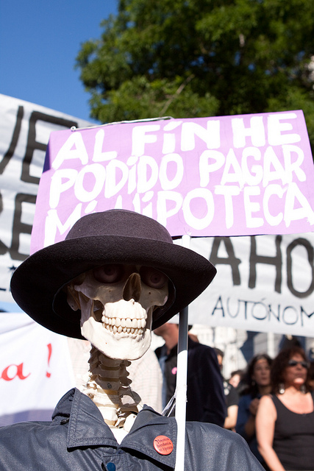
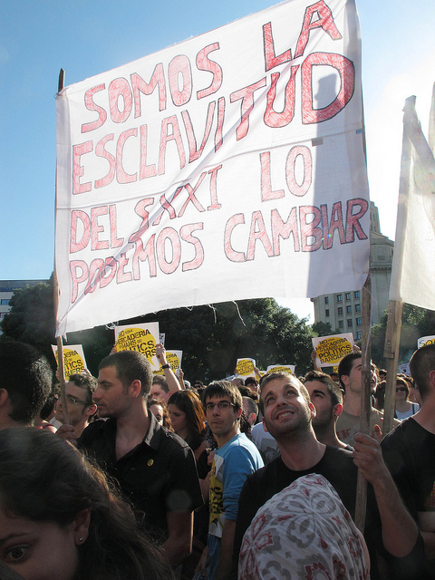
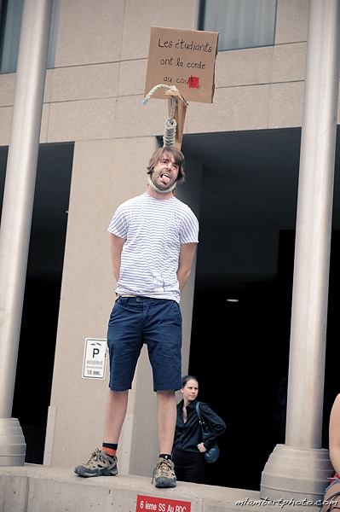
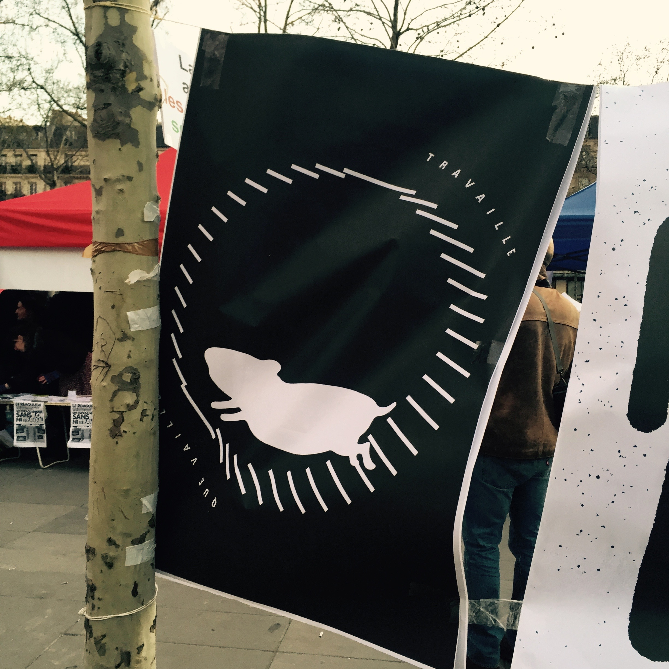
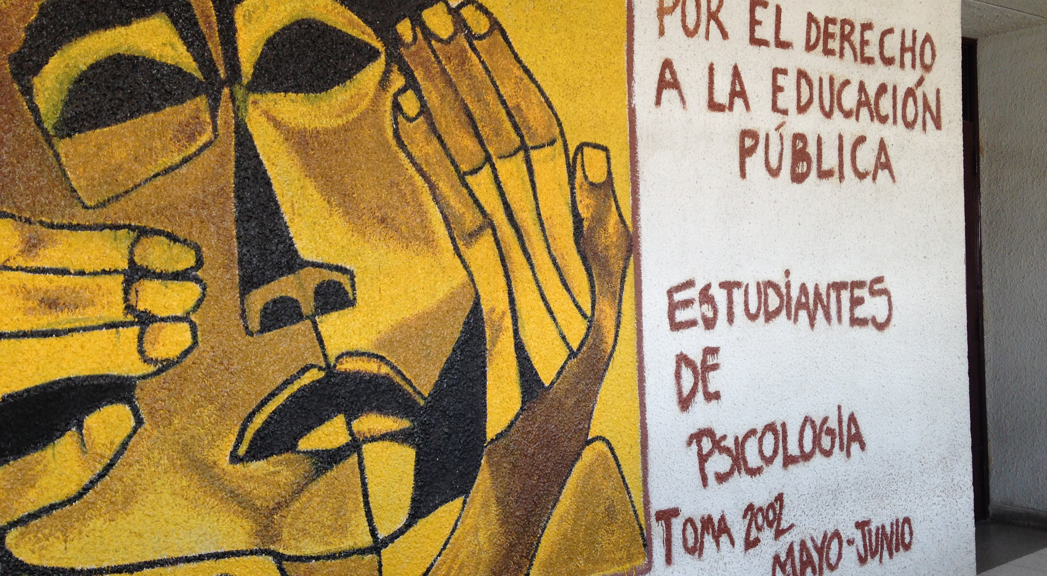
… The Deprivation of Sovereignty

Slide 9
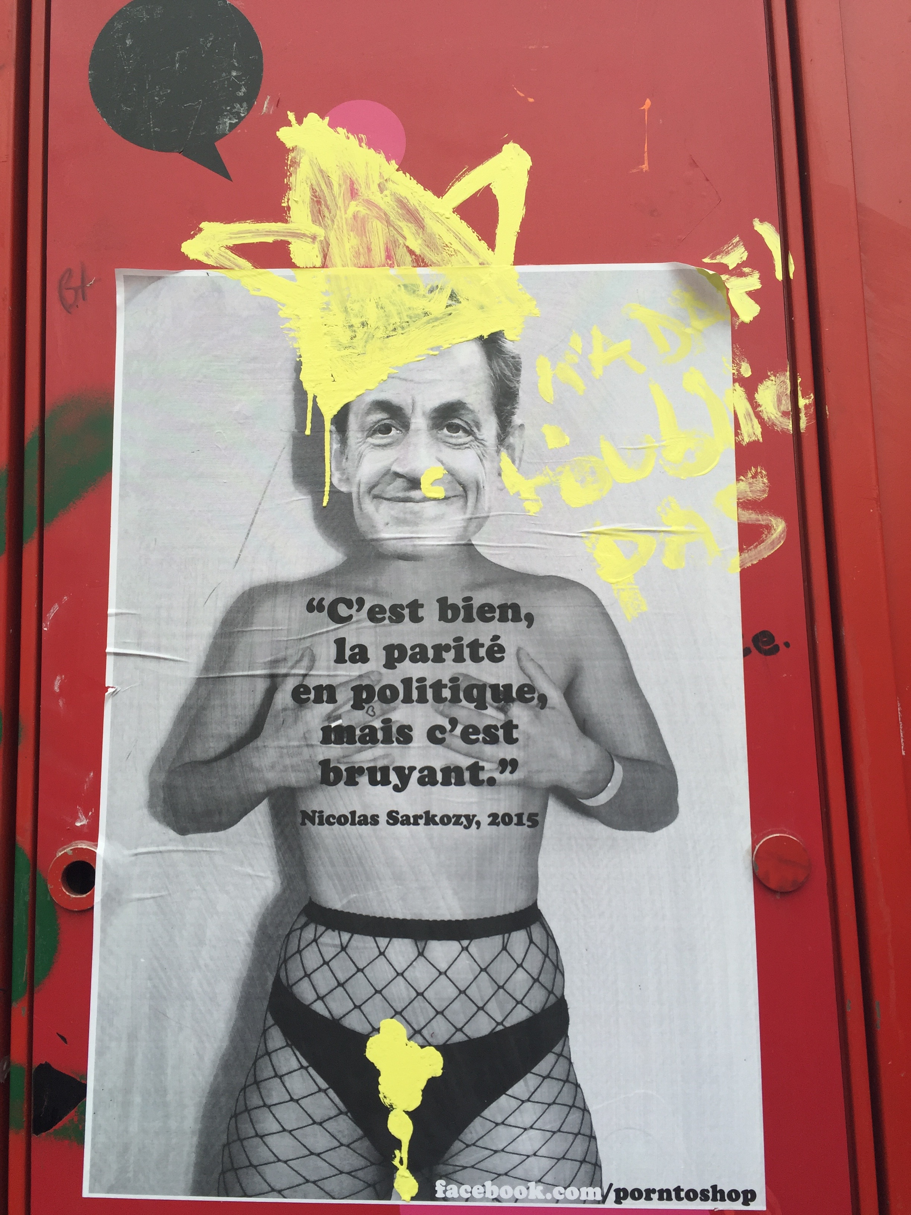
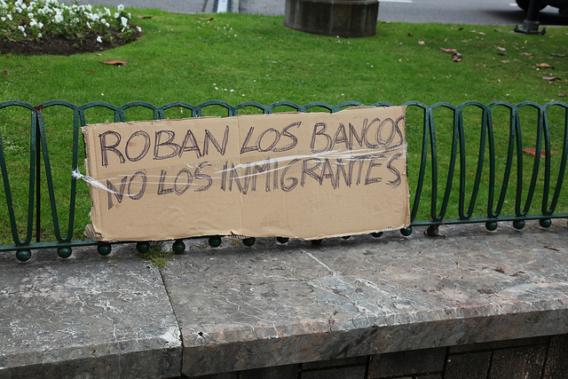
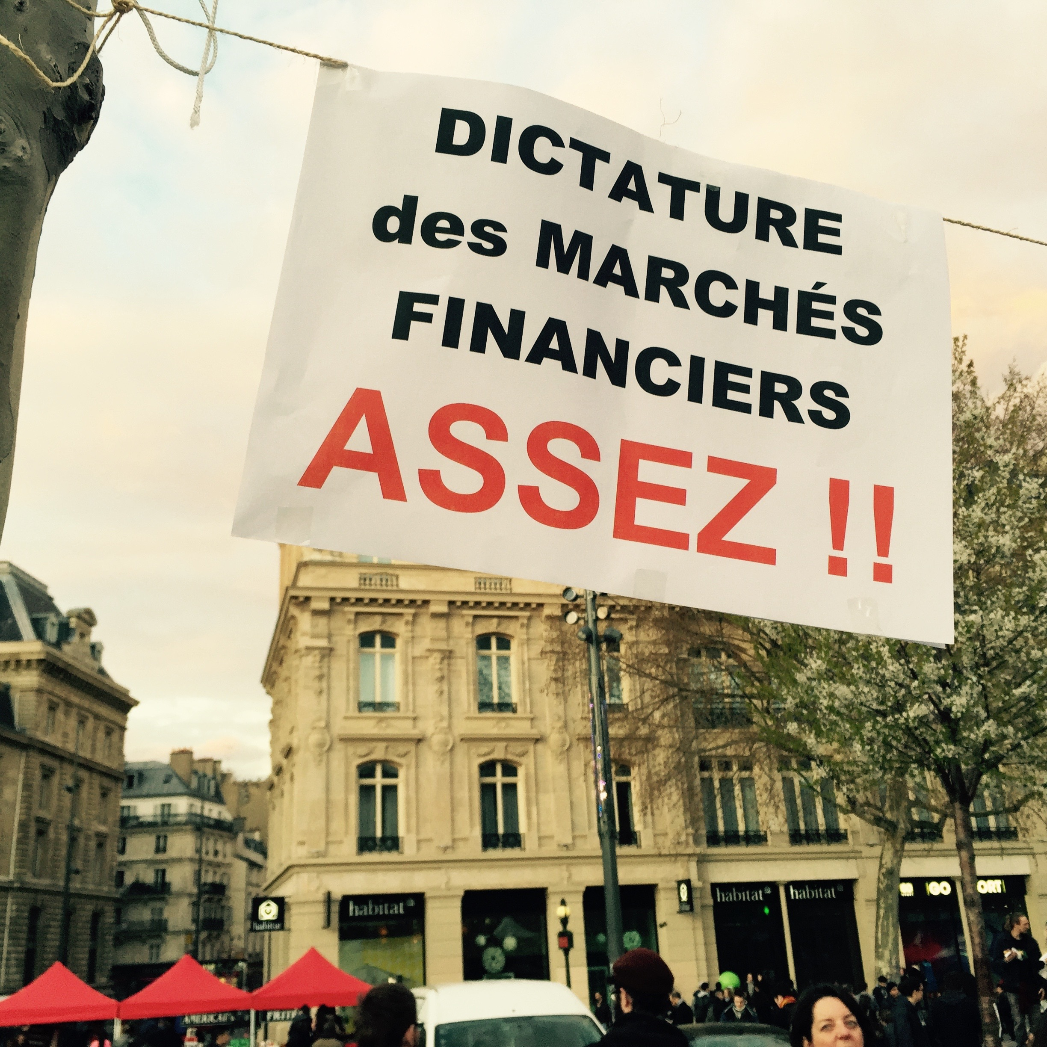
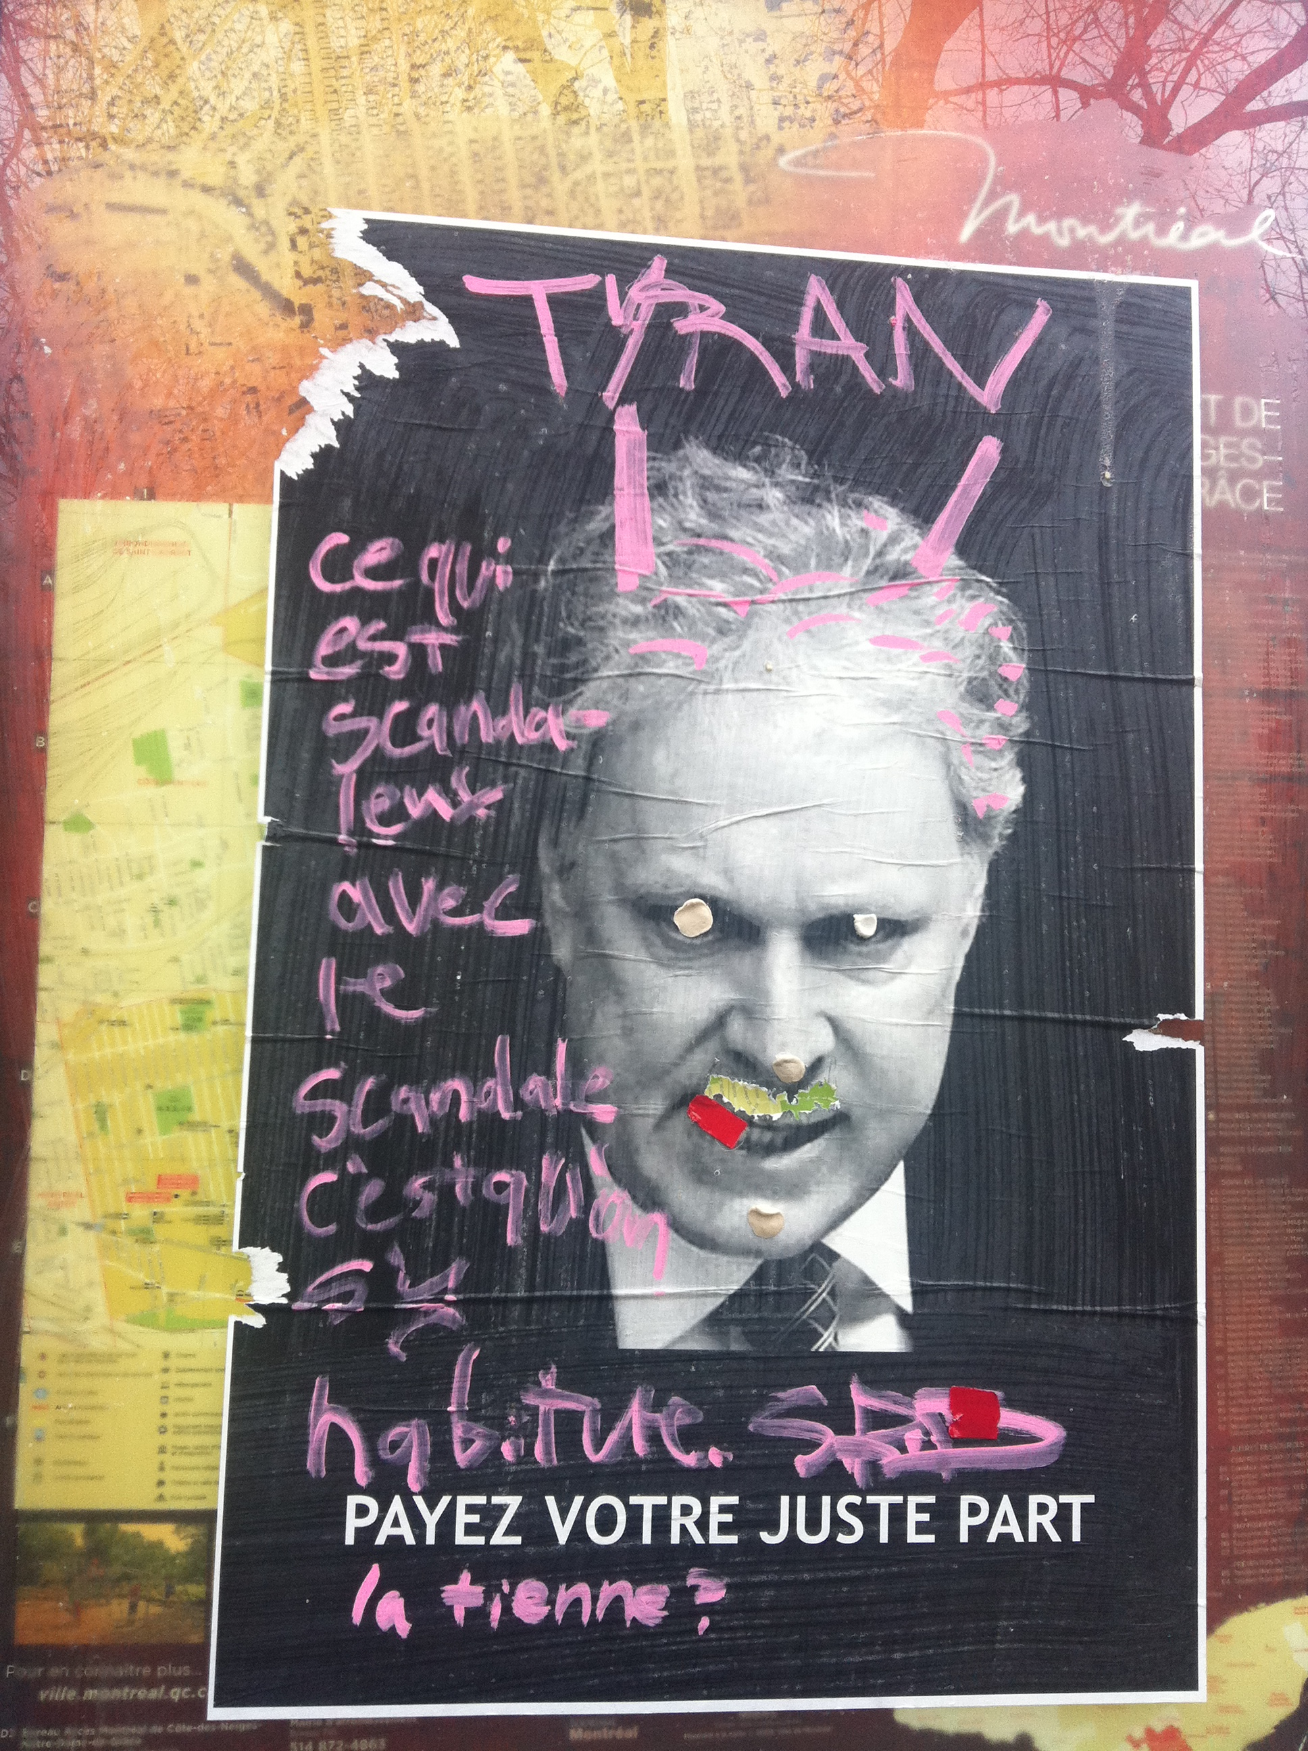
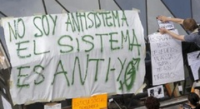
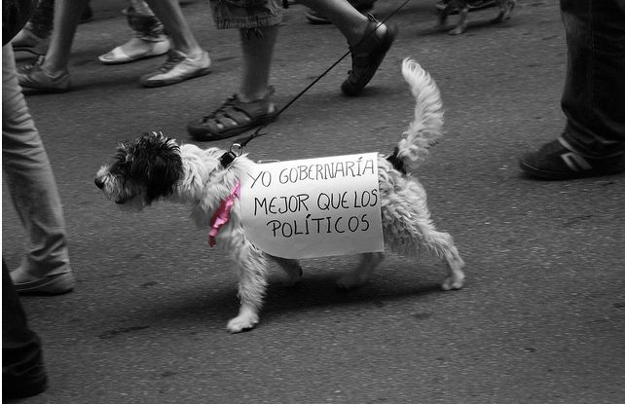
« Them » : an Unnamable Enemy?

Slide 10
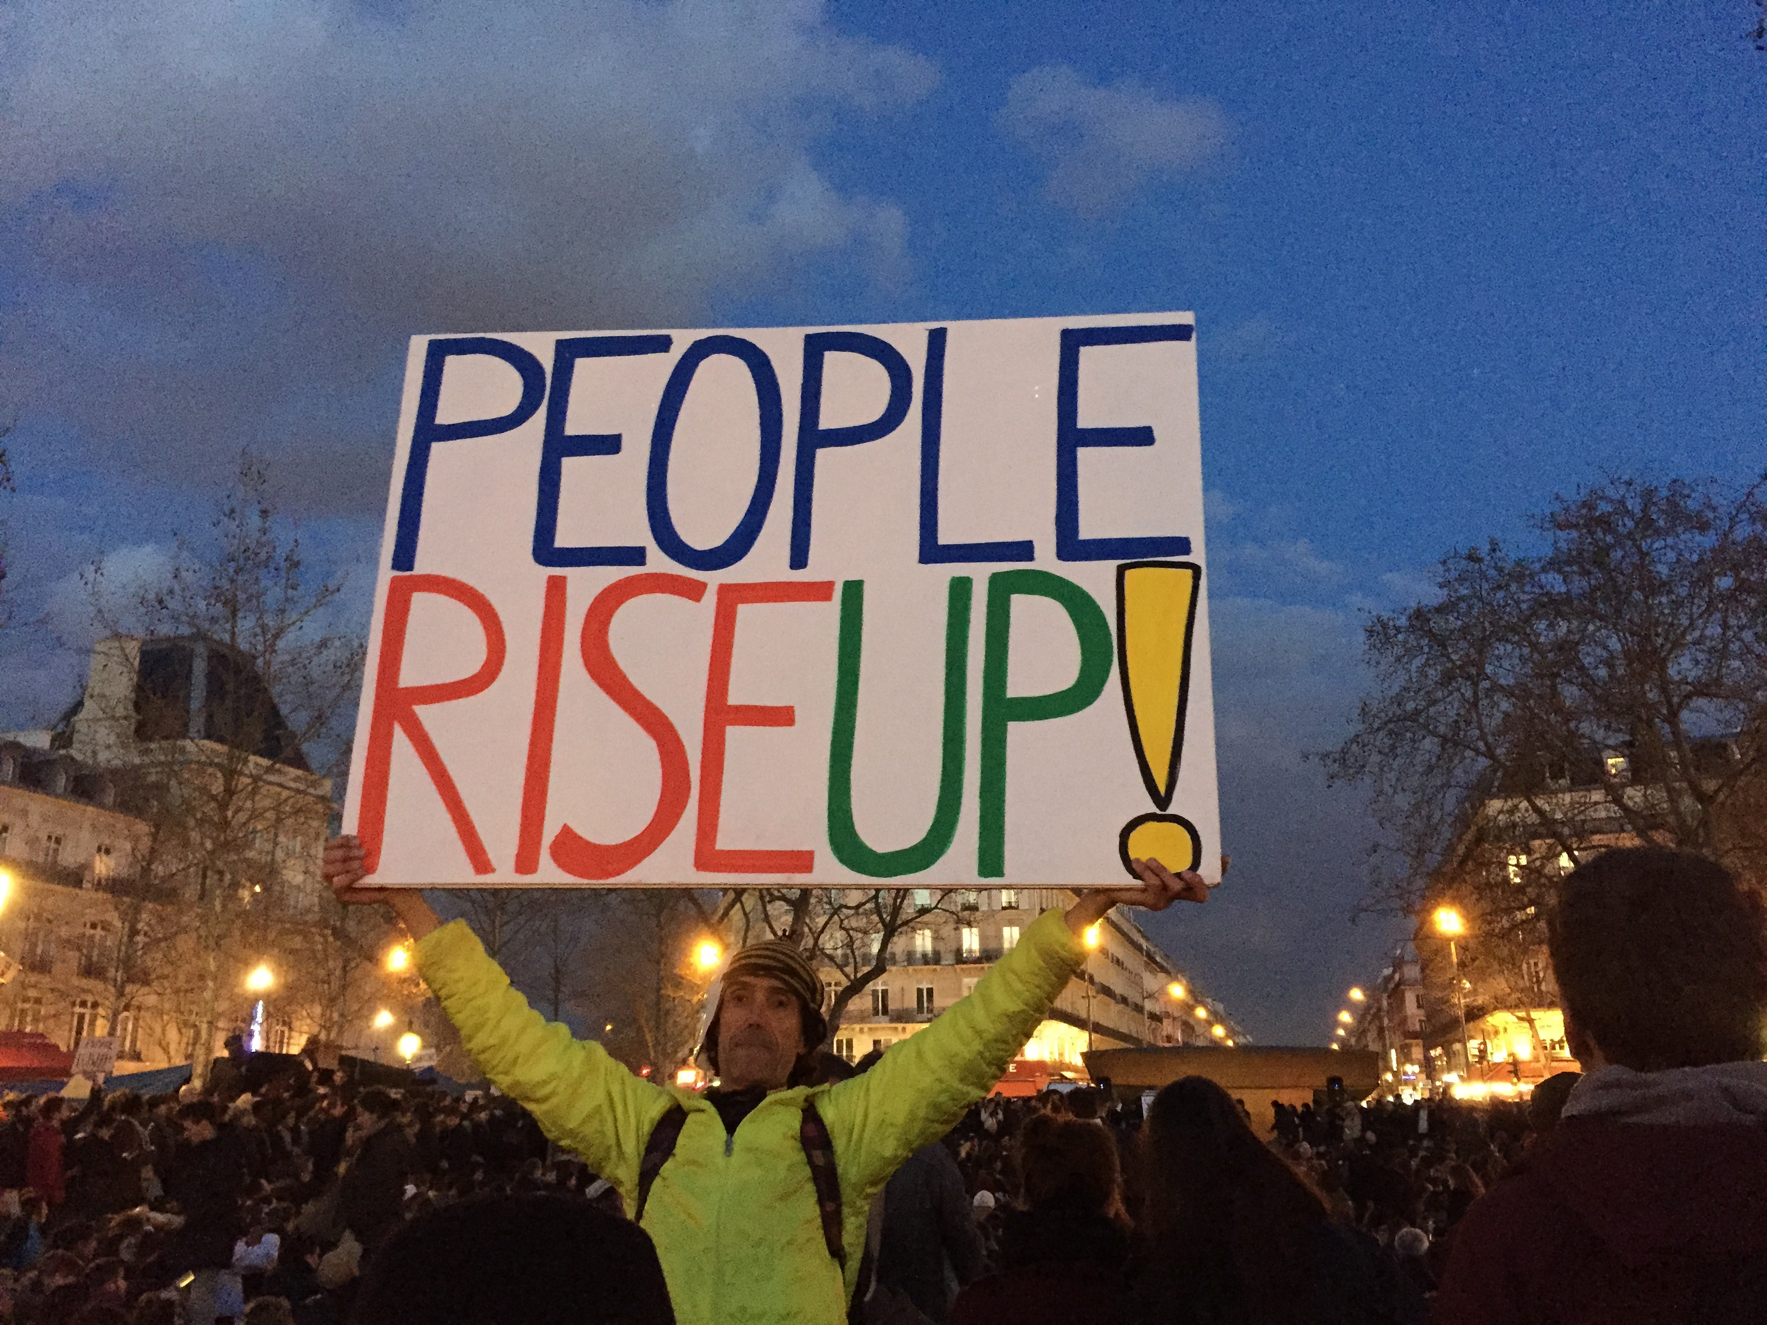
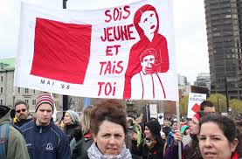
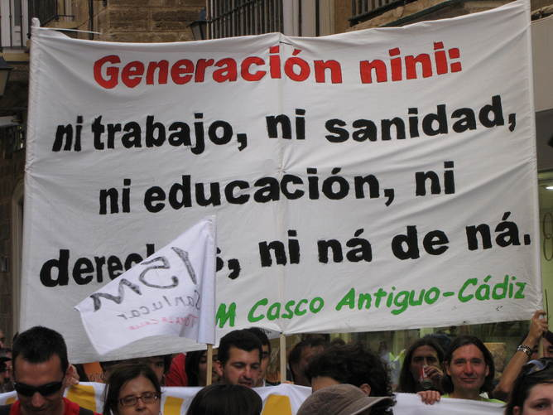
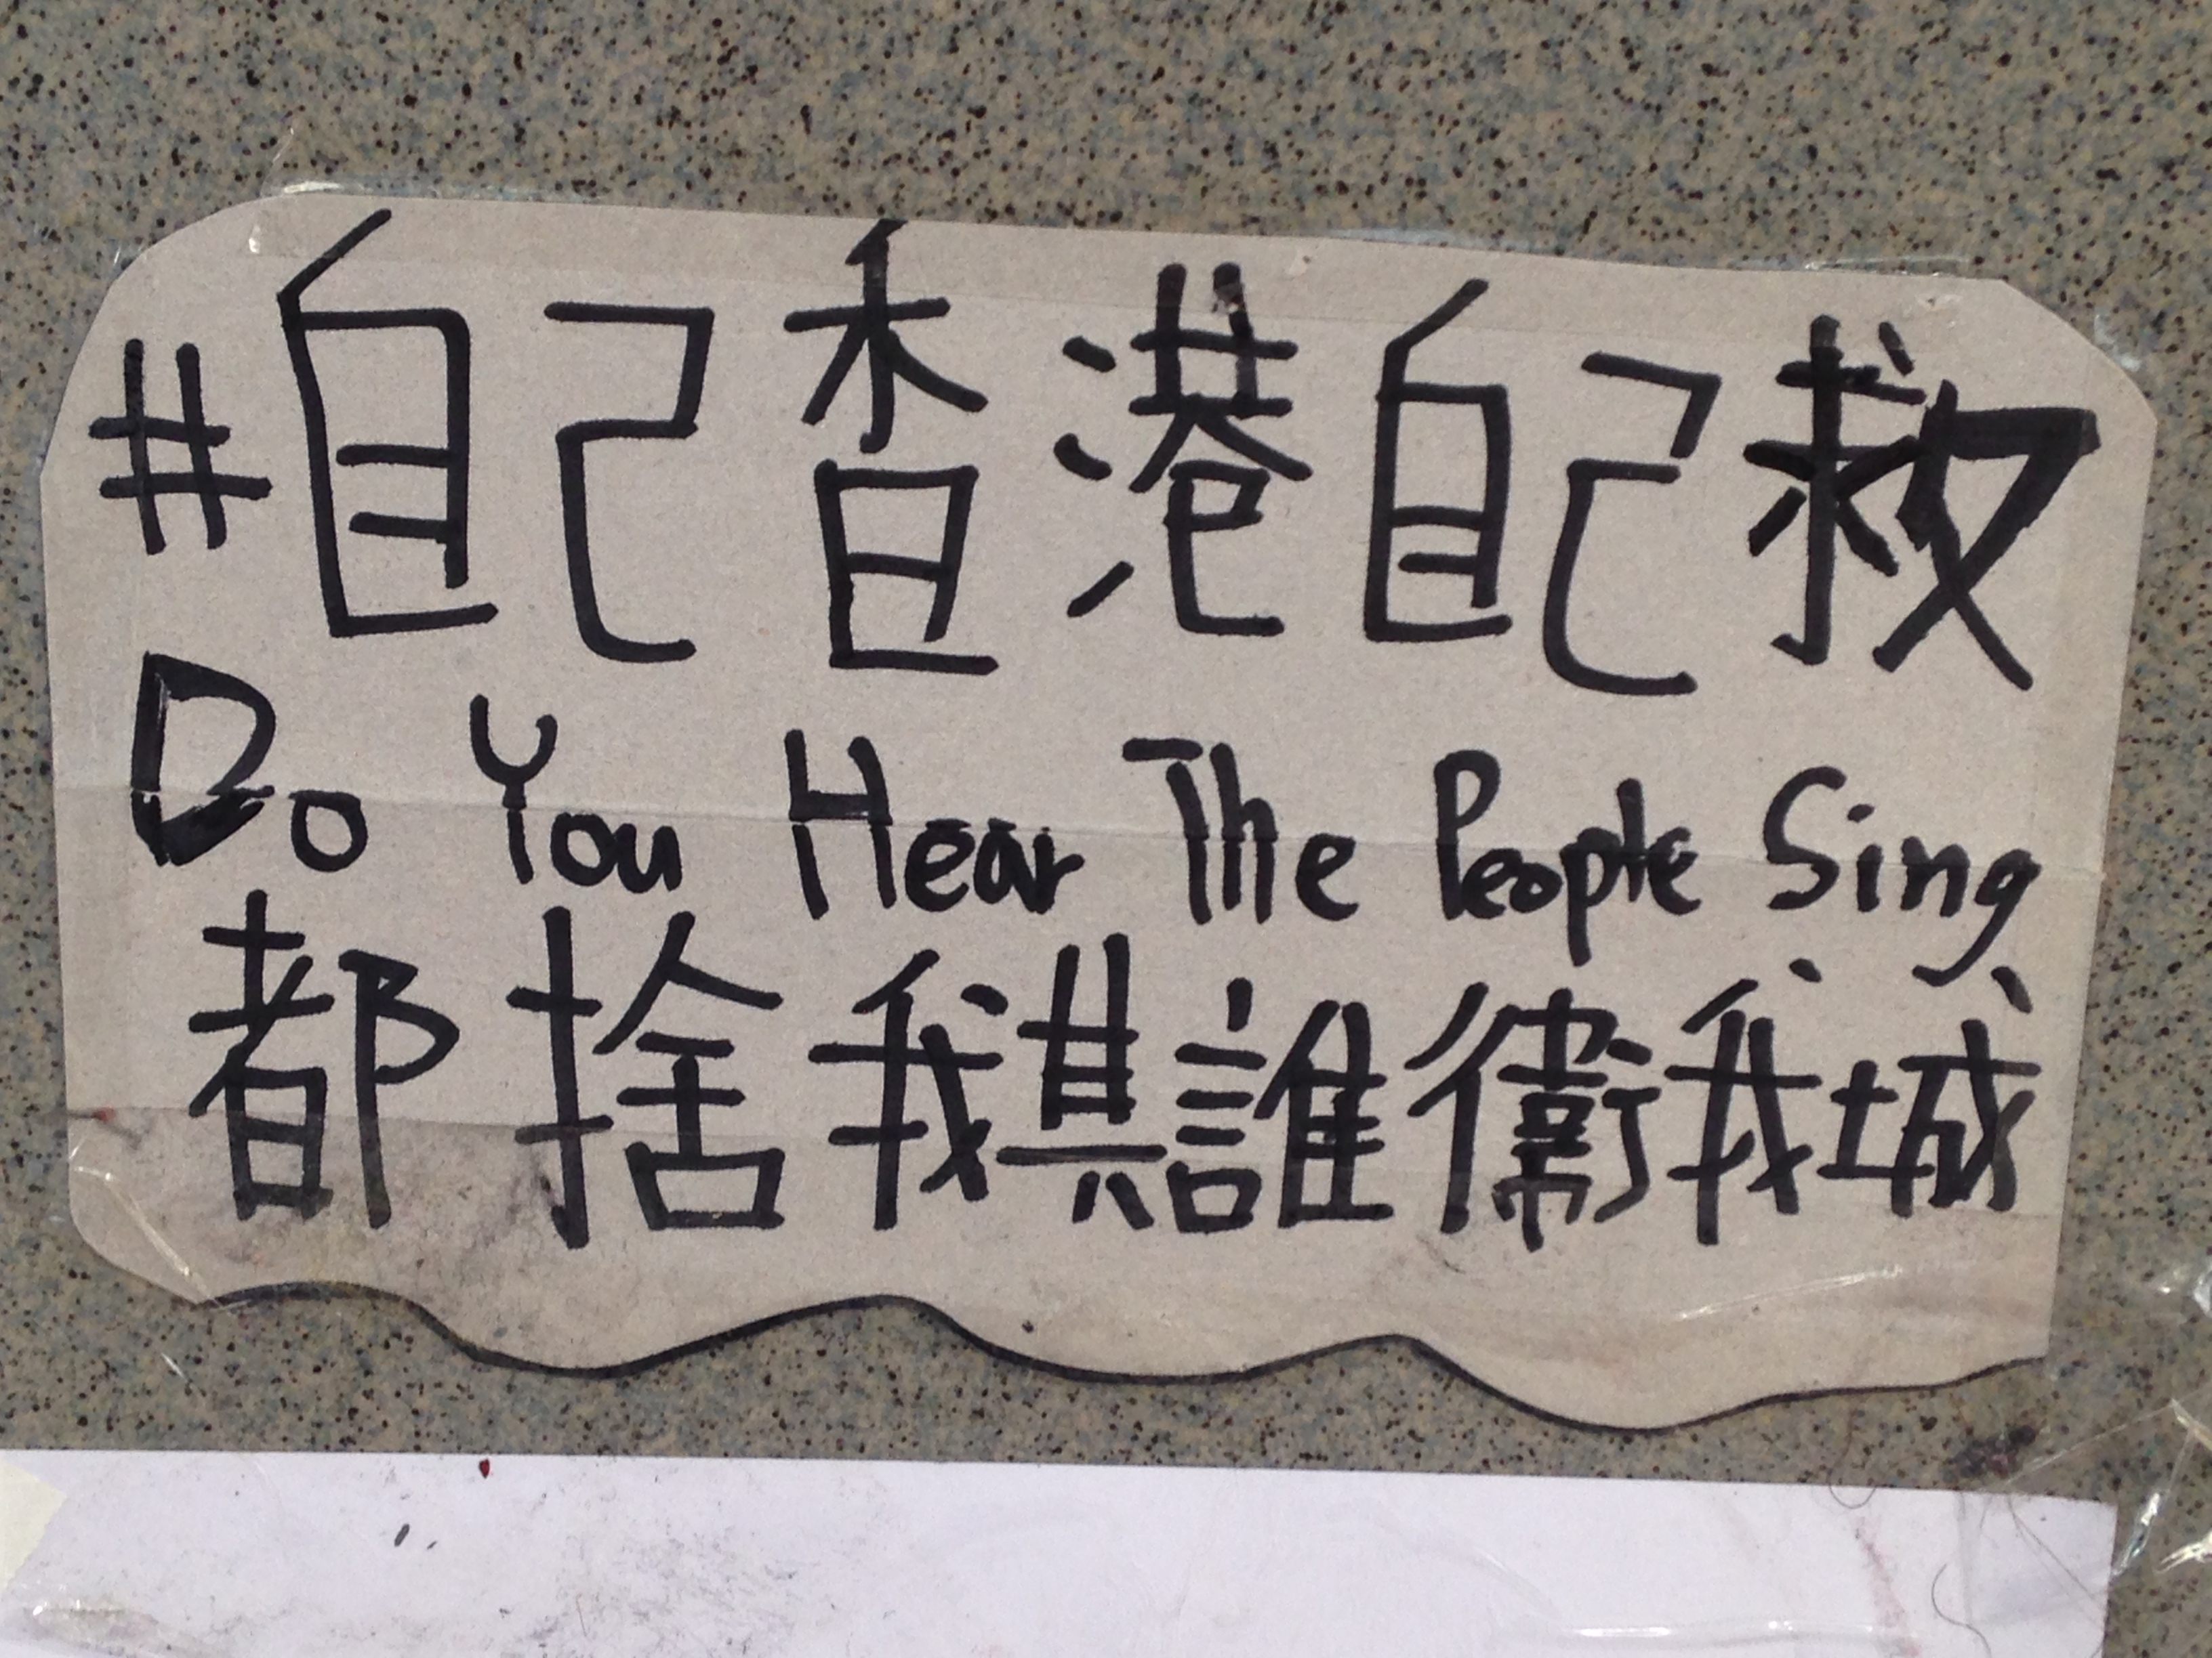
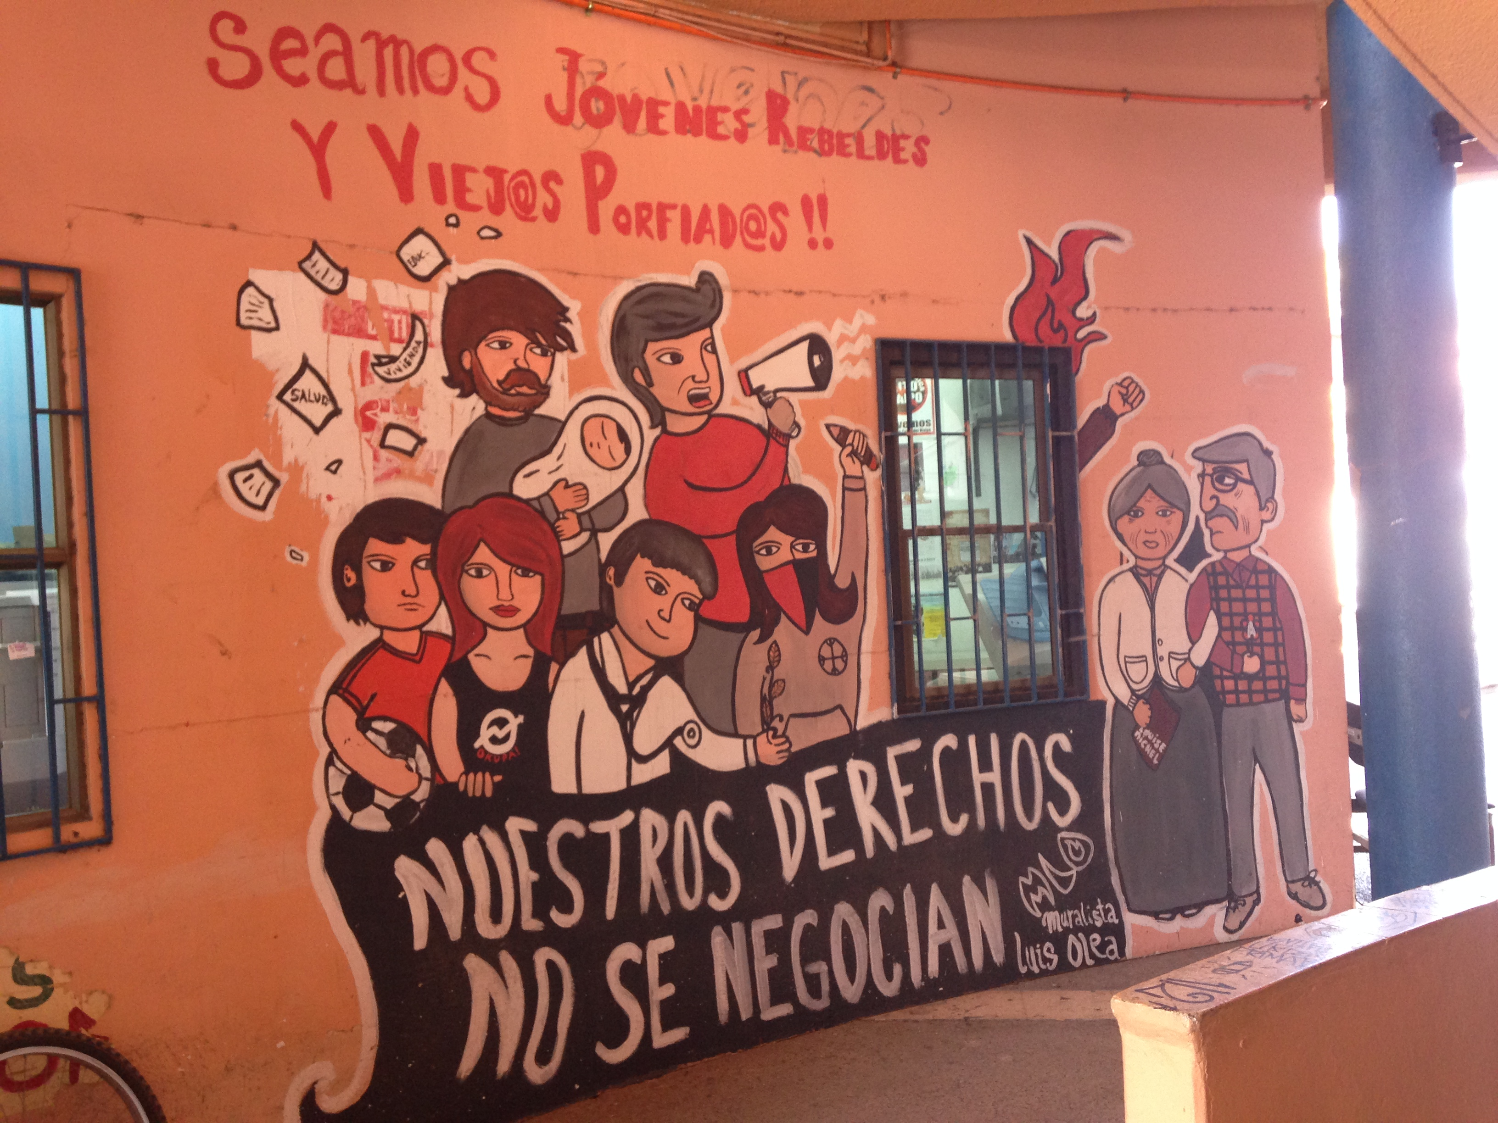
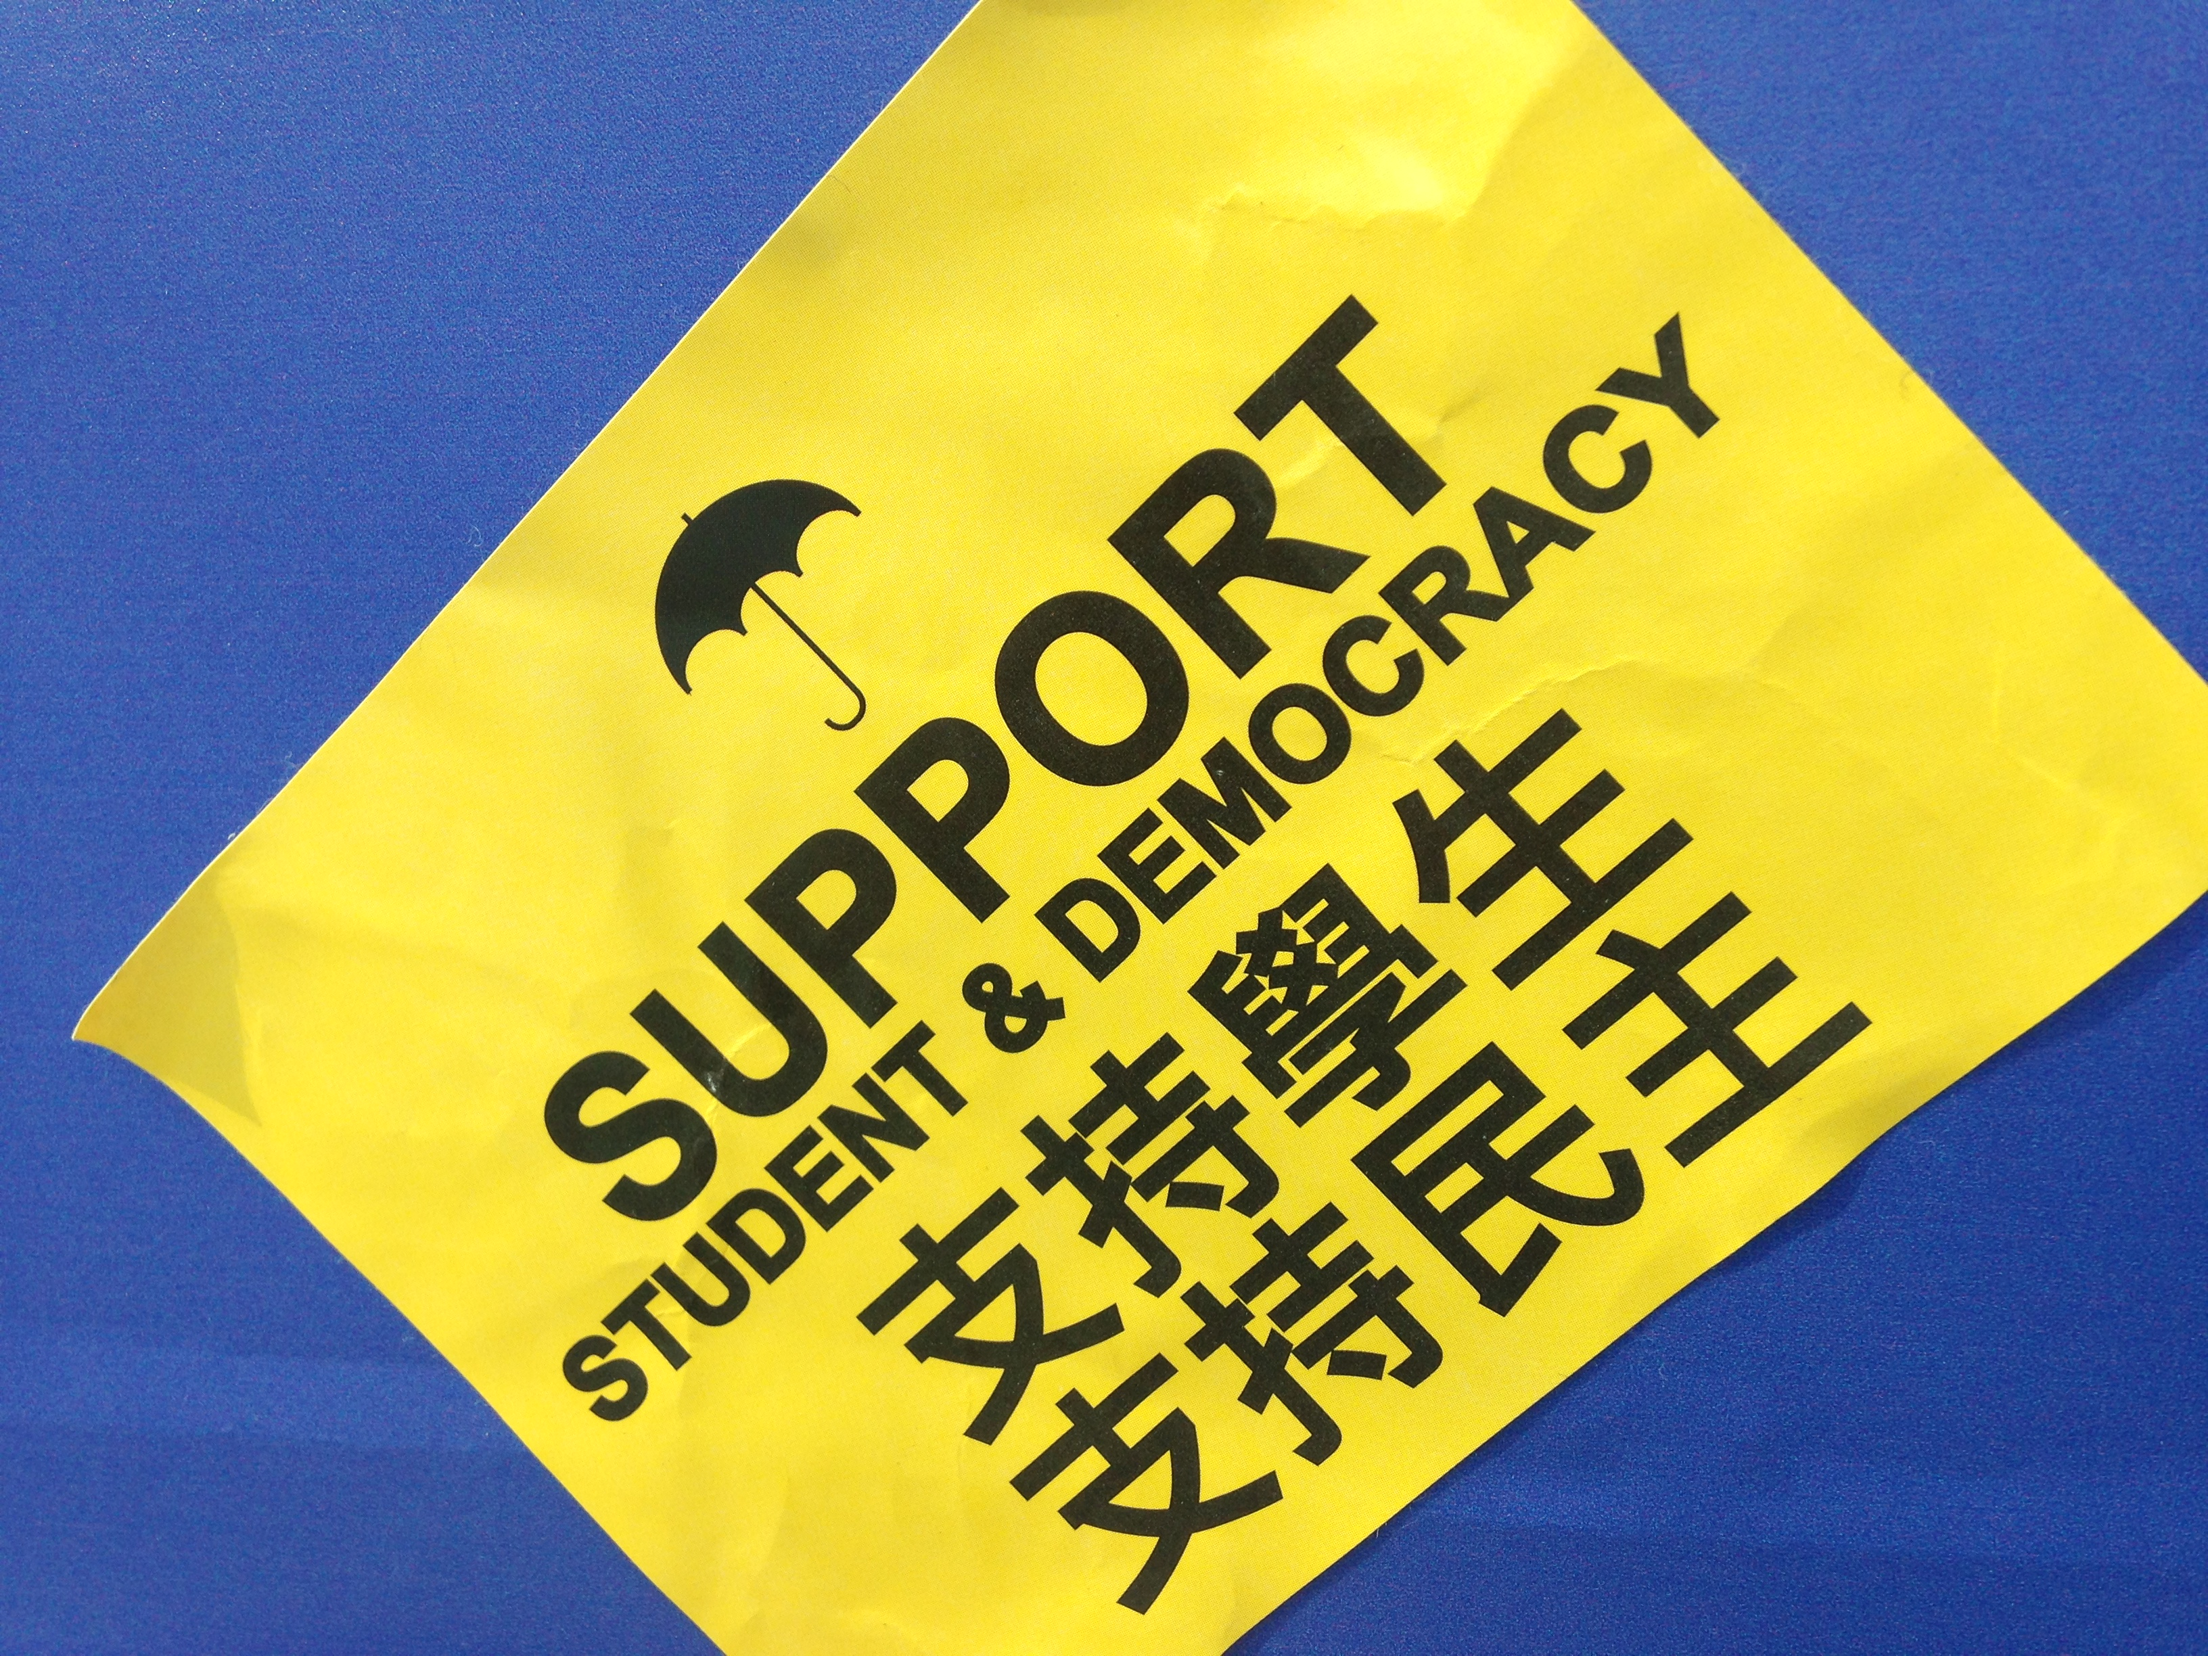
A Variable and Generational « Us »

Slide 11
Three Common Issues

Slide 12
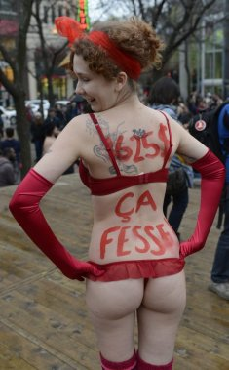
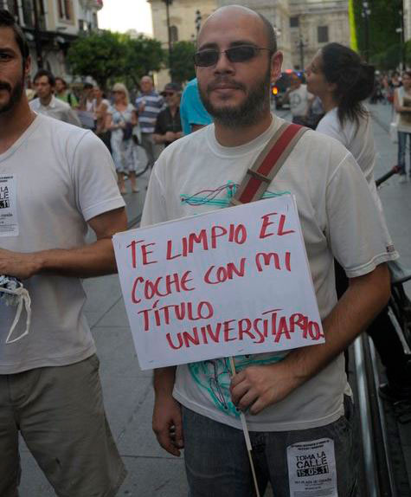
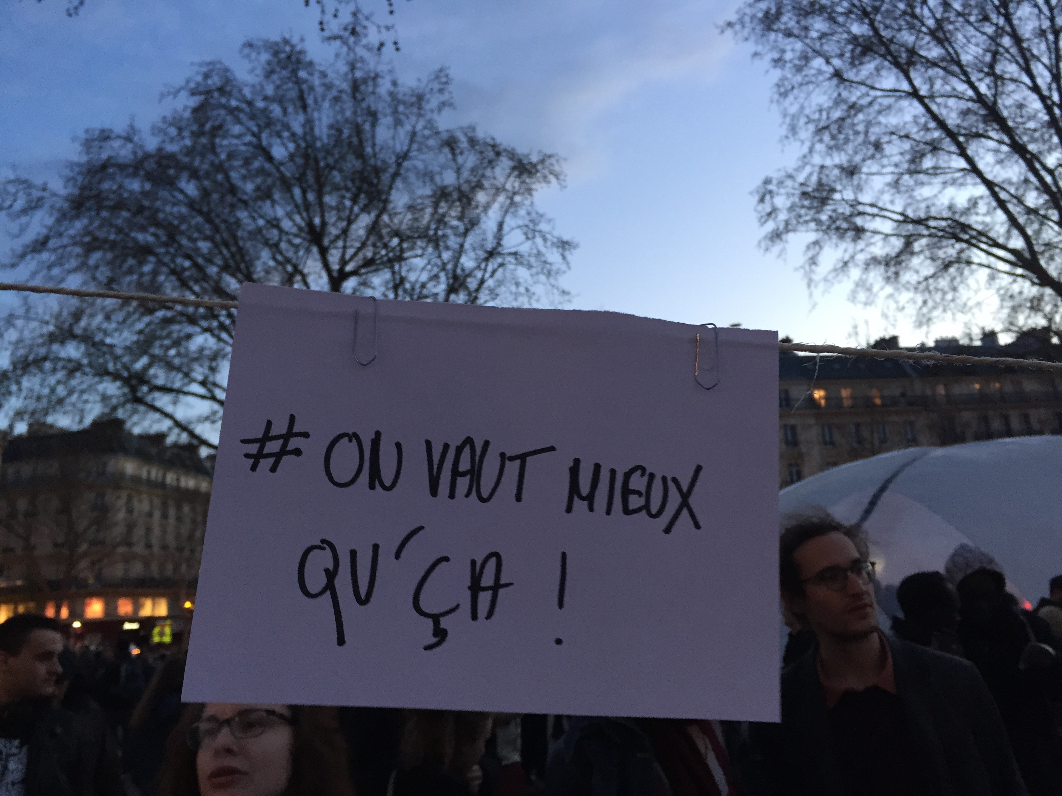
Education : Studying, at What Price?

Slide 13
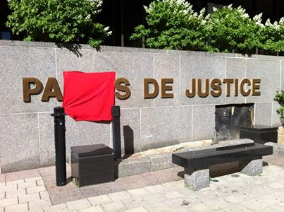
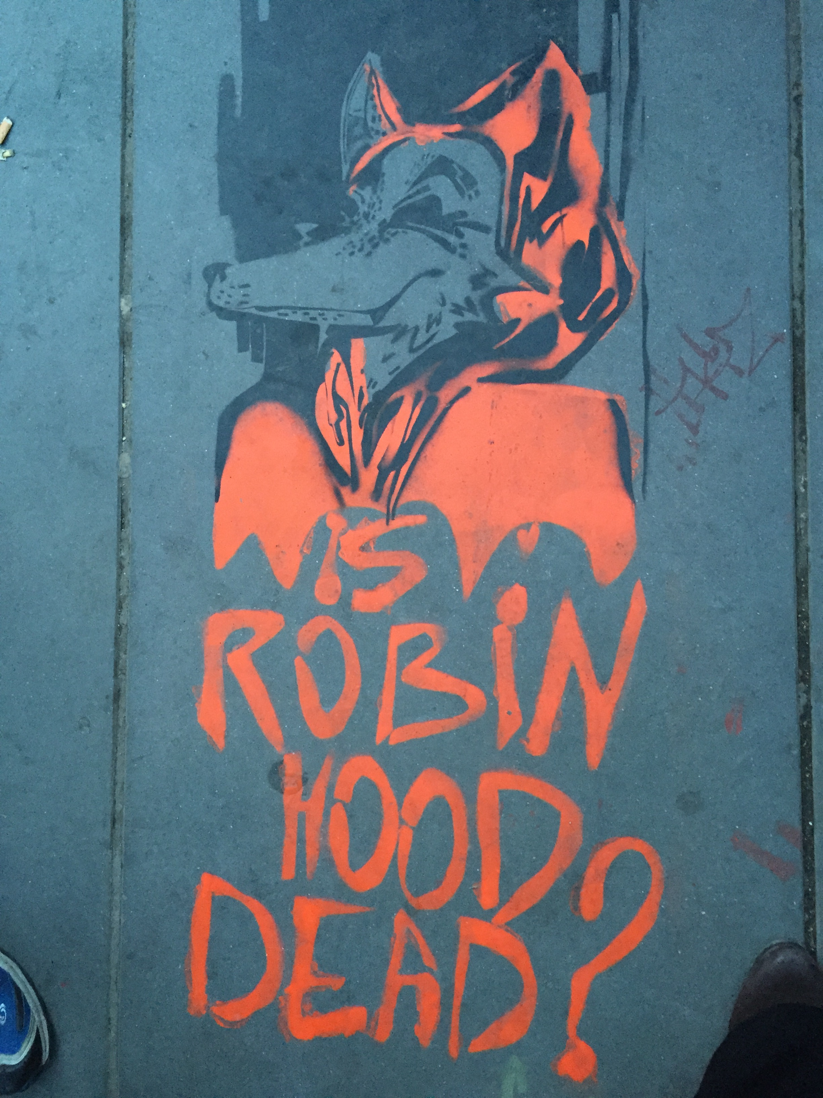
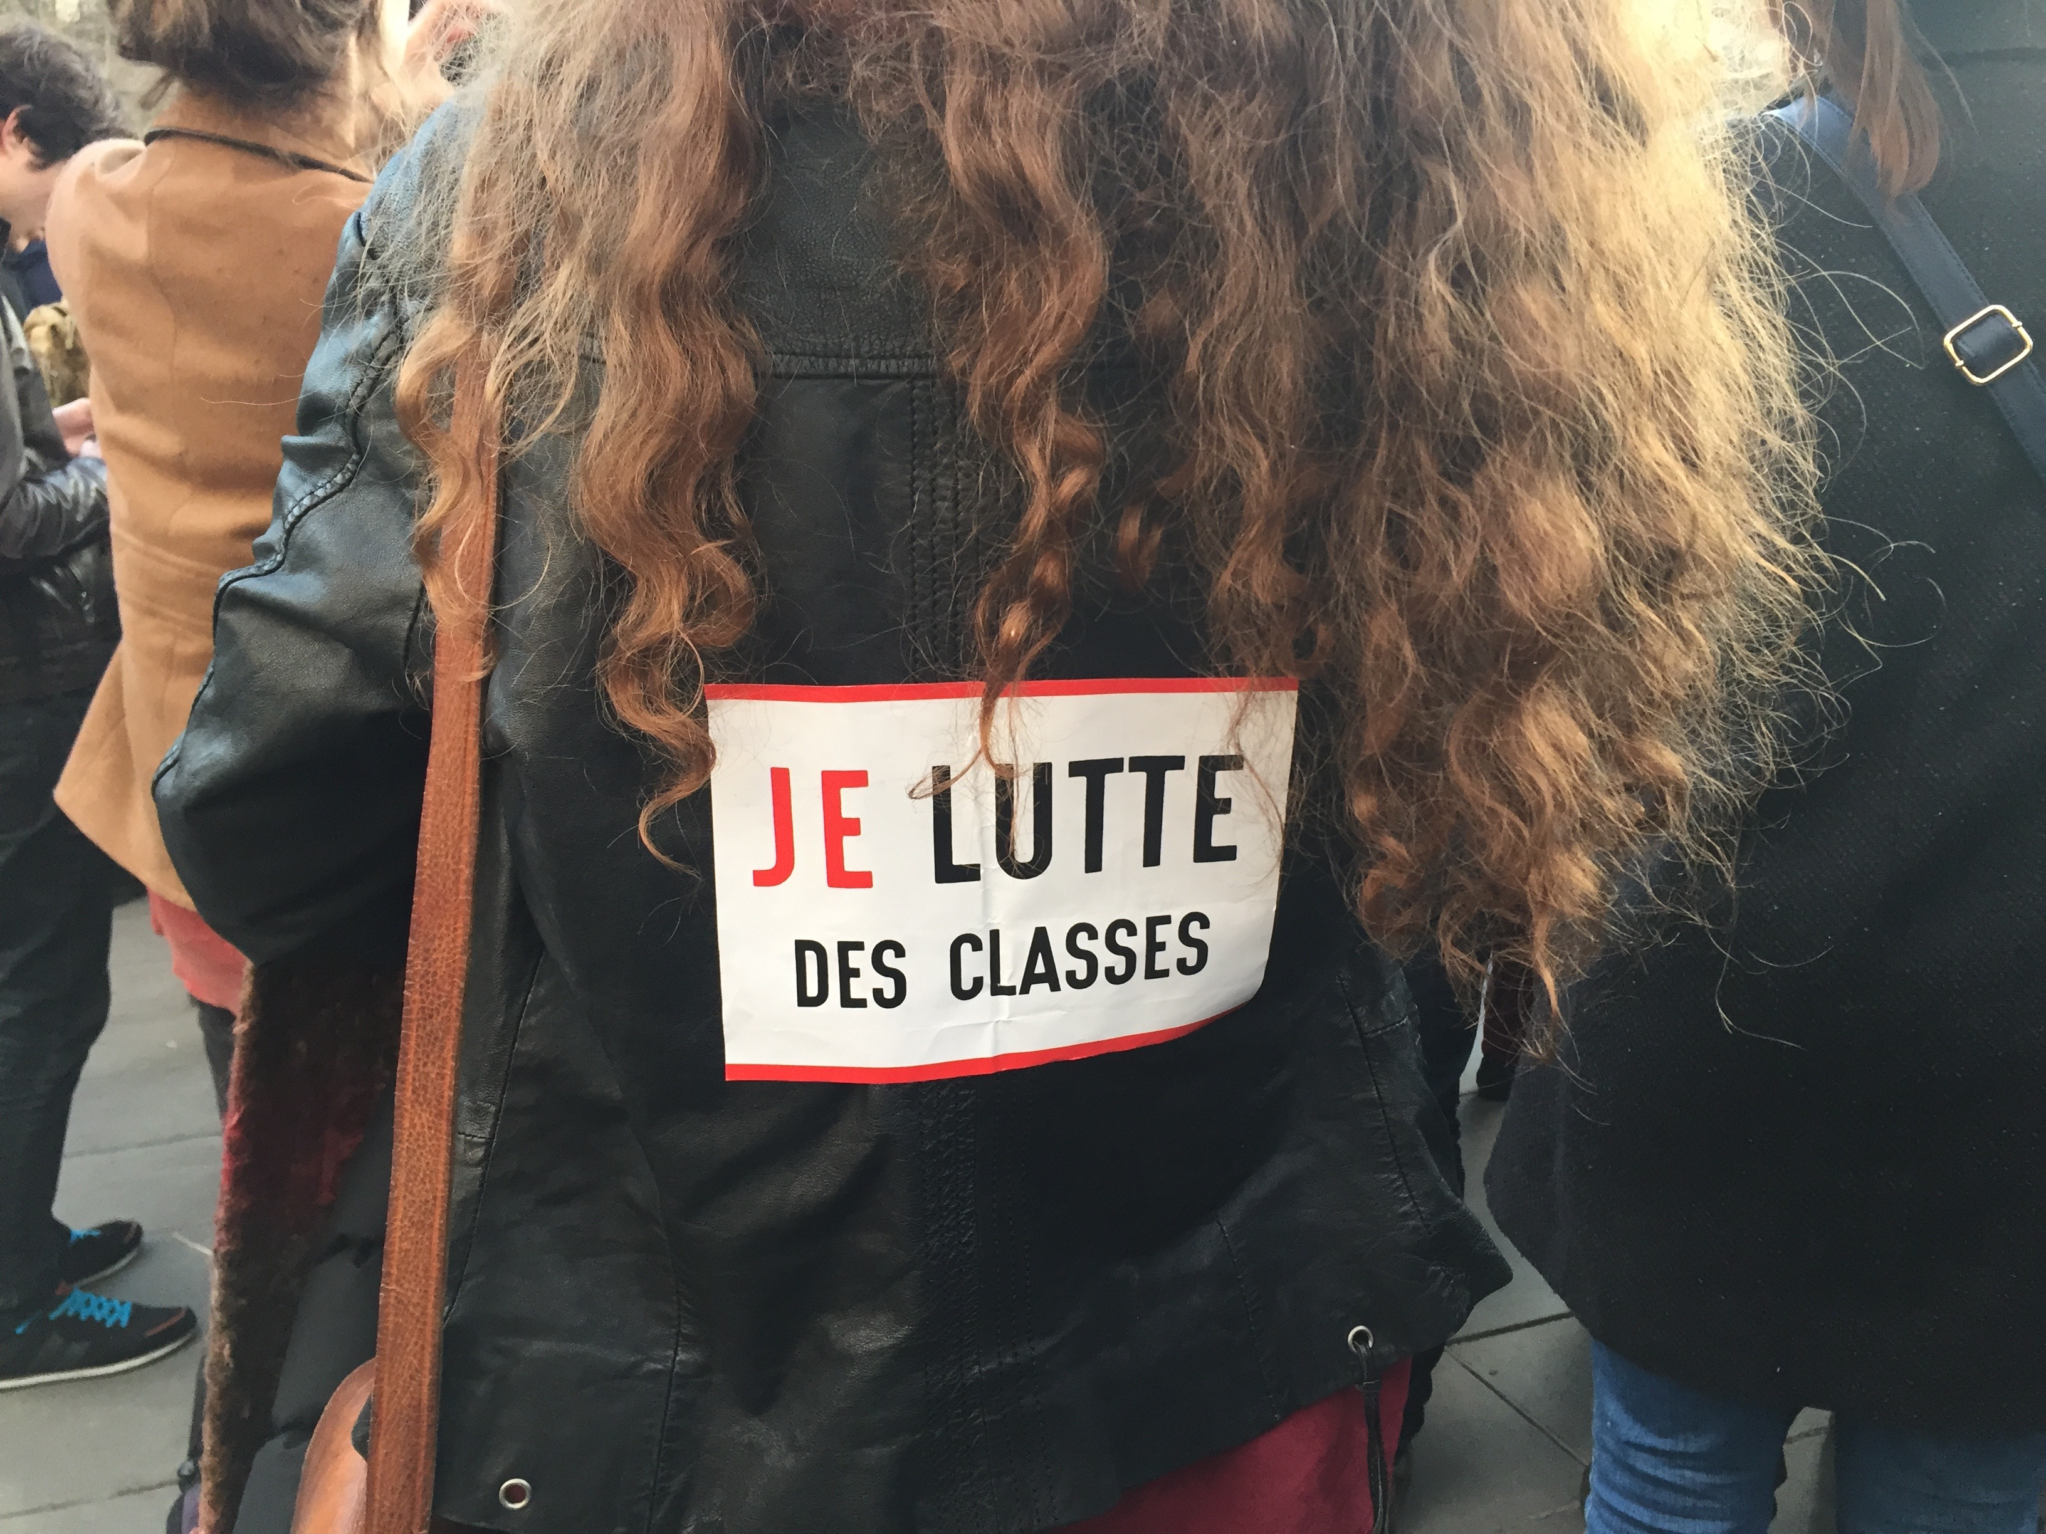
Justice : Who Must Pay the Debt?

Slide 14
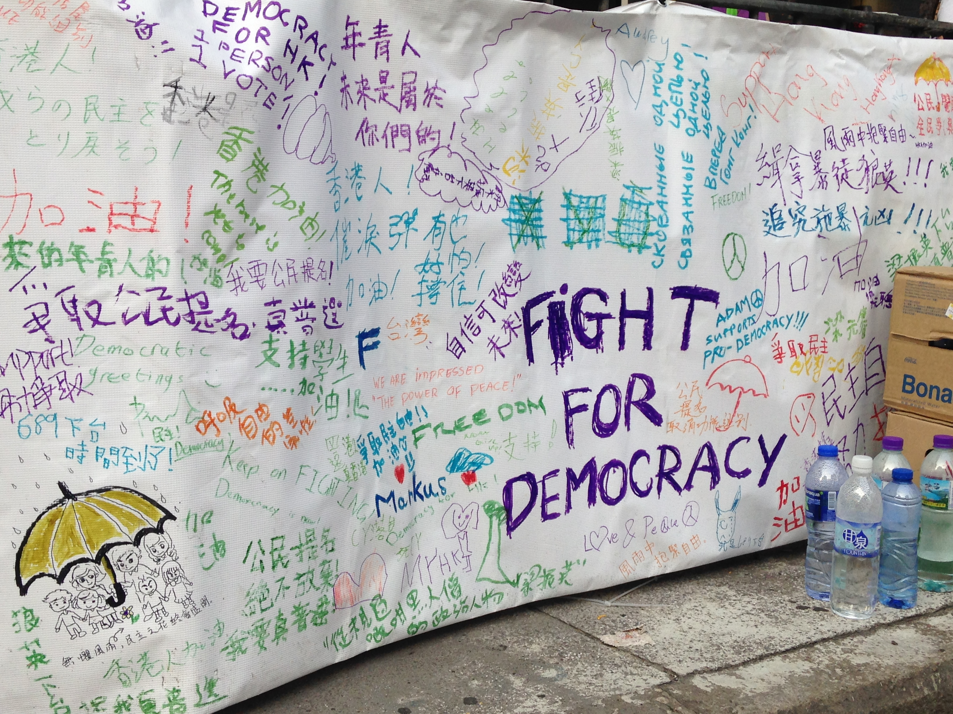
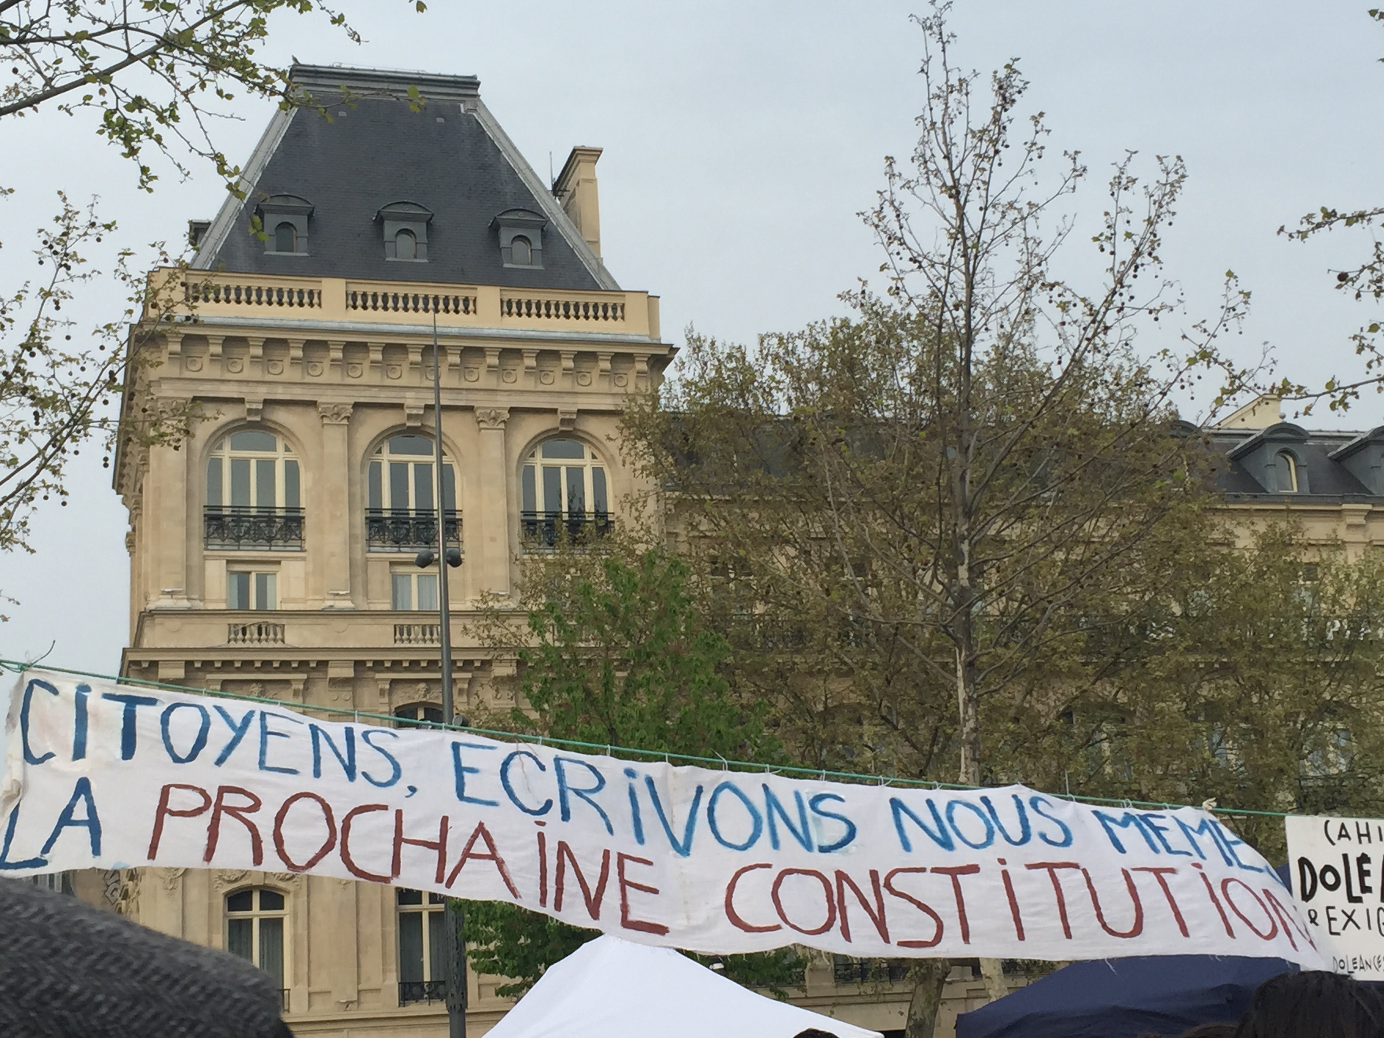
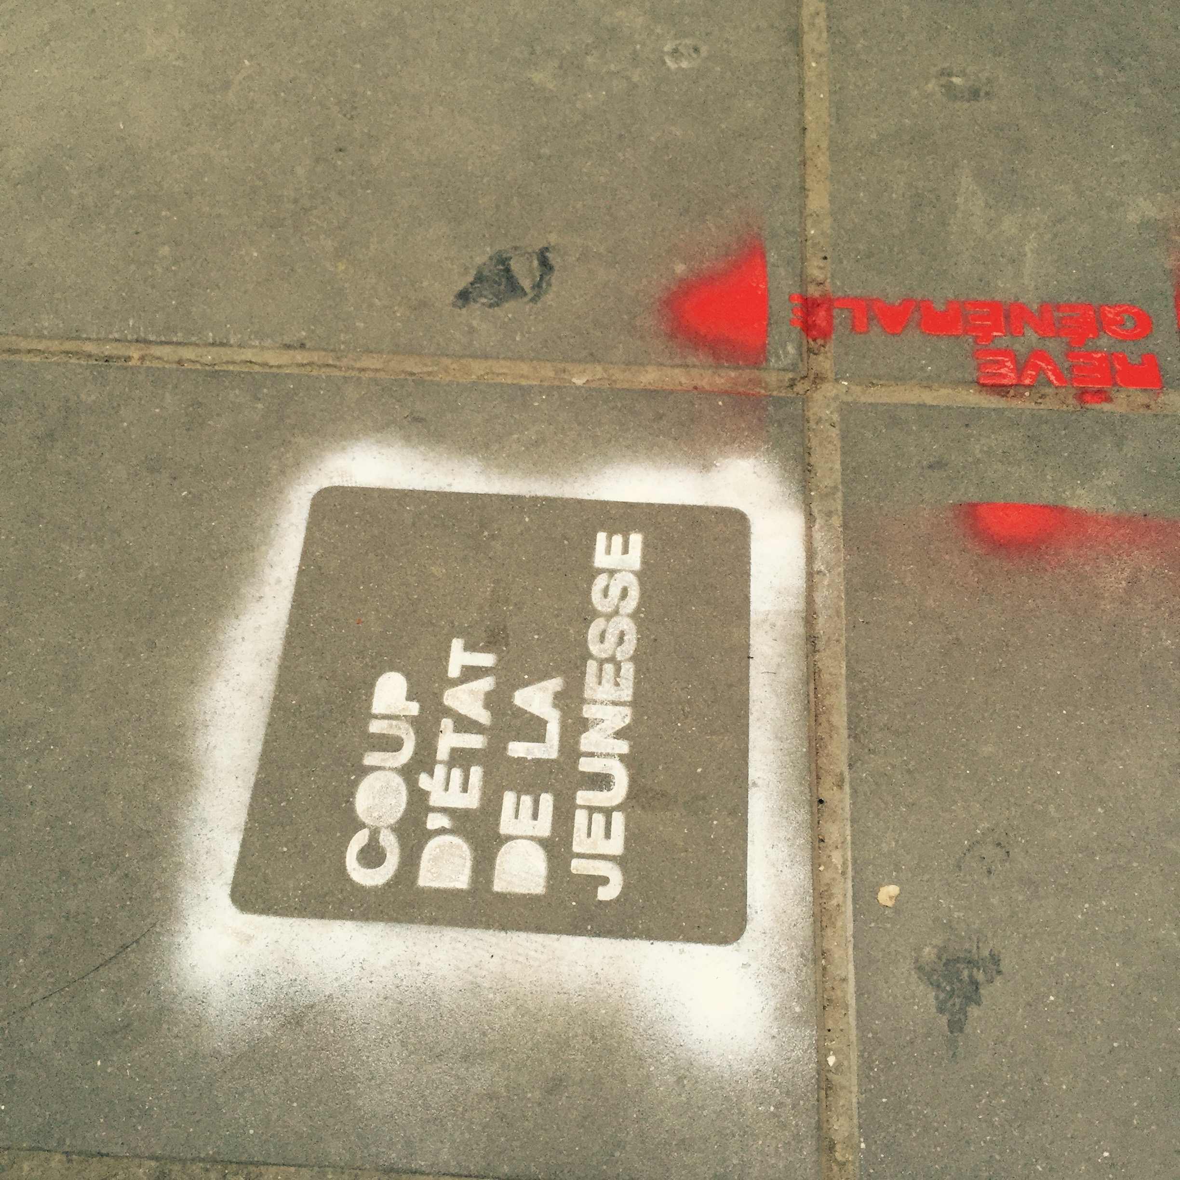
Democracy : What Right of Speech?

Slide 15
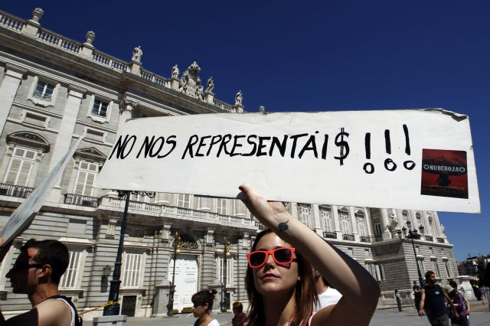
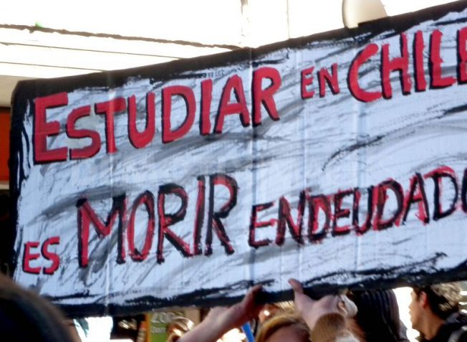
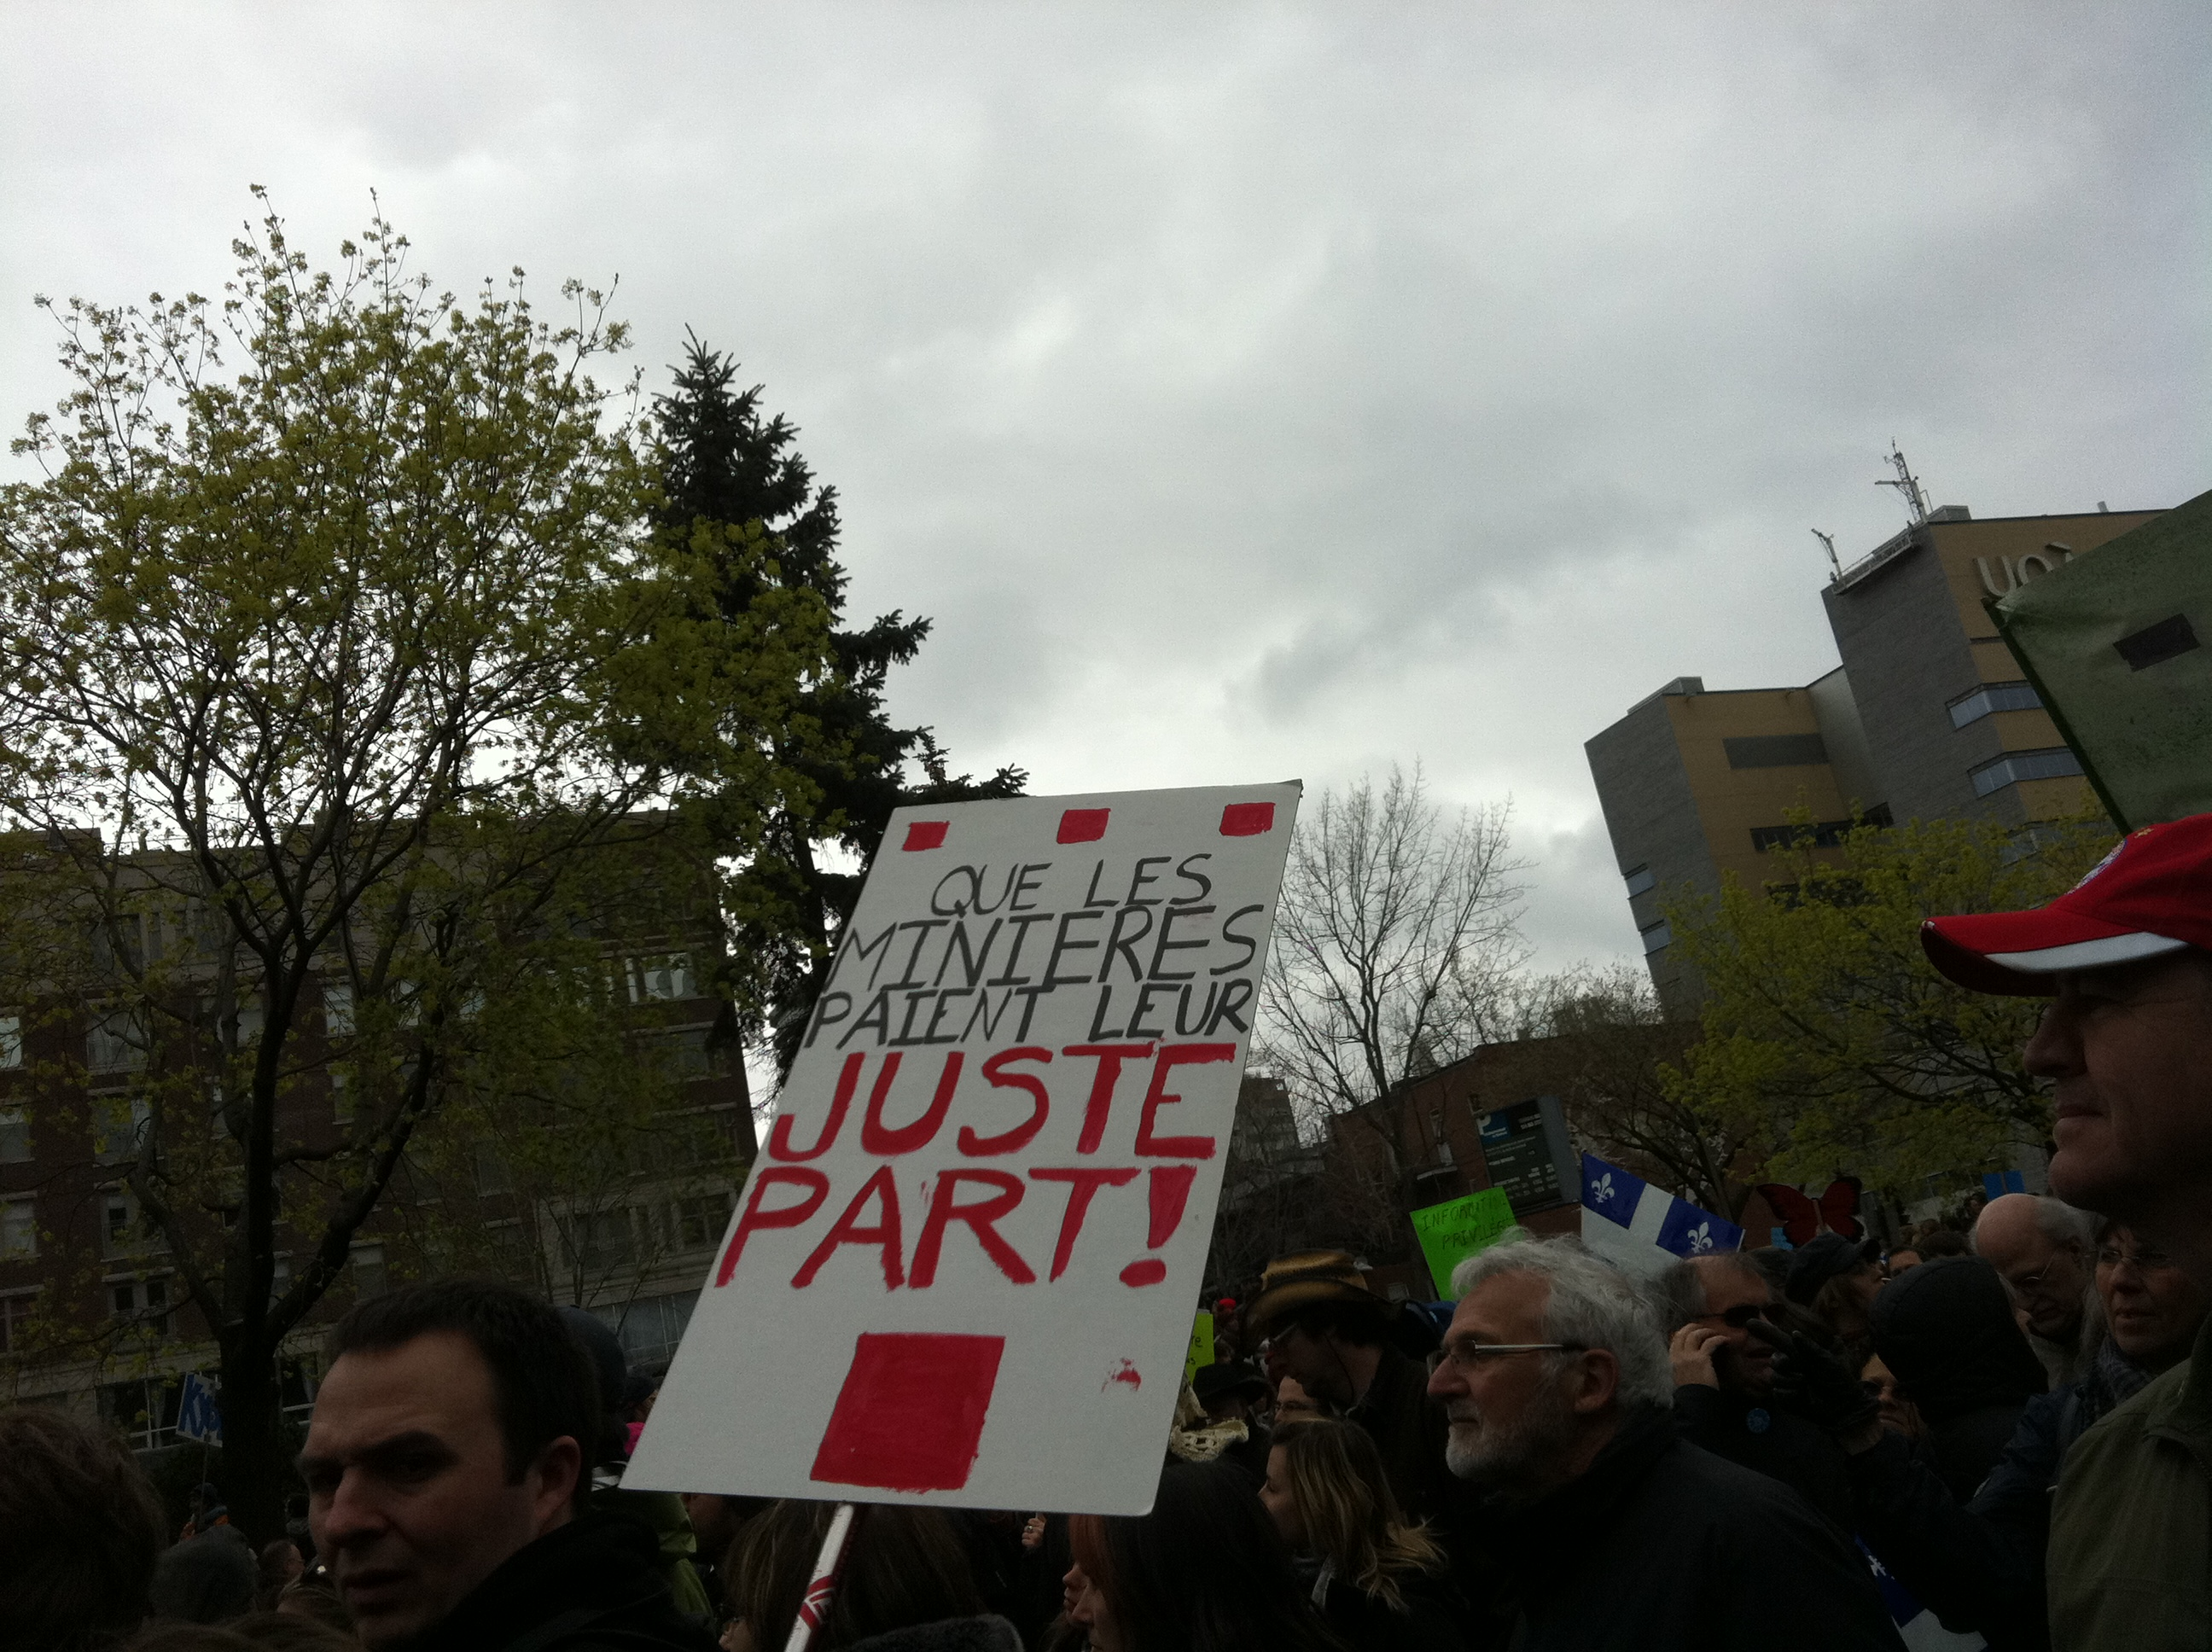
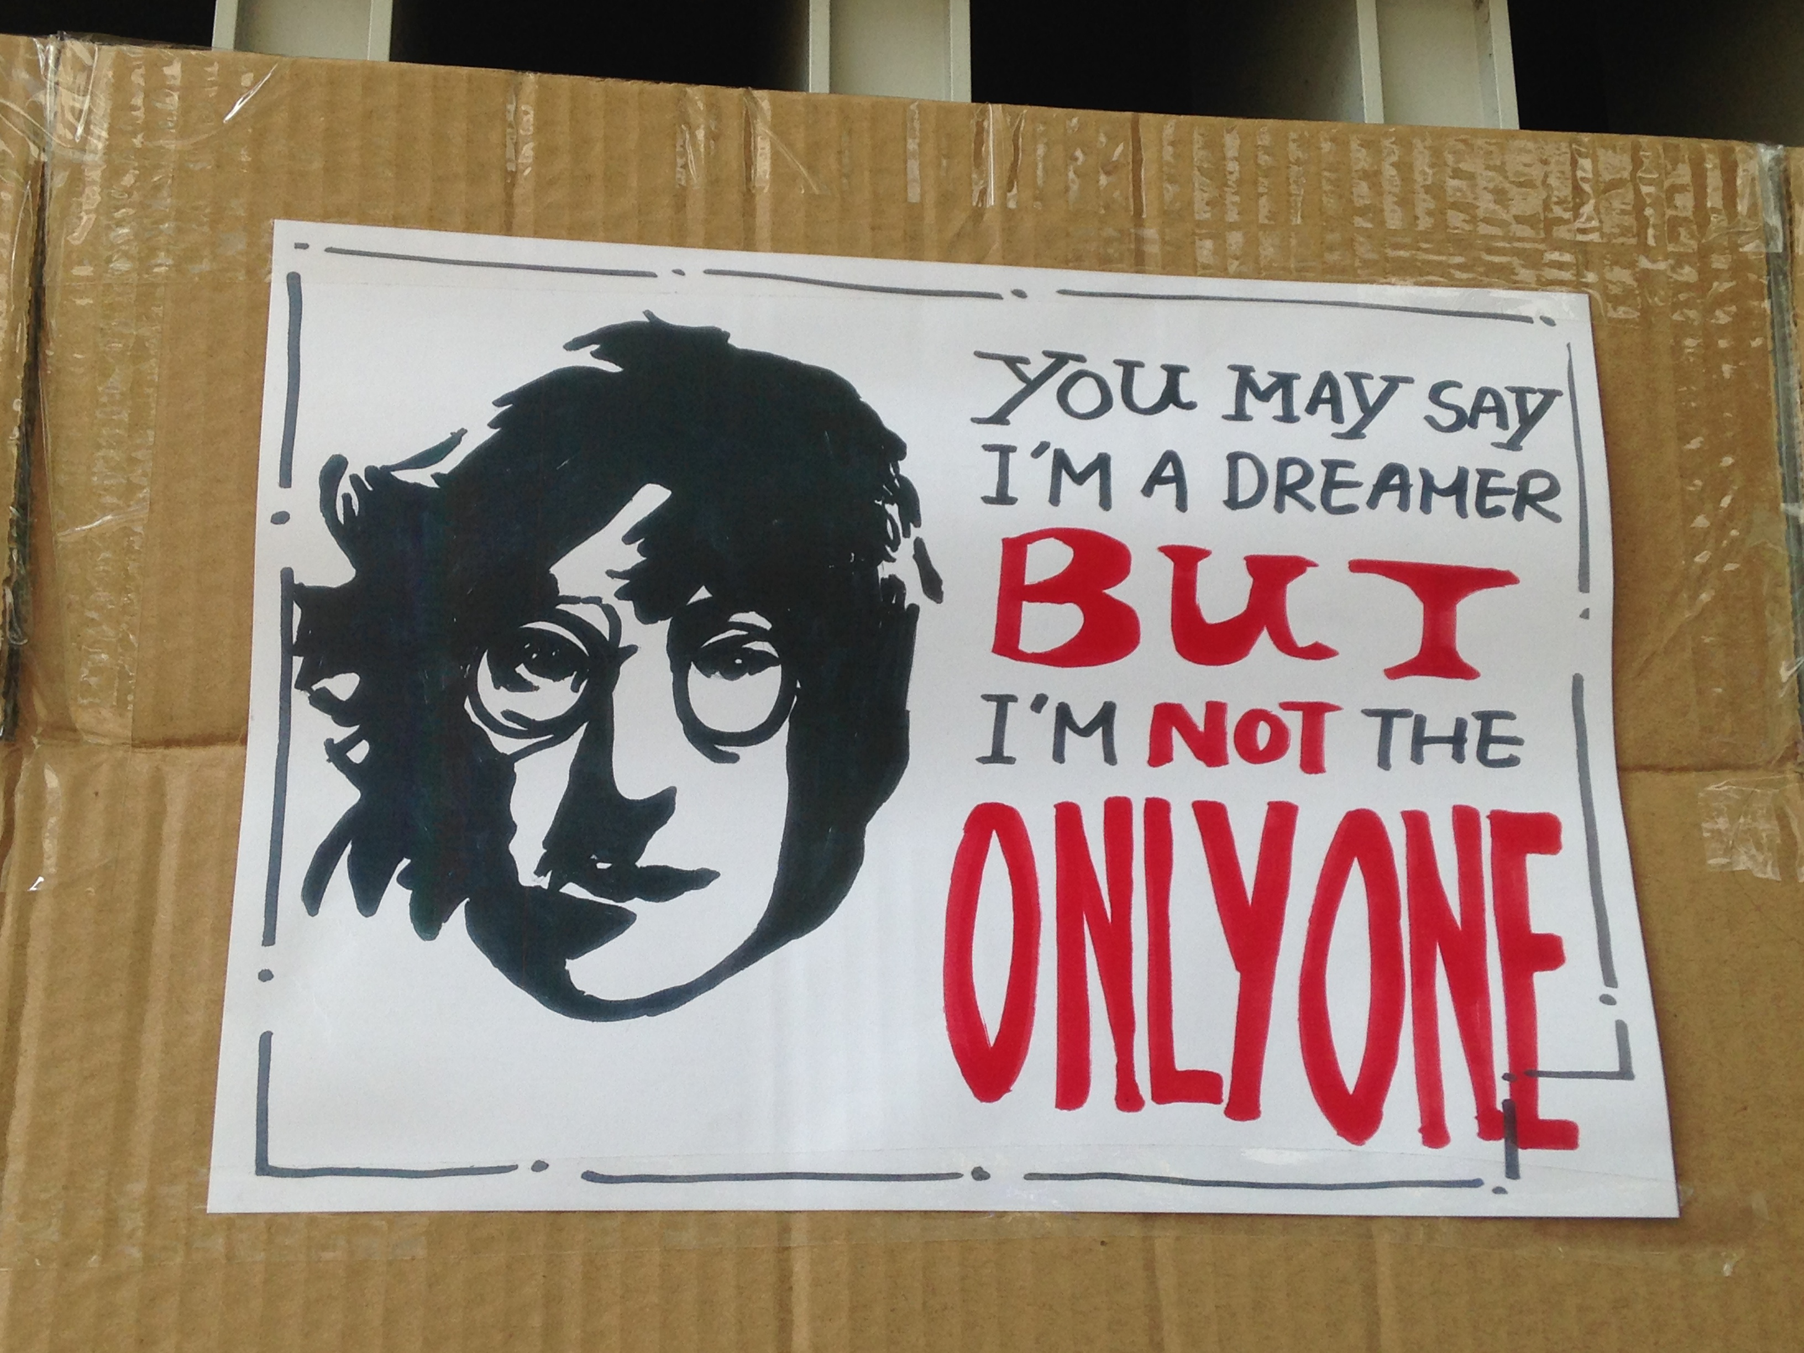
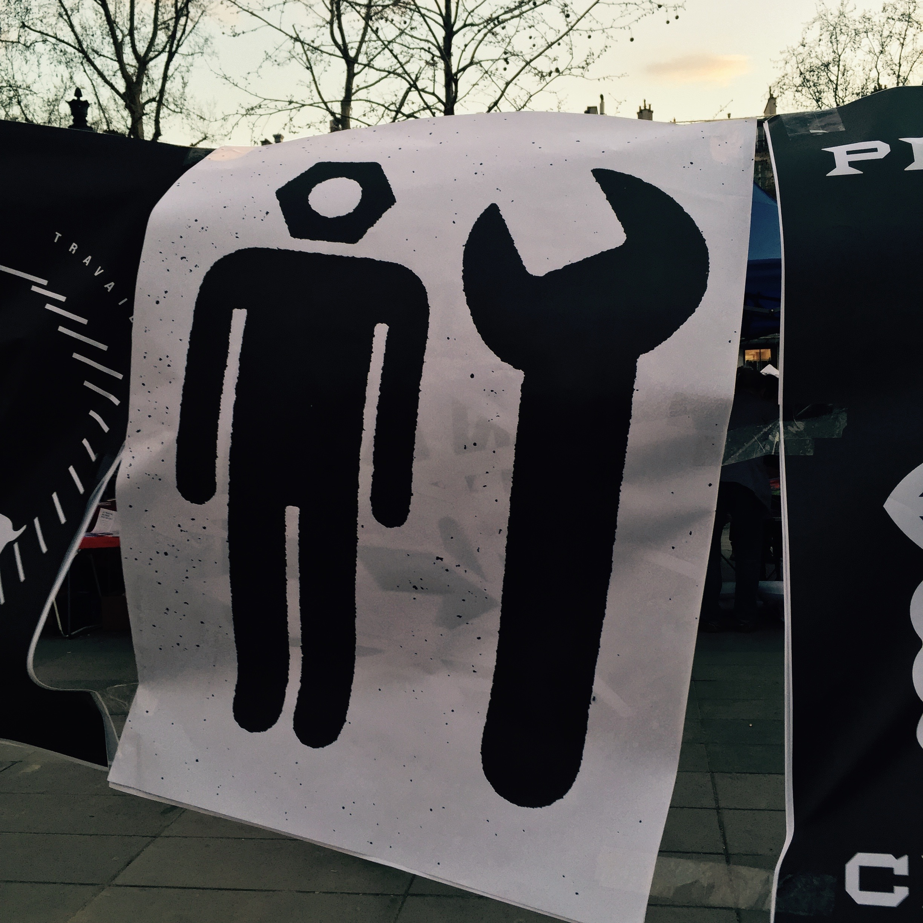
Protests and Societies

Slide 16
The Generational Roots. Fifty Shades of Anger
Deviations
The Rise of an « Existential Tension » and its Political Consequences
Angers, Solitudes, De-adherence
The Deafening Silent Angers

Slide 17
From Deviations to De-adherence
« - From all my commitments, from beginning to actually looking for a job, it made me really angry… Because I had moments not really of anxiety… but of anger. I was really outraged, I wanted to…
-Anger you say?
- Yes, anger. But you know, you ask yourself, what am I doing here… When you’ve tried everything, job agencies, all… Yes because I also looked for little jobs, and even that it’s not possible. Even for community work, you have to pull strings. Last week I even pulled strings to work for the Restos du Cœur. I had to pull strings, can you believe it?
- What were you angry about?
Against the system, the french system. Yes, against which takes advantage of it. I don’t want to exagerate, but sometimes out of disappointment you start to think : do I really have to change yet again to change my identity to get into something else? It’s never ending. »
F. 29 years old, postgraduate, unemployed, Paris
“Society turns its back on me, so I turn my back on society…”
F., 28 years old, postgraduate, unemployed, Madrid
“- I was angry against… I don’t know, bankers and stuff… Because I was never taken into account… They just said hey here is your loan, in a way I thought it was money for free… But mostly I am disappointed, I am angry with myself. It also my fault, I should have been more careful, I regret what I’ve done.”
M., 27 years old, high-level debt, loan counseler, Montréal.

Slide 18
Conclusion
Which Angers are to Fear?
The Place of Human Beings in the course of Societies : a Rising Tension
Contact : Cécile Van de Velde
Homepage : http://www.cvandevelde.com/
E-mail : cecile.vandevelde@umontreal.ca

