Slide 1

The consequences of the economic crisis on young people’s political participation in Spain
From social inequality to political inequality?
LLAKES Research Conference 2016 ‘Growing Up and Global Austerity”
Gema M. García Albacete
Universidad Carlos III de Madrid
gemgarci@clio.uc3m.es
Notes:
The goal of this paper is, although it is not yet there, to analyze changes in Young people’s political participation in Spain , and specifically, it is concerned whether an increasing social inequality is resulting in higher political inequality.
Please let me first give you some context on what has happened in Spain in the last years:

Slide 2
Great recession: dramatic economic consequences, particularly for young people
Source: Eurostat, 2015
Notes:
The Great Recesion had a huge effect on the economy, and resulted in a very long crisis in which we still are, an economic crisis that has hited particularly hard the youngest. Here you have an illustration of the percentage of unemployment among people aged 15 to 24 in diverse European countries, the highest value being Greece and Spain, where levels are still aroung 50%, and have been even higher in the last years.

Slide 3
And political consequences:
Satisfaction with democracy, average marginal effects, age and year, 2006 and 2012
Notes:
Triguered by the economy crisis, we have also withnessed a political crisis. This figure shows levels of satisfaction with democracy in 2006 and 2012.
This are quite extreme examples, so you can see how in Germany satisfaction with democracy increased, while it decreased in Spain and Italy.
As a side note to which I will come back, you can also observed how the change is even larger for those aged 26 to 35
Cambios en el tiempo son significativos para todos los grupos de edad

Slide 4
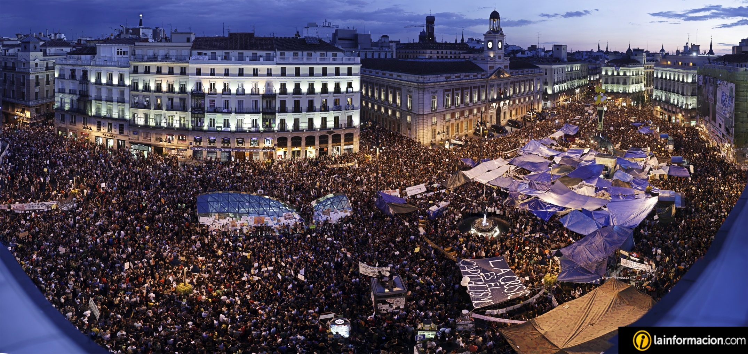
Reactions: protest participation (15M, 2011)
Notes:
Citizens reactions to this was first a change in government, and then huge protests around the country, with occupations on most cities that lasted more than a month.

Slide 5
Non-institutional participation, average marginal effects, age and year
Notes:
And of course, among the key actors on those protests were Young people. Individuals levels of participation in protest activities in 2006 and 2012, in Spain and Italy a significant increase in Young people’s participation in protest activities, although for slightly different groups, 18 to 25 in Italy and 26 to 35 in Spain
En Alemania los cambios no son sig para los jóvenes, sólo para los adultos
En España sig para los tres grupos más jóvenes y para los más mayores
En Italia sólo entre los más jóvenes!!!

Slide 6
Institutional participation (electoral turnout), average marginal effects, age and year
Notes:
When it comes to institutional political participation, we observe no change in Spain for the general elections but an interesting increase amongh the youngest in Italy (movimiento cince stelle
Cambios en el tiempo sólo significativos para Italia. Para los más jóvenes en +, para los dos siguientes grupos de edad en negativo
Germany positivo para grupo de edad 45 a 55
España nada

Slide 7
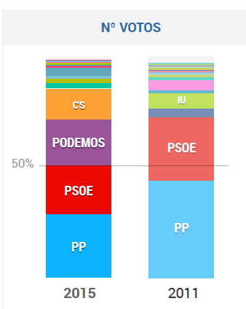
Institutional unexpected change
  Consolidated and stable party system with two main parties
  Electoral system, proportional with strong majoritarian effects due to districts
  Key point: European Parliamentary Elections in May 2014
  Podemos’ vote in 2014: young, no party id, low political trust (5 EMPs)
Notes:
However, change came some years later, actually, a radical change, a complete new configuration of the party system
When you look at who voted Podemos in the first place: Young, no party ide, low political trust, highly educated… Protest vote!

Slide 8
Party system change… by age
Notes:
And here is the confimation by age,

Slide 9
From a democratic normative point of view it is all good…
An interested and critical cohort of Young people willing to make their voice be heard
However, why are the 25-34 years more active than the 18-24?
  Political socialization: We should expect social transformations to have a stronger effect on attitudes and behaviors among those in their formative years
  Political crisis and mobilization → larger participation
  Economic crisis and social inequality → distinct effects according to individual economic circumstances
Notes:
So far, so good: an interested and critical cohort of Young people that is willing to sleep for weeks in the Street, to créate a new social networks unexistent until then and even go to the polls and change completely the political sphere to fight for their rights, and given the results, they definitely made their voice be heard.
So, it is all good.
However, there is still something that do not necesarily fit theoretical expectations. And that was somehow already visible already in 2011

Slide 10
Increase in social inequality

Slide 11
Working hypothesis and expectations
General argument: social inequality results in political inequality
Expectations:
- High levels of political involvement among young people who are still studying or already integrated into the labor market
- Political apathy among young people in precarious circumstances

Slide 12
Model
Data: 2015 December General Elections post electoral survey (realeased few weeks ago)
DV: Types of participants:
 |  | Non-institutional participation
 |  | Yes | No
Institutional participation (Turnout) | Yes | Participants | Voters
 | No | Protesters | None
Theoretical approach: How far are you willing to go?
In addition, confirmation with IRT models
Pure protesters? They do not seem to exist (these days)

Slide 13
Type of participants by age group (%)

Slide 14
Model
IV:
Age, life cycle, young people (up to 30!)
Education, as a proxy for resources, skills, cognitive abilities…
Previous studies contradictory findings regarding unemployment and political behavior
Unemployment vs other circumstances
Short vs long term unemployment
Uncertainty (low chances of finding a job if unemployed or high chances o losing it if employed)
Subjective social class
Control variables: gender (and education)
Multinomial logistic regressions, one interaction IV * age group at a time

Slide 15
Participants by level of education and age
Notes:
Strong relationship between education level and type of participant for all age groups
Among Young people differences even larger among those with only primary school but also visible among those that have completed secondary school
Caution to interpret this data given that many may not have completed their studies yet

Slide 16
Participants and unemployment by age
Notes:
There is also a relationship with employment but

Slide 17
Long vs short term unemployment

Slide 18
Uncertainty, low probs of finding a job or high probs of losing a job

Slide 19
Participation and perceived social class

Slide 20
Preliminary conclusions
It is about unemployment, long term unemployment
Is it a new type of unemployment? Highly educated, apathy due to frustration?
Social inequality results in political inequality, one of the most affected groups of the population is not getting involved politically in a context as politized and mobilized as the transition to democracy
With potential long term consequences due to:
- Impressionable years hypothesis
- Participation as a matter of habit
Work in progress:
Longitudinal perspectives with previous elections
Mechanisms: political efficacy, trust in institutions…

Slide 21
Thank you for your attention!

