Slide 1

Young people’s political participation: a comparative overview across Europe
LLAKES Research Conference 2015 ‘The crisis for contemporary youth’
Gema M. García Albacete
Universidad Carlos III de Madrid
gemgarci@clio.uc3m.es
Notes:
I would like first to thank you for being here today.
This is the presentation of my doctoral dissertation entitled „Continuity and generational? A longitudinal study of young people‘s political participation in Western Europe“
My goal for this presentation is to highlight some key points and main results.

Slide 2
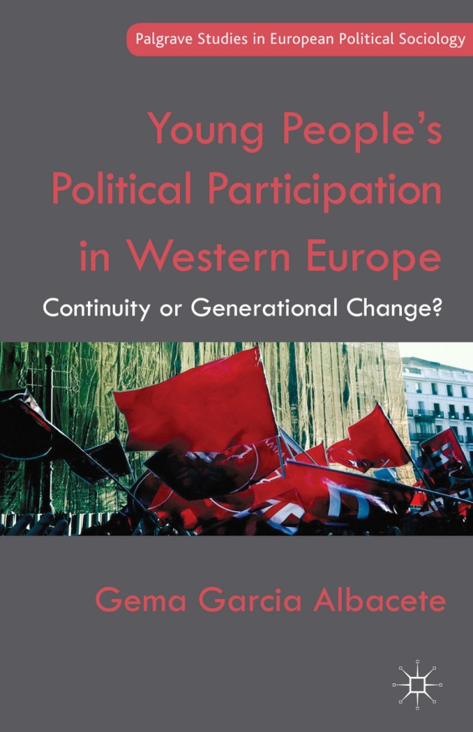
Research questions:
1) What’s distinctive of young people’s political participation at the beginning of the twenty-first century?
Apathy/cynicism vs. critical citizens
2) And if they participate differently, why?
Notes:
3 main ideas:
Participation among Young people is lower, and the do not longer participate more than adults on protest activities
This can be explain by a combination of cohort differences and life cycle effects
The transition to adulthood and thus the structural conditions in which Young people come to age are critical
→ The consecuences of the economic crisis on Young people’s political attitudes and behaviors in Spain

Slide 3
Main conclusions:
YP participate less – and no longer participate more than adults in protest activities
Lower participation can be explained by a combination of cohort and life cycle effects in most countries
The transition to adulthood is a critical period …
… and thus the structural conditions in which young people come to age
Notes:
3 main ideas:
Participation among Young people is lower, and the do not longer participate more than adults on protest activities
This can be explain by a combination of cohort differences and life cycle effects
The transition to adulthood and thus the structural conditions in which Young people come to age are critical
→ The consecuences of the economic crisis on Young people’s political attitudes and behaviors in Spain

Slide 4
Two tools to compare: participation and age across countries, life stages and time
Young people’s political participation in Europe
A new political generation?
- attitudes
- attitudes → behavior
Structural conditions:
- the economic crisis
Notes:
3 main ideas:
Participation among Young people is lower, and the do not longer participate more than adults on protest activities
This can be explain by a combination of cohort differences and life cycle effects
The transition to adulthood and thus the structural conditions in which Young people come to age are critical
→ The consecuences of the economic crisis on Young people’s political attitudes and behaviors in Spain

Slide 5
What’s distinctive of young people’s political participation at the beginning of the twenty-first century?
Introduction
Young people’s political participation
Explanations
Conclusions
Equivalent measures of political participation
Limitations available research
Propositions
Political participation measurement:
Development of cross-national and longitudinally valid instrument to measure political participation
Institutional and non-institutional participation
Emphasis in single modes of participation
Lack of cross-national studies
Lack of longitudinal studies
Absence of comparisons to adults
Ambiguous usage of the concept «age»
Notes:
This contradictions come from several limitations in former research:
The emphasis in single modes of participation
The lack of cross-national and longitudinal studies
The absence of comparisons to adults
And the ambiguous usage of the concept age
So, what exactly is distinctive of young people’s political participation?
To answer this question my study uses a cross-national and longitudinally valid instrument to measure political participation

Slide 6
What’s distinctive of young people’s political participation at the beginning of the twenty-first century?
Introduction
Young people’s political participation
Explanations
Conclusions
Youth and adulthood life stages
Limitations available research
Propositions
Political participation measurement:
Development of cross-national and longitudinally valid instrument to measure political participation
Institutional and non-institutional participation
2. What is “being young”?
Development of meaningful demarcation lines between youth and adulthood
Major markers of the transition to adulthood and their changes across time, countries and gender
Emphasis in single modes of participation
Lack of cross-national studies
Lack of longitudinal studies
Absence of comparisons to adults
Ambiguous usage of the concept «age»
Notes:
In addition, to avoid the usual strategy of comparing arbitrary groups of age it proposes a meaningful demarcation line between youth and adulthood based on the major markers of the transition to adulthood and their changes across time, countries and gender

Slide 7
Introduction
Young people’s political participation
Explanations
Conclusions
Results
What’s distinctive of young people’s political participation at the beginning of the twenty-first century?
Notes:
Using these two tools and comparing across time allows the examination of what exactly is peculiar of young people’s political participation at the beginning of the twenty-first century
The figure shows the average participation of young people and adults in 2002 and 1974. We can see that in both points in time the participation of young people in institutional activities is significantly lower than that of adults. And the gap is nowadays larger. In addition, while in the 70s thei participation in non-institutional activities was higher than that of adults. It does not seem that young people in recent years are compensating their lower participation in institutional activities by participating in non-institutional modes.

Slide 8
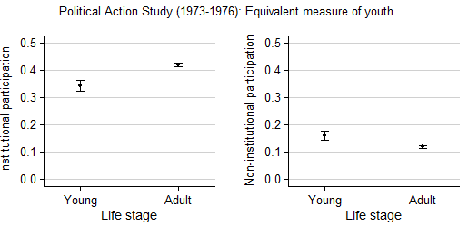
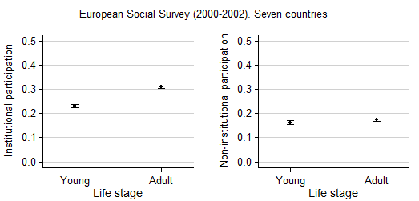
Introduction
Young people’s political participation
Explanations
Conclusions
Results
Notes:
Using these two tools and comparing across time allows the examination of what exactly is peculiar of young people’s political participation at the beginning of the twenty-first century
The figure shows the average participation of young people and adults in 2002 and 1974. We can see that in both points in time the participation of young people in institutional activities is significantly lower than that of adults. And the gap is nowadays larger. In addition, while in the 70s thei participation in non-institutional activities was higher than that of adults. It does not seem that young people in recent years are compensating their lower participation in institutional activities by participating in non-institutional modes.

Slide 9
Introduction
Young people’s political participation
Explanations
Conclusions
Results
Notes:
Using these two tools and comparing across time allows the examination of what exactly is peculiar of young people’s political participation at the beginning of the twenty-first century
The figure shows the average participation of young people and adults in 2002 and 1974. We can see that in both points in time the participation of young people in institutional activities is significantly lower than that of adults. And the gap is nowadays larger. In addition, while in the 70s thei participation in non-institutional activities was higher than that of adults. It does not seem that young people in recent years are compensating their lower participation in institutional activities by participating in non-institutional modes.

Slide 13
Do young people participate less due to distinctive cohort characteristics or due to a delayed and more complicated transition to adulthood?
Introduction
Young people’s political participation
Explanations
Conclusions
Age and political participation
Age | Young people participate less because…
Cohort | … of distinctive cohort characteristics given the social and political context in which they were socialized
Generation | … they constitute political generations shaped by the concrete political events taking place during their formative years
Life-cycle | … of they life cycle stage in which they are
Notes:
The second question is then why. My study puts emphasis in the need to understand what is it about age that influences political participation in order to understand changes across time. Do young people participate differently due to cohort characteristics given the social and political context in which they where socialized or due to a delayed and more complicated transition to adulthood?

Slide 14
Do young people participate less due to distinctive cohort characteristics or due to a delayed and more complicated transition to adulthood?
Introduction
Young people’s political participation
Explanations
Conclusions
Political generations and cohorts
Age | Societal transformations | Expectations
Cohort | Education, media | Sophisticated critical citizens
 | Money-driven politics, lack of attention from parties | Politically alienated
 | Professionalization of political parties | Lack mobilization networks
 | Life-style politics, welfare state recession, labor market | Individualistic
Generation | Country-specific events | Diverse developments across countries
Notes:
Most researchers (if not all) have pointed to cohort or generational changes, driven by several societal transformations. New generations have been said to be sophisticated critical citizens, or politically alienated or individualistic, or just to lack mobilization networks.

Slide 15
Do young people participate less due to distinctive cohort characteristics or due to a delayed and more complicated transition to adulthood?
Introduction
Young people’s political participation
Explanations
Conclusions
Political generations and cohorts
Age | Societal transformations | Expectations | Results
Cohort | Education, media | Sophisticated critical citizens | More continuity than change Cohort characteristics Remaining gap to explain
 | Money-driven politics, lack of attention from parties | Politically alienated
 | Professionalization of political parties | Lack mobilization networks
 | Life-style politics, welfare state recession, labor market | Individualistic
Generation | Country-specific events | Diverse developments across countries
Notes:
However, a longitudinal exploration of several political attitudes does not support these claims. In contrast to recent literature, there is overall more continuity that change. There are also some cohort characteristics but they are not as extreme as it has been suggested and refer mainly to lower levels of political interest and support for political parties. In addition, even when we take these new characteristics in account, there is a remaining participatory gap to explain

Slide 16
Interest in politics (1980-2008)

Slide 17
Political trust: confidence in political parties (1980-2008)

Slide 18
Marginal effect of being young on institutional and non-institutional participation across levels of political interest in Denmark

Slide 19
Do young people participate less due to distinctive cohort characteristics or due to a delayed and more complicated transition to adulthood?
Introduction
Young people’s political participation
Explanations
Conclusions
Life stage
Age | Societal transformations | Expectations | Results
Cohort | Education, media | Sophisticated critical citizens | More continuity than change Cohort characteristics Remaining gap to explain
 | Money-driven politics, lack of attention from parties | Politically alienated
 | Professionalization of political parties | Lack mobilization networks
 | Life-style politics, welfare state recession, labor market | Individualistic
Generation | Country-specific events | Diverse developments across countries
Life-cycle | Longer transition to adulthood | Delay in political «start up»
Notes:
I suggest that there is an additional transformation that has been overlooked by political scientists. We know that political participation increases as individuals reach adulthood. […….]That is, the fact that the transition to adulthood is a longer and more uncertain process and it might have resulted in young citizens’ political start up.

Slide 20
Do young people participate less due to distinctive cohort characteristics or due to a delayed and more complicated transition to adulthood?
Introduction
Young people’s political participation
Explanations
Conclusions
Changes in the transition to adulthood. Some results
Age | Societal transformations | Expectations | Results
Cohort | Education, media | Sophisticated critical citizens | More continuity than change Cohort characteristics Remaining gap to explain
 | Money-driven politics, lack of attention from parties | Politically alienated
 | Professionalization of political parties | Lack mobilization networks
 | Life-style politics, welfare state recession, labor market | Individualistic
Generation | Country-specific events | Diverse developments across countries
Life-cycle | Longer transition to adulthood | Delay in political «start up» | ✓
Notes:
All together, the results give support to the expectation that a longer transition to adulthood is at least partialy an explanation of young people’s lower levels of participation at the beginning of the twenty-first century

Slide 21
Continuity or generational change?
Introduction
Young people’s political participation
Explanations
Conclusions
Continuity or change?
Continuity:
Young people are not reinventing political activism
Young people are not particularly critical or alienated from the political system
Their levels and modes of participation are to a larger extent due to their stage in life
Change:
Lower levels of interest in politics and weaker relationship to political parties in some countries
Structural conditions in which young people come to age
Notes:
In order to conclude, I would like to come back to the title of my dissertation.
Contrary to many stressing change, a careful look across, time, countries, forms of participation, groups of the population and the different meanings of age bring a much more nuance picture. There is no indication that young people are reinventing political participation but neither are they particularly critical or alienated form the political system. In addition how they participate is to a larger extent due to their stage in life.
There is some change in the structural conditions in which young people come to age and lower levels of interest in politics in some countries.

Slide 22
The effect of the economic crisis on young people’s political participation in Spain
LLAKES Research Conference 2015 ‘The crisis for contemporary youth’
Gema García- Albacete
Javier Lorente
Irene Martín
Notes:
Main ideas:
There have been significant changes in attitudes and behaviours
Among the young, but not exactly the youngest
But new gaps between the empolyed and the unemployed
But be carefull: when activated, they may change the whole sytem!

Slide 23
Conclusions
Against our expectations, we find larger changes among those in the age group 25 to 36
  Potential explanations:
    Life cycle
    More aware of the impact of the crisis
    Expectations

Slide 24
Satisfaction with democracy, average marginal effects, age and year, 2006 and 2012
Notes:
Cambios en el tiempo son significativos para todos los grupos de edad

Slide 25
Institutional participation (electoral turnout), average marginal effects, age and year
Notes:
Cambios en el tiempo sólo significativos para Italia. Para los más jóvenes en +, para los dos siguientes grupos de edad en negativo
Germany positivo para grupo de edad 45 a 55
España nada

Slide 26
Non-institutional participation, average marginal effects, age and year
Notes:
En Alemania los cambios no son sig para los jóvenes, sólo para los adultos
En España sig para los tres grupos más jóvenes y para los más mayores
En Italia sólo entre los más jóvenes!!!

Slide 27
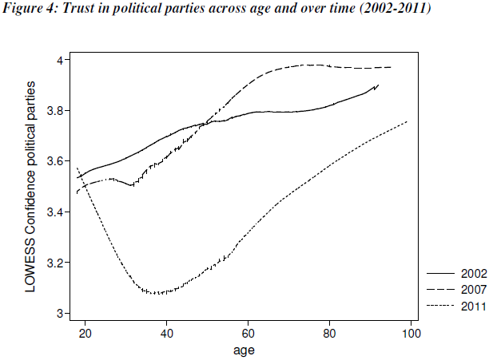
Trust in political parties across age and over time (2002-2011)

Slide 28
Conclusions
Against our expectations, we find larger changes among those in the age group 25 to 36
  Potential explanations:
    Life cycle
    More aware of the impact of the crisis
    Expectations
In general, change seems positive, disaffection results in protest
However, social inequalities (unemployment) are resulting in political inequalities
New gap among young people according to their occupational status: apathy vs. critical citizens

Slide 29
Non-institutional participation, contrast unemployed across age and over time, Spain

Slide 30
Non-institutional participation, contrast unemployed across age and over time, Italy

Slide 31
Non-institutional participation, contrast unemployed across age by satisfaction, Spain

Slide 32
Conclusions
Against our expectations, we find larger changes among those in the age group 25 to 36
  Potential explanations:
    Life cycle
    More aware of the impact of the crisis
    Expectations
In general, change seems positive, disaffection results in protest
However, social inequalities (unemployment) are resulting in political inequalities
New gap among young people according to their occupational status: apathy vs. critical citizens
Relevance of the political supply: comparison between Italy and Spain, or changes in Spain 2012-2015

Slide 33
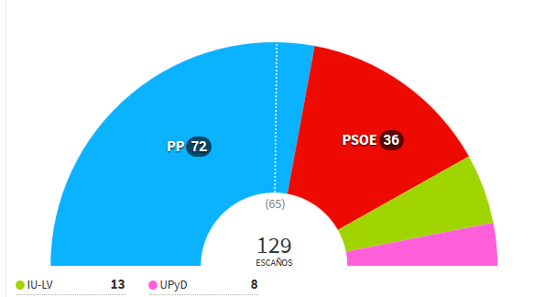
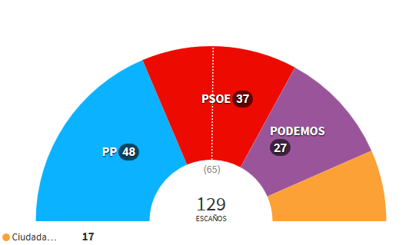
Final note:
  Young people changing the political parties system?
2011
2015

Slide 34
Final note:
  Young people changing the political parties system?

Slide 35
Thank you for your attention!

Slide 36
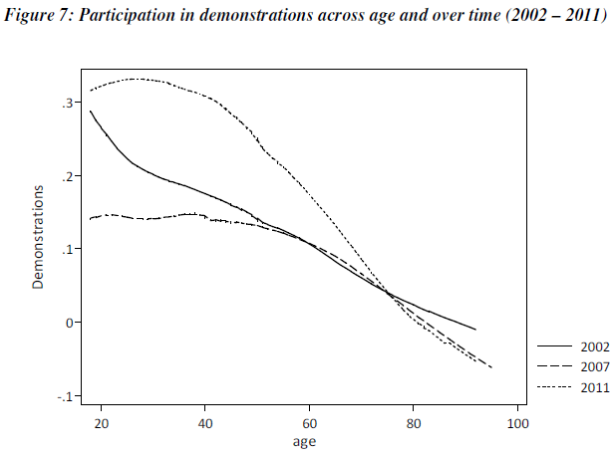
Participation in demonstrations across age and over time (2002-2011)

Slide 37
Introduction
Young people’s political participation
Explanations
Conclusions
Changes in the transition to adulthood. Some results
Marginal effects of being young on institutional political participation as respondents move forward in the transition to adulthood, 2002
Notes:
An interesting result however, is that passing to the transition to adulthood not only does not have the expected positive effect on participation but, in a number of countries, it even depresses participation.
This is a particular important result because the life-cycle model of participation is one of the most common assumption in political behavior research
To understand this trajectory, three explanations were proposed to explain this finding:
Not all the transitional events have positive outcomes for political participation in every country
The second proposal is that the transition to adulthood requires some time to gbring about the resources and motivation that foster participation. And particularly so, at the beginning of the twenty-fiorst century
The thirs is that the transition to adulthood has dissimilar effects for men and women

Slide 38
Transition to adulthood and institutional participation:
Introduction
Young people’s political participation
Explanations
Conclusions
Changes in the transition to adulthood. Some results
Direct positive effect
No effect
Short term disruptive effect and long term positive effect
Differences across gender
Notes:
Empirical evidence was found for most of these scenarios. In some countries the events comprised in the transition to adulthood have a direct positive effect on institutional political participation

Slide 39
Transition to adulthood and institutional participation:
Introduction
Young people’s political participation
Explanations
Conclusions
Changes in the transition to adulthood. Some results
Direct positive effect
No effect
Short term disruptive effect and long term positive effect
Differences across gender
Notes:
Or have no effect

Slide 40
Transition to adulthood and institutional participation:
Introduction
Young people’s political participation
Explanations
Conclusions
Changes in the transition to adulthood. Some results
Direct positive effect
No effect
Short term disruptive effect and long term positive effect
Differences across gender
Notes:
Or have an effect only from an specific age on.

Slide 41
Continuity or generational change?
Introduction
Young people’s political participation
Explanations
Conclusions
Further research
Only life- cycle effects:
Belgium
Denmark
Ireland
Portugal
Sweden
Life-cycle and cohort effects:
Austria
Finland
Germany
Italy
France
Greece
Spain
Norway
Exceptions:
United Kingdom
The Netherlands

Slide 42
Introduction
Young people’s political participation
Explanations
Conclusions
Results

Slide 43
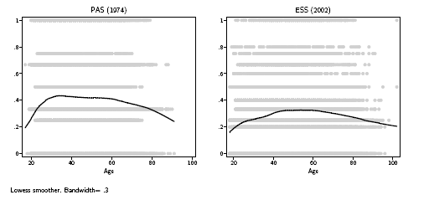
Institutional participation and age in seven European countries, 1974 and 2002

Slide 44
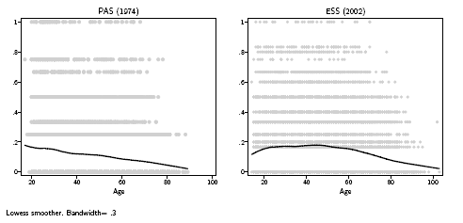
Non- institutional participation and age in seven European countries, 1974 and 2002

Slide 48
Notes:
Participación institucional en función de los años que han pasado desde el primer empleo

Slide 49
Notes:
Participación institucional en función del número de años que han pasado desde el último hijo para hombres y mujeres

Slide 50
Cambio en actitudes políticas y participación en función de la edad
Los cambios son más pronunciados entre los jóvenes, pero no entre los más jóvenes.
Confirmación de que los cambios son mayores para el grupo de 25-36 años

Slide 51
Y, ¿los jóvenes desempleados?
Nueva brecha entre jóvenes empleados y no desempleados, que no surge para otros grupos de edad:

Slide 52
Identificación partidista
Encontramos esta nueva brecha en actitudes y comportamientos políticos relacionados con partidos políticos y el proceso electoral: confianza en los partidos, identificación partidista, voto y firma de peticiones.

