Slide 1
Making it Against the Odds: Diverse strategies and successful adaptation in school-to-work transitions in England
Ingrid Schoon
University College London, Institute of Education and Wissenschaftszentrum, Berlin (WZB)
LLAKES Research Conference
Growing Up and Global Austerity
London, 27-28 June 2016

Slide 2
Outline
Making it against the odds – the study of resilience
A developmental-contextual approach
What is a successful youth transition?
What enables young people to beat the odds?

Slide 3
What is Resilience?
positive outcomes despite the experience of adversity
continued positive or effective functioning in adverse circumstances
recovery after a significant trauma
Rutter, 1987; Masten, 2001; Schoon, 2006

Slide 4
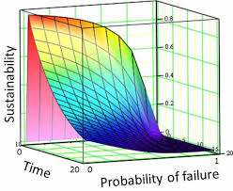
Identifying resilience
Resilience is not a personality characteristic
It is not directly measured, but based on two judgements:
is there now or has their been any significant risk or adversity to be overcome?
is the person doing ok?
Notes:
The notion of resilience differs from other terms such as general positive adjustment or coping, insofar as it takes into consideration the circumstances and processes under which development takes place
One cannot talk about resilience in the absence of adversity – and the construct of resilience is inferred on the basis of constellations of exposure to adversity and the manifestation of positive adjustment in the face of that adversity.
Instead of focusing on maladjustment or deficits, the focus on resilience aims to identify strengths and resources that facilitate adjustment
The identification of resilience is based on two fundamental judgements: is a person doing ok? And is there now, or has their been any significant risk or adversity to be overcome
A central assumption in the study of resilience is that some individuals are doing alright, despite being exposed to an adverse risk situation, while others fail to do so. The very definition of resilience is therefore based on an expectation of successful or problematic adjustment in response to risk factors that are assumed to affect adaptations:
In order to identify resilience it has to be established whether the circumstances experienced by individuals do in fact affect their chances in life.
If there would be no association between the experience of adversity, access to resources and opportunities, and consequent adjustment, the phenomenon of resilience would be a mere chance event, a random occurrence.
Positive adjustment occurring with, versus without conditions of adversity often have different correlates and thus reflect different constructs. Furthermore, several studies have found varying antecedents of positive adjustment in general versus resilience in the face of adversity (Rutter, 1990).
The two-dimensional definition of resilience brings with it the challenge of defining our understanding of risk and adversity, as well as positive adjustment.

Slide 5
Paradigm shift
from deficit view to model of capabilities
from constancy model to dynamic models of human development
from pathogenic to transactive systems models
(Rutter, 1987; Masten, 2001, 2014; Schoon, 2006, 2012)

Slide 6
Human Development in Context
Wider Social Context
Community
Family, Friends, Peers
Individual
An Ecological Approach
(Bronfenbrenner, 1979, 1986, 1989)

Slide 7
A Life Course Perspective:
Paradigmatic Principles (Elder, 1993, 1998)
Human Development as a
Life-Long Process
Human
Agency in
Constrained
Situations
Linked
Lives
Lives in
Time and
Place
Timing in
Lives
The life course as a holistic experience, a purposeful creation, and social formation

Slide 8
Schoon, 2006
Notes:
This Figure illustrates the different spheres of influence shaping individual adjustment. Notably the varied spheres do not exist in isolation, they are inter-related and mutually interdependent.
Furthermore the model advocates a systems view to resilience (postulating a holistic approach) incorporating multi-level person-environment interactions. The model also captures the transactional nature of development over time, focusing on the reciprocal interactions between risk experiences and individual adjustment, which are embedded in the wider socio-historical context.
The model is an explicit developmental model, allowing us to assess the dynamic interactions between individual and context. Any point in the life span has to be understood as the consequence of past experience and as the launch pad for subsequent experiences and conditions. For example, early adjustment patterns influence later adjustment, and early risk experiences are linked to the experience of risk at later life stages. Early experiences and the meanings attached to them are carried forward into consequent situations. Yet, life-long development may also involve processes that do not originate at birth or early childhood but in later periods.

Slide 9
The Transition to Adulthood
Demographically dense period involving assumption of multiple social roles
The Big 5
Pivotal in setting the scene for adult functioning and adjustment; is both formative and risk laden
Shaped by previous experiences and current conditions

Slide 10
What is a successful transition?
Doing ok
Adjustment within the average for a normative cohort
Meeting developmental tasks
Objective achievements (education, occupational position, income)
Subjective evaluation (life satisfaction, health and wellbeing)
Timing and sequencing
Normative, or ‘on-time transitions’ are ‘culturally prepared’ by socialization and institutional arrangements (Model, 1989) and are understood to be psychologically salutary
those who are ‘off-time’: too early or too late are thought to be the target of negative social sanctions and experience psychological strain (Heckhausen, 1999; Rossi, 1980)
Can vary by age, culture and historical context
Who decides?

Slide 11
Current Debates
Normative approach – emerging adulthood (Arnett, 2000)
Ideal type of late and protracted transitions (Billari & Liefbroer, 2010)
Increasing individualisation - Entrepreneurs of the self (Foucault, 1979; Ehrenberg, 2009)
De-institutionalisation (Hogan & Astone, 1986; Mayer & Müller, 1986)
De-standardisation and individualisation (Modell et al., 1976; Beck, 1986; Buchmann, 1989)
Cumulative (dis)advantages and polarization of experiences
fast versus slow transitions (Bynner et al., 2002; Jones, 2002; Ross et al., 2009)
optimal versus problematic transitions (Kerckhoff, 1993; McLanahan, 2004, 2014)
Diverse Pathways View – dynamic systems model
Multi-directionality, multi-finality and relational dynamic systems (Baltes, 1987; Bronfenbrenner, 1979; Elder, 1974; 1993; Lerner, 1984; Schoon, 2006, 2015)
more than one optimal pathway; continuity and change; turning points; plasticity

Slide 12
Diverse Pathways View
Dynamic systems view:
Continuity and discontinuity; potential for change
Non-linearity
Individual differences
Holistic approach: multiple and interlinked influences
Person-centred: variation in how experiences combine within individuals
Longitudinal – following lives over time
Schoon, 2015

Slide 13
Need for Longitudinal Data UK Cohort and Panel Data: Overview
LSYPE (n=15,884)
Annual survey since 2004
age 14-20
BHPS (Panel Study; started in 1991)
Since 1994 youth panel of 12-15 year olds is included
1970 British Cohort Study (BCS70); n=17,189
Age 5 10 16 26 30 34 38 42 46
1974 1980 1986 1991 1996 2000 2004 2008 2012 2015
Oil crisis Onset of the recession Second wave Recovery Credit Crunch
Collapse of housing market
New Technologies IT and social media

Slide 14
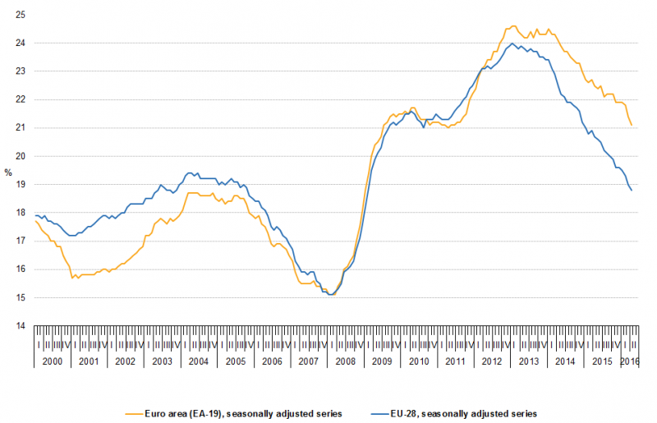
The Great Recession
Rising unemployment
especially among young people
Concern about ‘the lost generation’

Slide 15
NEET (age 15-24) across Europe

Slide 16
How did the recession effect school-to-work transitions?
Evidence from the British Household Panel Study
Comparing cohorts born in 1980/84 and 1985/89
Focus on education and employment transitions
Sequence analysis to assess patterns in timing and sequencing of transitions
5 employment states measured between 16-20
FT or PT employment
Unemployed
Family activity
Full time education
Sick or otherwise not in the labour force
We identified 5 patterns

Slide 17
Timing and sequencing of transitions (ages 16-23)
Pattern of school-to-work transition | Pre-Recession Cohort born 1980-84 1996-2007 | Recession Cohort born 1985-89 2001-2012
Extended Education | 33.1 | 35.3
Employment after some education | 25.2 | 24.4
Early work orientation | 30.1 | 17.5
Inactivity | 7.0 | 6.1
Persistent unemployment (NEET) | 4.5 | 16.7
N | 468 | 360
Schoon & Lyons-Amos, 2016

Slide 18
Antecedents of Transition Patterns
Cohort effects
Family socio-economic background (parental education and employment status)
Education aspirations
Regional unemployment

Slide 19
Transitions in a current cohort
Longitudinal Study of Young People in England
Cohort born in 1989/90
Comprises more than 17,000 individuals
-> more fine-grained analysis
Sequence analysis of school-to-work transitions
-> We identified 6 groups

Slide 20
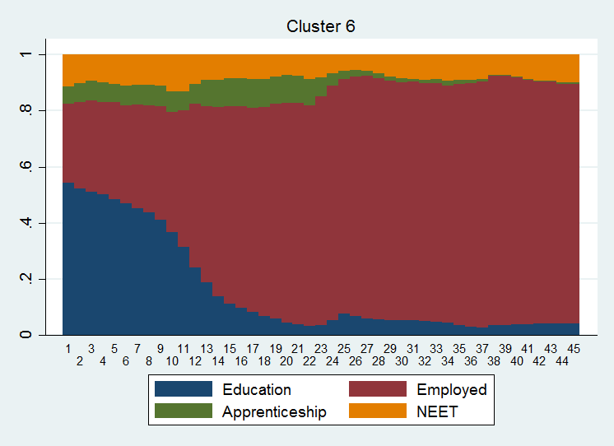
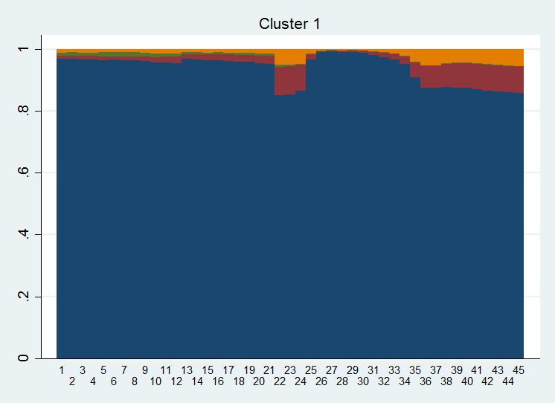
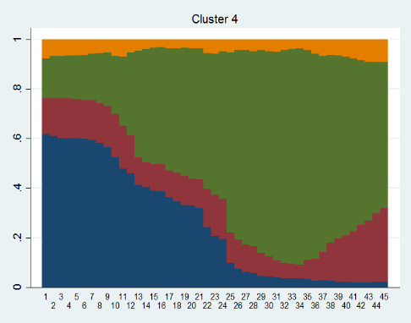
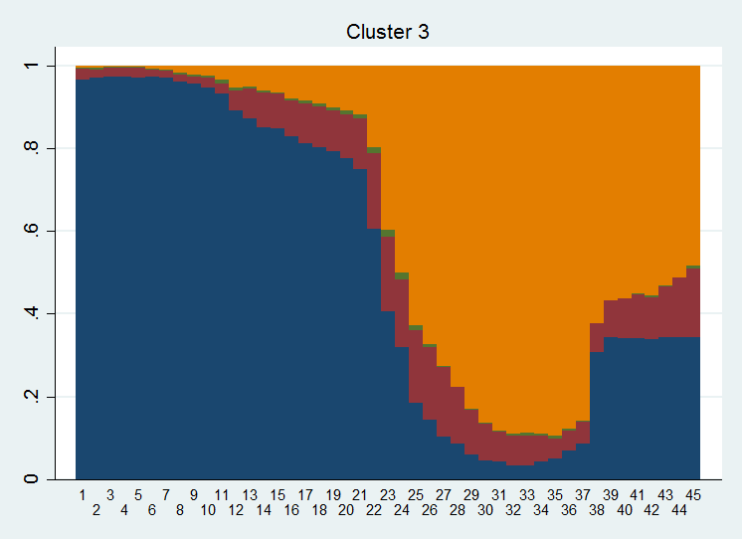
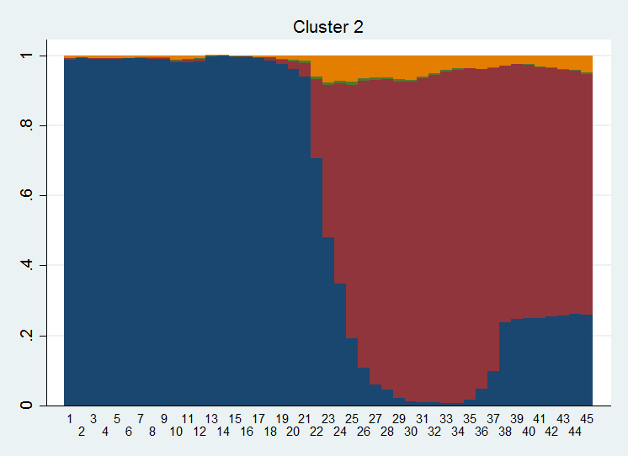
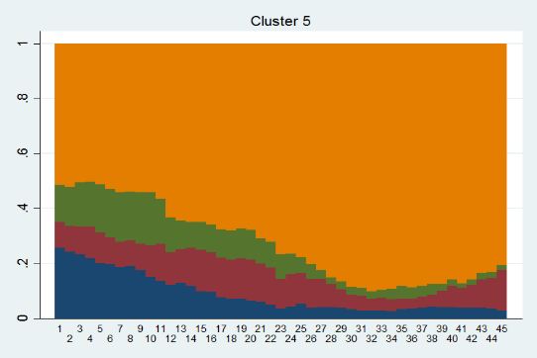
Transitions between age 16 to 20 (LSYPE)
Mostly education (45.2%)
Apprenticeship (6.5%)
Employment after further education (15.5%)
Early work orientation(21.1%)
Unemployment after further education (7.1%)
NEET (5.6%)

Slide 21
What is a successful transition?
Subjective evaluation

Slide 22
Life Satisfaction by Group
Schoon & Lyons-Amos, in press

Slide 23
Antecedents of Transition Patterns
Family socio-economic background (parental education and home ownership)
Gender
Ethnicity
Area Deprivation (IMD)
Prior academic attainment
Indicators of agency:
Education expectations
Academic self-concept
Goal certainty
School engagement

Slide 24
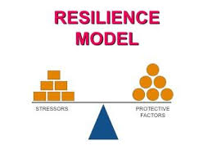
Beating the Odds
Risk and Protection

Slide 25
The Concept of Risk
Statistical versus actual risk
Focus on single risk factors
Accumulation of risk effects -> multiple risk models
Plurality of meaning
Duration and timing of risk effects
The context of risk
Schoon, 2006, 2012, 2015

Slide 26
Indicators of social risk in two age cohorts growing up twenty years apart
Dichotomised indicators of social risk that are comparable across the two cohorts
 | BCS (%) Born 1970 Aged 16 in 1986 | LSYPE (%) Born 1990 Aged 16 in 2006
Low parent education (<NVQ2) | .49 | .16
Low parent SES (routine occupations) | .18 | .23
YP lives in a lone parent household | .03 | .17
YP was born to a teen parent | .08 | .07
YP lives in social housing | .28 | .12
YP lives in a workless household | .04 | .09
Duckworth & Schoon (2012)
Notes:
The Table shows the incidence of six dichotomised measures of social risk in the two cohorts, measured at age 10 in the BCS and 14 in the LSYPE. There are clearly other indicators of social risk but we have chosen indicators that are comparable across the two cohorts.
Again highlights the expansion in educational participation between the two cohorts: in the BCS half of families lived in households with less than Level 2 qualifications while fewer than 1 in 5 young people in the LSYPE cohort live in households with similarly low levels of education.
Conversely, greater number of families are in low SES households in the LSYPE possibly reflecting the nature of the jobs available in the labour market and changes in family size and structure...more young people in the LSYPE live in lone parent and workless households.
Numbers in social housing has more than halved.
Interestingly, the only thing that hasn’t changed, is the number of young people born to a teenage parent
Low parent education – less than level 2 qualifications
Low parent SES – routine occupations / unemployed
YP lives in a lone parent household
YP was born to a teen parent – 20 years or younger at time of CM’s birth
YP lives in social housing
YP lives in a workless household

Slide 27
Cummulation of risks
Given comparability in the two datasets, we combine indicators into a single score of the summed dichotomous indicators
Notes:
This approach enables consideration of cumulative risk as well as allowing our analysis to take into account the different incidences of each risk across the two cohorts and so some of the socio-historical differences which exist between them
Analysis here also shows that in relation to NEET status, the relationship between the number of risks and becoming NEET is very linear. For our education and employment outcomes the relationship is slightly more curvilinear with those young people experiencing 3 or more risks being particularly less likely to remain in education or move into employment

Slide 28
The youth labour market in historical context
Comparing experiences in two age cohorts
 | BCS: born 1970, aged 18 in 1988 | LSYPE: born 1990, Aged 18 in 2008
FT education | 25% | 45%
Employed (with or without training) | 68% | 40% (33% paid work, 6% apprenticeships)
Out of the labour force (NEET) | 7% | 16%
Notes:
A large number of initiatives have been introduced over recent decades which have radically transformed the transition from school to work. Trends in young people’s first destination states following the end of compulsory schooling, for example, show that during the 1970s and into the early 1990s, employment declined in importance relative to youth training and continuing education (Andrews & Bradley, 1997).
Nevertheless, many young people continue to choose an employment based route on leaving school and while many succeed in doing so, a significant minority of young people struggle to make the transition into work after leaving full time education

Slide 29
Greater experience of social risks is associated with becoming NEET
The greater the number of social risks experienced by young people, the higher their likelihood of becoming NEET
This relationship is remarkably linear and is particularly marked for young people in the later born LSYPE
Persistent NEET between 16-18
Duckworth & Schoon (2012)
Notes:
In both the BCS (Table 5) and the LSYPE (Table 6) the relationship between the number of risks experiences and the likelihood of being NEET appears fairly linear: with each additional risk experienced, the likelihood of being NEET at 18 increases.
Controls for region, income and gender.
There is a higher overall risk of being NEET in the LSYPE (16% vs. 7% in the BCS)
In both cohorts there is a strong relationship between the number of social risks experienced by young people and the likelihood of becoming NEET
Bynner and Parsons (2002) highlight the dynamic rather than static nature of being NEET and the need to define it longitudinally, i.e. It must represent a minimum period of time outside education, training and employment

Slide 30
Beating the Odds: Risk and Resilience
NEET
Yes No
Expected Vulnerability | Resilient: doing well in the face of adversity
Unexpected vulnerability | Expected positive adjustment
Risk
Low High

Slide 31
Potential protective factors that help young people to “beat the odds”...
Triachic model of resilience (Masten, 2001, 2014; Rutter, 1987; Schoon, 2006, 2012; Werner & Smith, 1992):
Individual attributes
Previous academic attainment (Duncan et al., 2012; Heckman, 2006)
Educational aspirations and engagement (Appleton et al., 2006; Schoon, 2006); self regulation
Early engagement in the labour market (Mortimer et al, 1999; 2004)
Characteristics of the family and wider social networks
Parental education aspirations (Eccles, 1993; Pillig, 1990; Schoon et al., 2004)
Parental monitoring
Close relationships with other capable adults
Aspects of the wider social context
Effective schools (Rutter, 1989; Schoon & Bartley, 2008; Van Ryzin, 2011)
Effective neighbourhoods - area characteristics

Slide 32
Risk and Protection
Reference group is the “Expected” group, i.e. YPs exposed to risks who become NEET
 | Not NEET for 6 months or more between ages 16 – 19 years
 | BCS | LSYPE
Cumulative Social Risk score | .89 | .72***
Female | .69*** | 1.07
Reading (age 10/11) | 1.21* | 1.19†
Maths (age 10/11) | 1.05 | 1.26**
School motivation (age 16) | 1.69** | 1.51**
YP wants to stay on in education (age 16) | 1.13 | 1.44***
YP does not truant (age 16) | 1.93*** | 1.66***
YP has part-time job (age 16) | 1.95*** | 1.24
Parent wants YP to stay on (age 16) | 1.09 | 1.23
School characteristics (social indicators ) | 1.18*** | 1.20**
† p <.10; * p <.05; ** p <.01; *** p <.001
Duckworth & Schoon, 2012
Notes:
Controls for region, income and gender.
Controlling for the number of social risks experienced, prior achievement, school motivation and parents’ educational aspirations all appear to help YPs avoid becoming NEET
Shift in gender differences across the two cohorts
They don’t become NEET, i.e. avoiding the bad outcome despite having risks compared with those that do not avoid the NEET trap – THEY ARE RESILIENT
Both have risks but the Beating the Odds group have fewer risks
Shift in gender patterns across the two cohorts – girls in the LSYPE are less likely to become NEET. Removing those who experienced lone parenthood reduces this coefficient to non-significance in the LSYPE presumably because many of the females in this cohort who are NEET are young mums.
Achievement is protective against becoming NEET: interesting though it’s reading for the BCS and maths for the LSYPE. Might reflect differences in the nature of the test
Higher school motivation helping YPs to beat the odds
Parents’ aspirations: only significant for NEET at 18 in the LSYPE – likely reflecting that the majority of parents of the LSYPE cohort want their children to continue on in education post-16
Next steps in the analysis to examine beating the odds of deep risk – i.e. those with 3 or more risk factors
Also interested in the “unexpected” group – namely young people who do not experience any risk factors yet go onto become NEET – other element of the off-diagonal

Slide 33
Summary
Diversity in school-to-work transitions – more than one optimal pathway
Social structuring:
relative disadvantaged students are more likely to become NEET;
Cumulative risk a crucial risk factor, esp. for younger cohort
Risk effects have to be considered in context: changing social realities
Resilience: not all young people exposed to even severe hardship go on to become NEET
Factors promoting positive adjustment include:
Supportive parenting
Prior academic attainment
Individual agency: education aspirations and school engagement
School characteristics
Area characteristics

Slide 34
Conclusion
Transition to adulthood - a holistic experience, a purposeful creation, and social formation
Contextual challenges: Recession and economic downturn; emergence of new realities
Structural challenges: Parental social position and assets
Individual agency: motivation, planning and achievements
Multi-directionality and -finality: more than
one optimal pathway

Slide 35
Implications
Preventing young people from becoming NEET should be high on the policy agenda, aiming to avoid negative long-term consequences and vicious cycles
Increasing polarization of risk exposure: pockets of ‘deep risk’ –> support for most vulnerable families
Eliminate or reduce risk and improve communities
School context is crucial:
Improving school motivation and educational engagement
Improve school characteristics
-> spill-over benefits to capacity building and later attainments
Information and guidance

Slide 36
Thank you
I.Schoon@ucl.ac.uk

Slide 37
Selected References
Schoon, I. (2015). Diverging Pathways: Rethinking the Transition to Adulthood. In P. Amato, A. Booth, S. McHale, & J. Van Hook (Eds.), Diverging destinies: Families in an era of increasing inequality. New York: Springer.
Schoon, I. (2014). Parental worklessness and the experience of NEET among their offspring. Evidence from the Longitudinal Study of Young People in England (LSYPE). Longitudinal and Life Course Studies, 6(1), 129-150
Schoon, I. (2012). Temporal and contextual dimensions to individual positive development: A developmental-contextual systems model of resilience. In: M.Ungar (Ed). The social Ecology of resilience: culture, context, resources, and meaning. New York: Springer (pp.143-156)
Duckworth, K., & Schoon, I. (2012). Beating the odds: Exploring the aspects of social risk on young people's school-to-work transitions during recession in the UK. National Institute Economic Review, 222, 38-51.
Schoon, I. & Bartely, M. (2008). Growing up in poverty: the role of human capability and resilience. The Psychologist, 21:24-27
Schoon, I. (2006). Risk and Resilience: Adaptations to changing times. Cambridge: Cambridge University Press
Schoon, Ingrid and Lyons-Amos, Mark (2016) Diverse pathways in becoming an adult: the role of structure, agency and context. Research in Social Stratification and Mobility . ISSN 02765624. http://www.sciencedirect.com/science/article/pii/S0276562416300178

