Slide 1
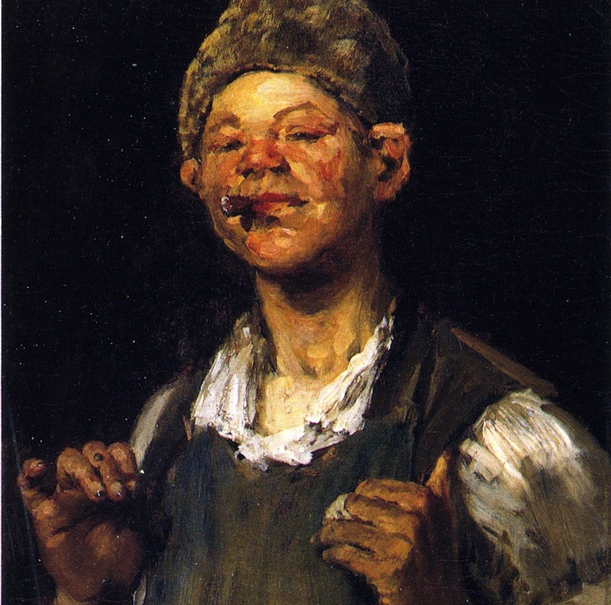
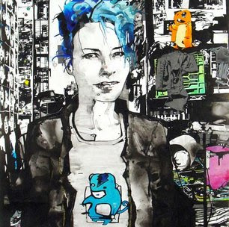
Opportunity, Safety Nets, and Self-Worth in the Neoliberal Era
Pathways to Adulthood
Jennifer M. Silva
Sociology & Anthropology
Bucknell University

Slide 2
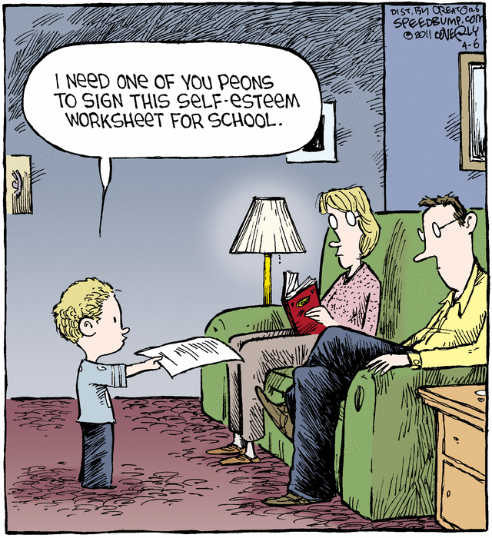
Millennial Characteristics…
Traditional markers of adulthood have become delayed, disorderly, reversible, or even foregone
Delayed adulthood reflects increased opportunity for self-exploration and self-focus
Millennials are too self-absorbed and entitled to “grow up”

Slide 3
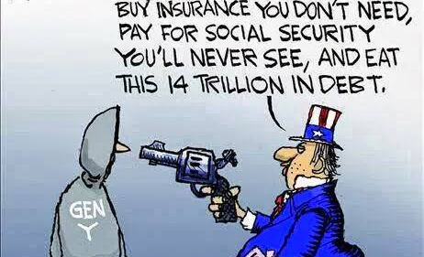
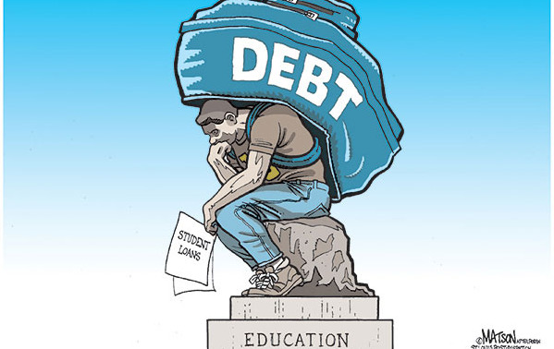
… In Context
Disappearing jobs
Fragile families
Shrinking social supports and social safety nets
Privatized risk
Falling trust in institutions
Cultural logic of self-reliance

Slide 4
Research Questions
How do working class men and women construct what it means to become an adult in contemporary America?
How do economic and social instability shape working-class young people’s adult selves, their understanding of the American Dream, and their futures?
How do they explain their failures to enter middle class America, and how do they console themselves for such failings?

Slide 5
Methods
100 in-depth, semi-structured interviews with men and women from working-class families. “Working class” defined as parents without college degrees.
Sample was 60% white, 40% black, and split evenly by gender.
Median age = 27 years.
Recruited at gas stations, casual dining restaurants, coffee shops, fast food chains, retail chains, daycares, temporary agencies, community and regional colleges, military training sites, and police and fire stations.
120 additional interviews across the US with middle and upper class young adults

Slide 6
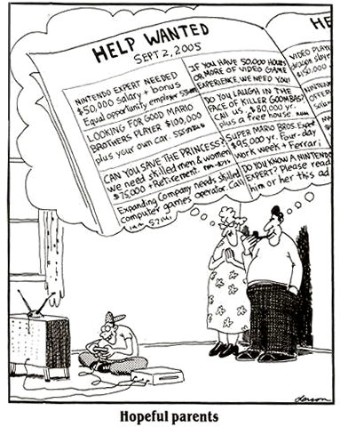
The Impossibility of Tradition
Working-class Millennials bounce from one unstable job to the next, relying on credit cards to pay their monthly bills.
They lack the tools and knowledge to invest in their futures.
Shocks such as injury or sickness often set them back on the road to adulthood, even when they try to get ahead.

Slide 7
I won’t grow up…or I can’t?
“I am looking for a new place. I don’t have a job. My car is broken. It’s like, what exactly can you do when your car is broken and you have no job, no real source of income, and you are making four or five hundred dollars a month in [military] drills. Where are you going to live, get your car fixed, on five hundred a month? I can’t save making five hundred bucks a month. That just covers my bills. I have no savings to put down first and last on an apartment, no car to get a job. I find myself being like, oh what the hell? Can’t it just be over? Can’t I just go to Iraq right now? Send me two weeks ago so I got a paycheck already!”

Slide 8
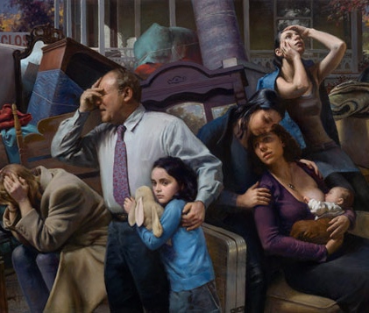
Betrayal and Distrust
Difficulty navigating the institutions that determine their future trajectories.
Report being betrayed by higher education, the military, the legal system, the housing market, foster care, and health care system.
This is in sharp contrast to the privatized social safety nets and guidance of the middle class

Slide 9
“Cheated” by Education
I knew I was smart and that I wasn’t a straight C student, yet all my teachers, you know we had thirty kids in the class, and the teachers were just too busy…unless you were destructive, you really didn’t get attention. I guess knowing, once I knew that I had ADHD, knowing if somebody had seen it in me earlier, I could have gotten so much further. Now I am medicated, which makes a world of difference. It is just bad. If somebody had just known…sometimes I feel cheated out of life, I could have been in college by now. I could have had a real live career that is not just a cook. That sounds terrible.

Slide 10
Middle-Class Pathways
Middle-class parents mobilize a vast array of economic, social, and cultural resources to launch their children into adulthood
They rely on private safety nets to manage risks

Slide 11
Self-Reliance as Self-Worth
“I have a buddy of mine who has something called spina bifida. And his parents have brought him up babying him, giving him everything he wanted, and everything else. Then I have a buddy who only has one leg. This other guy’s parents [his friend who only has one leg], they said, you only got one leg, deal with it. We’re not going to baby you. Which I think is the right way to do it. Because there’s nobody in this world that’s gonna baby you. When you get out from under the wing of mommy and daddy, the government doesn’t care if you’re disabled. They’re gonna tax you just like everybody else. You gotta make a living. Be it however little you can make or whatever.”

Slide 12
Neoliberal Selfhood
Naming structural barriers to achievement are interpreted as a “crutch.”
Self-reliance becomes a sign of moral worth.
Working-class youth reject institutions and embrace isolation as the only way to survive.

