Slide 1
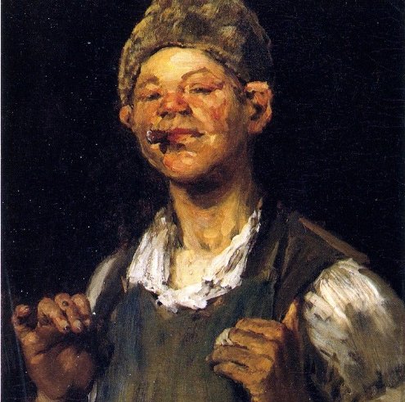
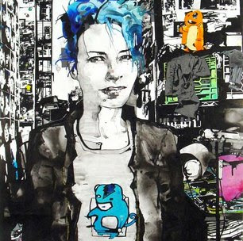
Millennials Rising?
Class, Solidarity, and Politics in the Wake of the Great Recession
Growing Up and Global Austerity
UCL Institute of Education
June 27, 2016
Jennifer M. Silva
Assistant Professor of Sociology
Bucknell University

Slide 2
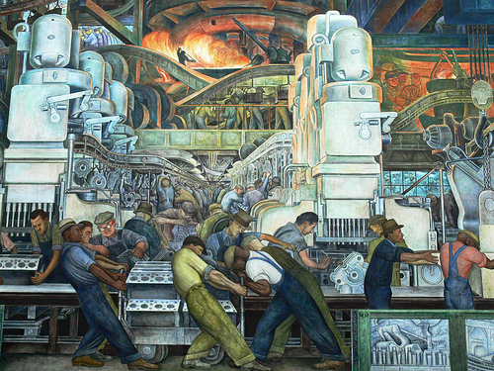
Change and Continuity in Working-Class American Life
Economic dislocation
Increasing social isolation and distrust
Gender and family transformation
Political shift toward the Right since the 1960s

Slide 3
Research Questions
Will working-class young Americans create new loyalties and dissolve older attachments in the wake of the Great Recession?
How might a working class that is no longer white or male forge solidarity across lines of race and gender?
If young adults are “fed up” (Pilkington and Polluck 2015) with traditional politics, what might new forms of civic engagement look like?

Slide 4
Data and Methods
In-depth interviews with white, black, and Hispanic young adults (18-34) and their parents
Ethnographic observation of practices – family dinners, church services, drug addiction support groups, volunteer fire company shifts, local sporting events
Situate intergenerational life histories within the context of life as a whole

Slide 5
Pain, Prison, and Politics
Environmental concerns about regulation of fossil fuels
Heroin epidemic
Rural health crisis
Racial and ethnic flux
Rural prison boom as “economic salvation”

Slide 6
“Big money runs this country. They will serve whoever is in their pocket. You want change? Get rid of every elected official. Get rid of this politician for life bullshit and start fresh. Republican or Democrat, two heads on the same body. We have a bunch of rich old people who do nothing half the year making decisions for everyone and if you think they'll take less so you can have more then you're plainly ignorant. They keep us bickering amongst ourselves while they live above the law. If any of us did the things they did we would be sitting in prison.”

Slide 7
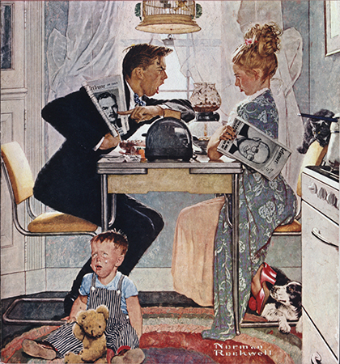
The Politics of Family Life
Young adults draw upon their own narratives of family betrayals and disappointments as a tentative bridge to politics at the national level.
Abstract ideals about inclusion translate into strong moral boundaries against family members who are not self-reliant.

Slide 8
Abstract Ideals
Melissa (daughter): They [refugees] should be able to come here and find safety and they shouldn’t have to be dealing with like… they are victims of ISIS right now…
Lynne Marie (mother): But I said we have to worry about our own Americans. You know we can’t save the world and we’ve got to realize that we can’t save the world so we need to save us true Americans.
Melissa: And I’m saying that we’re all one world and we should all be together.
Lynne Marie: Wouldn’t that be great. Everyone wants world peace.

Slide 9
Concrete Boundaries
“Yeah and it’s like almost…when he was younger and when school ended he would still have a teacher come to the house so he didn’t revert back and forget things. I sorta think that’s what’s happening now is, he just seems so confused with a lot of stuff and I don’t know if it’s because all those years he had like a crutch and now he’s just on his own. You know in a sense I thought it was good thing but now I think it made it worse.”

Slide 10
“Yeah. I mean Katie she’s 20 now she doesn’t have anything for herself. She has no vehicle no education no job no money no nothing but she’s made her decisions and … We’ve tried to help her. My whole family has tried to help her. I mean we all went through the same divorce…it was tough on everyone…we all went to counseling, just Katie took it differently. She had different means of handling it and expressing her feelings about it and got in with the wrong group of people and got into what she got into. You just can’t help someone who doesn’t want to be helped. If you want something bad enough you work for it”

Slide 11
Thank You

Slide 13
Images
Chase, W. M. (1875). The Leader [image]. Retrieved from http://www.the-athenaeum.org/art/full.php?ID=46581
Smith, Z. (2003). Varrick in a Shirt I Made That has a Monkey [image]. Retrieved from http://www.artnet.com/magazine/features/honigman/honigman6-7-3.asp
Rivera, D.M. (1932-1933). Detroit Industry [image]. Retrieved from http://lbpost.com/life/arts-culture/2000002661-molaa-event-to-focus-on-detroit-s-creditor-art-specifically-rivera-murals
Rockwell, N. (1948). Breakfast Table Political Argument [image]. Retrieved from http://www.nrm.org/2016/01/28545/

