Slide 1
Cultural estrangement, ‘expulsions’ and the re-making of youth cultures in the securitized state: a South African and UK comparison
low-income, ethnically marginalized young people’s and longstanding community members’ understandings of increasing surveillance, security anxiety and new policing practices (e.g. new privatized surveillance technology in townships, police infiltration of youth communities, surveillance discourses (e.g., UK CCTV operatives));
young peoples’ perceptions and responses to urban security and militarization across time against those of police officers and associated ‘security’ professionals and community members (e.g. social workers, legal experts, security officials, private security officers);
how security concerns about young people and associated surveillance mechanisms have developed in relation to highly mobile transnational anxieties associated with youth, ‘terrorism’ and violence and its impact on subcultures;
differential nature and national characteristics of ‘security anxiety’ as compared to young people’s political sentiments, forms of estrangement or structured emotions in a cross-national setting
Security anxiety can defined as both individual and collective public fears about personal and national security associated with perceived threats to the nation or globe (Newman, 2006, 2011).

Slide 2
Building the Ethnographic Case: Contained Young Lives, Intergenerational Conflict and the Power of History/Memory
*examine how the embodiment of racial conflict and urban change are expressed through young people’s political narratives and popular discourses (EDL), and symbolically through insignias and other forms of embodiment.
*examine variations of this historically/temporally, particularly in relation to securitization and surveillance
[History as a conjectural moment and as extended narrative across generations, Ricoeur on culture as a representation of temporality which is stretched and not fixed]
Ricouerian notion of the narrative imagination striving toward utopian view yet being pulled back into dystopian life worlds
History and memory as important resources for understanding ourselves in time, and time in ourselves, as well as surveillance and just policing
‘The two ways of making history are always inextricably linked, with the latter ceaselessly striving, through interpretation, to complete the meaning of the actions of the former. History remains the event of the past just as it is also the event of interpreting that self-same past – by way of that surplus meaning which is always generated by the actions and utterances of historical actors – in the present.’ Gardner (2010)

Slide 3
Methods
Ethnographic Approach
Historical, Spatial, National, Global
Archeology and the Archive: Historical/Spatial Optic
Records, Maps of the City, Police Documents, Youth Activist Pamphlets, colonial accounts of the city
Oral Histories of what it was like to be young and securitized
Contemporay Cultural Optic
Cultural Mapping of Populist youth communities: Social Media Movements
EDL, EEF, photographic documentation, visual representations
Interviews, Focused Groups, Visual Methods (e.g, Photo narratives, time-lines, self portraits, images of citizenship, walking ethnographies (see Ingold)

Slide 4
Background & Context
UK Context
Right wing youth populist movements have been a enduring feature of the 20th century in many nation-states
European facist histories associated WWI and WW2, White Defense League, British National Party, Union Movement.Mossly, EDL, youth subcultural groups against immigration and otherness (Teddy Boys), National Front, UKIP
South African Context
both far right and left wing youth movements (not necessarily always populist as more dificcult to characterize), youth ANC, young SWAPO, Young PAC, Youth Communist League, Black Consciouness Youth Movement, EEF
Complex imperial histories associated with displacement, ’land grab’ as land dispossion, ’white settler societies’, expanionist projects extending from the ’Global North’ concerned with capital accumulation

Slide 5
Case Study Site 1: Mapping Popular Sentiments in their Contested Forms in the UK
Political Affect, Embodied Culture
Popular Aesthetic Practices
Populism and Embodied Affect
English Defense League
Economic Freedom Fighters
Spatial Divisions/Defensible Spaces
Spaces of Belonging
Rappers, Activist Responses, Protests
Sanitized Places
Securitized Places

Slide 6
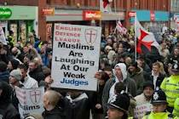
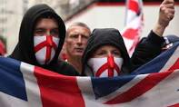

Mapping Contexts/UK Case: Popular and Populist
Political Sentiments, Spatial Injustices and Young People: Symbolic Violence and the Art of Refusal
Darcus Howe versus Edwina Currie

Slide 7
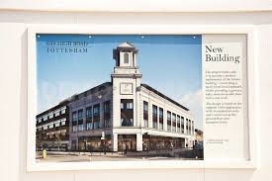
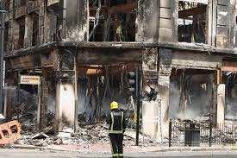
Ethnography Meets Theory:
Bordering Ourselves, Bordering Others in Divided Cities

Slide 8
Theoretical Ideas
Border and Critical Security Studies
Bordering, Security Anxiety, Cultural Practice of Bordering as intensified yet localized practice of imperialist/sometimes inherited facist practice – ‘seeing like a border’- patrol and self surveillance, humans as border patrol inside race relations
Critical Race Studies and Human Geography
race relations can be seen as a cultural production in the making, a material formation and highly intense emotions about race and identity in the city.
interface between racial anxiety and nationhood provides some context for better understanding the reconfiguration of race relations and social conflict as they emerge on the ground
Reorganizations of cities according to dispersal, expulsion or top down urban planning (multinationals) so race relations are recast in new ways but still premised on dispersal or expulsive political practices (e,g. group area act)

Slide 9
Phenomenology and Urban Imagineries
Phenomenologies of Urban Meaning: Spatial Imaginaries, Identity Violence and the Sacrificial Stranger
  explore the spatialized and divided ways in which disadvantaged young people conceptualize and narrate concepts of the border, the foreigner or sacrificial stranger, as Richard Kearney (1998) puts it. As Kearney suggests, the ‘sacrificial stranger’ stands as a social and historical representation of people’s experiences of the ‘exteriority of otherness’. This otherness implies, in everyday practice, that those who we imagine may threaten our collective identity must be deemed strangers. However, if we are to think in terms of a much larger sense of spatial justice this practice of othering represents a demonization of alterity; that is, it undermines our ability both individually and collectively to recognize difference as a legitimate frame of reference for our own sense of being and legitimacy in particular times and places (see Levinas, 1977).

Slide 10
Surveillance, Space and Defenses
Not enough to simply imagine a Foucauldian notion of surveillance in relation to the MK freedom fighters and young people
Value of history and memory in understanding how surveillance was understood, ‘interpreted’ and acted upon across time and space
A hermeneutics/anthropology of surveillance and security in the present but divisions inherited from past time/narratives
Torture and infiltration inscribes surveillance onto the body and the self, a self that is constantly observed and punished (nation, torture, culture, embodiment)
to make sense of an event from a now absent past yet projecting a dual reference, taking as their simultaneous referents the there and then of the past, and also the here and now of the present
Where does wounded memory meet just memory and how can studying the enactment and responses to surveillance assist in this project?

Slide 11
Methods: South African Case
HISTORICAL
Archival Analysis: Youth and Surveillance on a temporal scale
Oral Histories with MK freedom Fighters (militarized wing of the ANC)
National
Representational Analysis of Photos, documents, police files, journaistic accounts, maps, government files (key eras, critical incidents)
Interviews: Young People living in associated townships and settlements, youth activiists (Rhodes Must Fall, EEF)
Spatial, Contemporary

Slide 12
Methodology: Reading and interpreting the subtextual accounts of youth populism as political messaging
  Levels of Analysis: Social Media, Journalistic Accounts, Visual Representations
  Website (discourses, representations, political messages)
  Facebook
  Twitter
  *one year comparative analysis of convergences and divergences in relation to political strategies, aims and purposes of political engagement
  *preliminary discourse analysis with a contextual lens

Slide 13
Mapping Ethnographic Affect: Move 1
Mapping Populist Discourses on Race, Borders, Security, and Nation
Digital Optics: Social Media and English Defense League
In what ways are youth populist movements grounded in discourses of security and nationhood? Or are they?
If this is so, why might it be so?
How does the language of security and surveillance shape the nature of these movements and their associated political strategies?
What part does race, space, nation and migration play in these strategies, political narratives and accounts of state legitimacy?

Slide 14
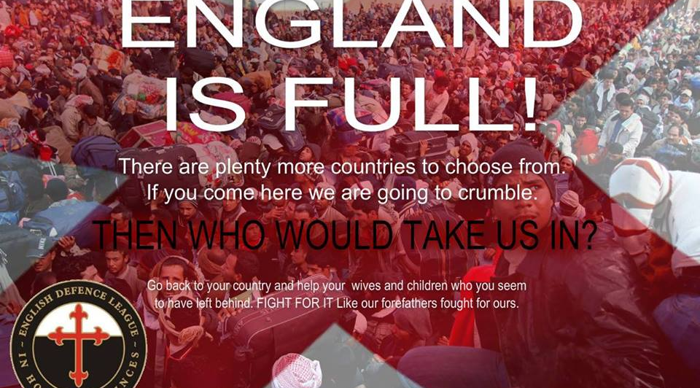
Facebook Feeds: EDL website

Slide 15
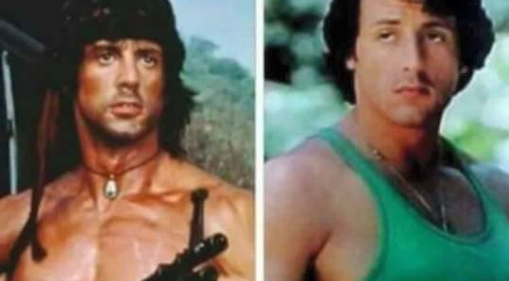

Slide 16
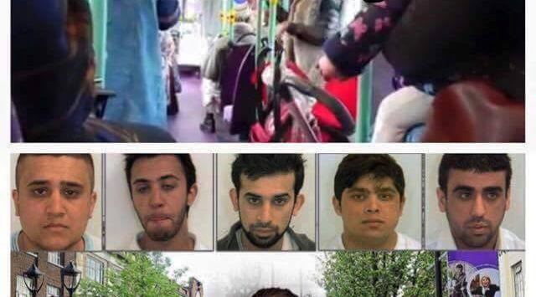

Slide 17
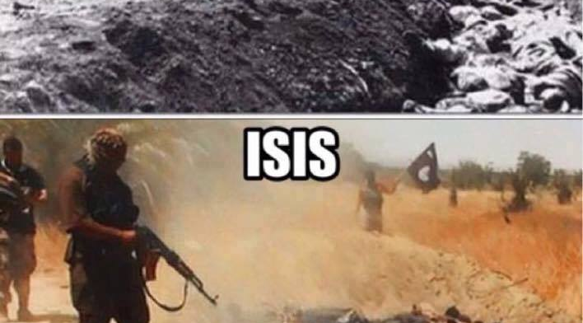

Slide 18
Preliminary Findings - EDL
*Predominant focus on Islam, anti-immigration and perceived threat to national security (UK security, and collective security)
*Anxieties associated with displaced, lost citizenship and border controls (’seeing like a border’)
*cultural noise responding to feelings of loss and insignificance in the changing cultural landscape of the UK and the EU
*Subcultural politics reinvented through the sub-text of neo-facist and neo-colonial conceptions of citizenship
’United we stand against Islam’, romanticitization of the British Forces

Slide 19
Preliminary Findings - EFF
*politically motivated strategies for national transformation
*historically inherited commitment to a Marxist Fanonion political ideology
*’anti-capitalist’ (’white monopoly capital’) narrative associated with land dispossession (’workers must have share in companies’, ’self hating mass murderers, party of comprador bourgoise’
  *anti-racist: ’Rhodes must fall’, ’oh she behaves like a madam’ as a representation of white elite colonialism
  *anti-corruption
  *more unified messaging across platforms yet still militarized in style and form (’war council’, ’we send revolutionary condolesences’, red beret, militarized clothing, singing, mass movement and following, Commander in Chief, Central Command Team )

Slide 20
Masculinization of Space and Nation
Militarization and Border Control
Reimagining ‘Multicultural’ Britain
Securitization and Protection

Slide 21
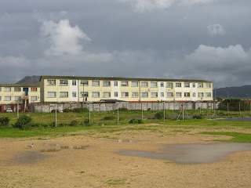
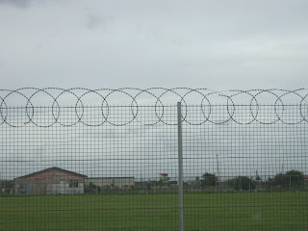
Case Study Site 2: South Africa
Cape Flats
Cape town suburbs, ‘coloured’ majority (largest Muslim suburban population in South Africa)
Highest gun crime, unregulated township settlements
Close links with private security and police
Police paid extra to parol LH
Dispersals of District 6

Slide 22
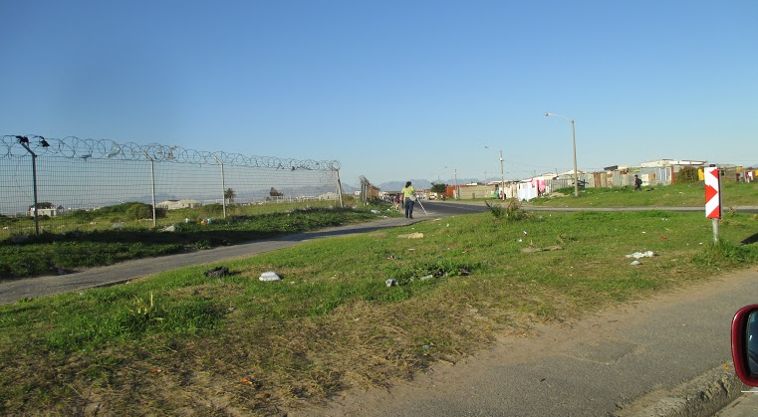
Cape Flats

Slide 23
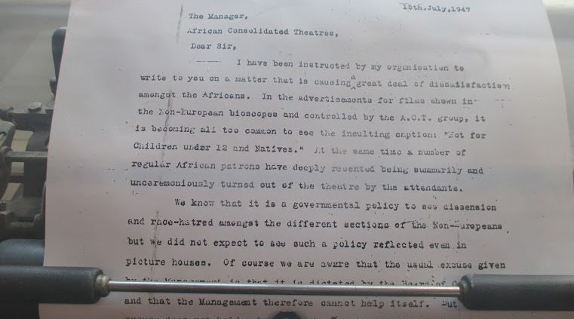

Slide 24
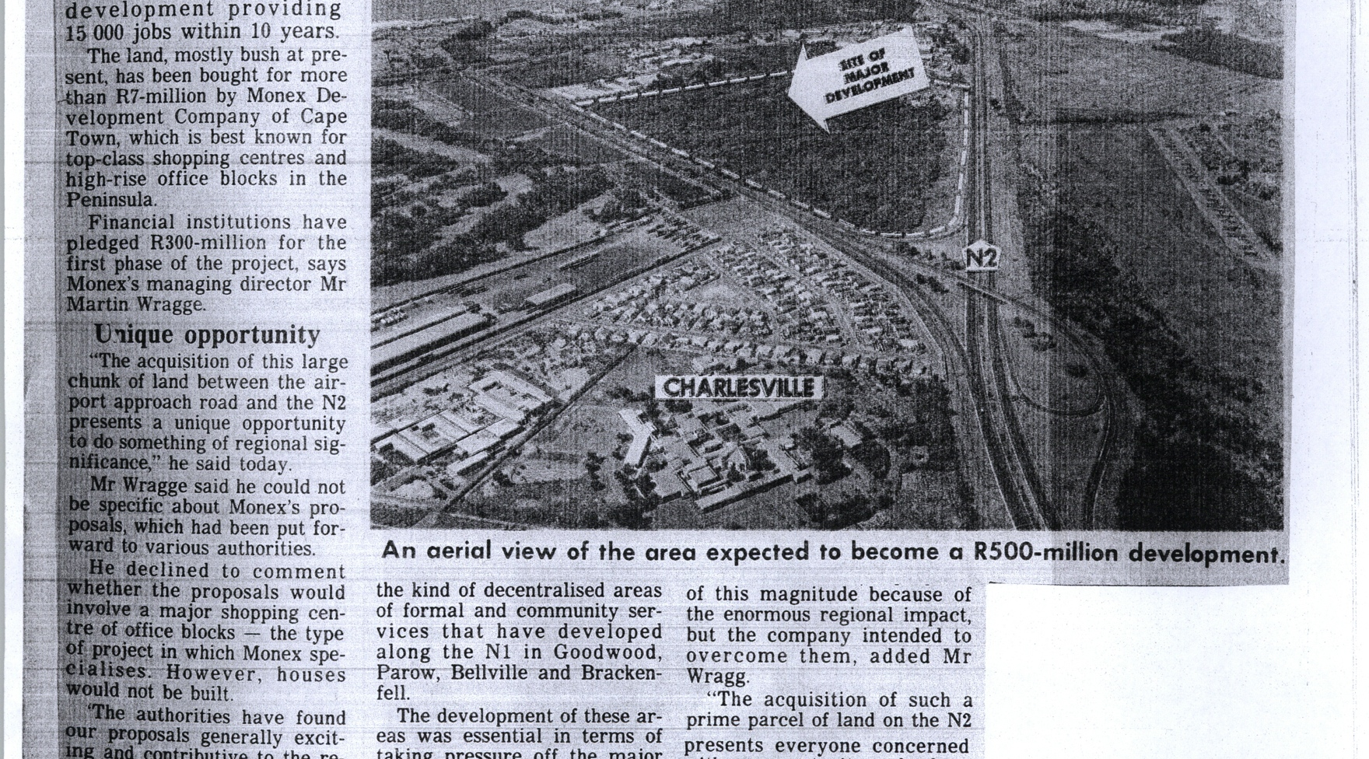
Changing nature of Surveillance, Expulsion and Dispersed Youth

Slide 25
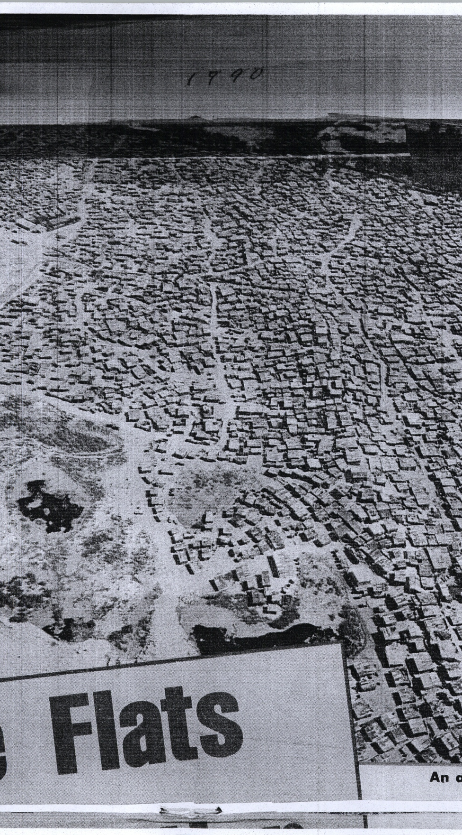

Slide 26
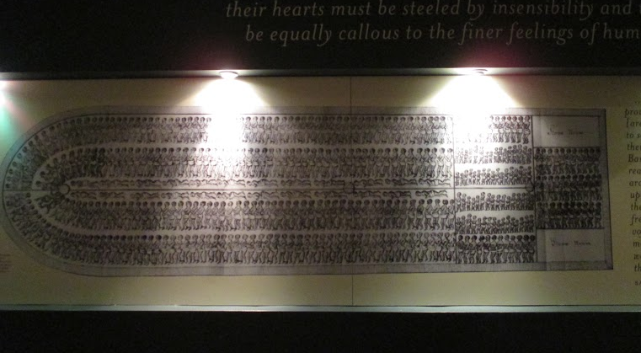
Image of Enslavement and Movement to the Cape Horn

Slide 27
Normalizing Violence and Expulsion: Youth accounts of Confinement and Containment
Spatializing the Gangster metaphor as dividing practice in schools and townships
R: Are you scared in the townships or at school? Thabo: I have family members who are in the gangs..I know a lot of people so I am not afraid..I walk alone to school and take a different route because if I walk with the group I’ll be seen as one…they live on one side of the township and I live on the other…I stay on my road..I stay in and stay away..in my own road not a lot of people are finishing school..and they follow your footsteps. School territories influenced by where people live. They get control of the territory
Mawani: in Manneberg there are wanna be gangster and if you want to be a gangster you must do what they do….the dangerous areas are Bonteheuwel, the Clubs in Cape town…I see the gangsters’ faces and I avoid them and in the school there is lots and lots of fighting, stabbing. I can’t go anywhere. I’m used to staying in. I don’t go out.
Sinbabi: You get forced into fights..its normal, its part of life, its mostly boys..some people say I look like a gangster. They live on one side but try to control the whole township so we have to stay away and stay inside.
Ellouise: my daddy was shot by a gang member…I feel scared about being shot, safest place is at home but its not right for us to be involved but there is nothing for us to do in the townships now to support activities..its all just faded away…and seriously when I see certain people I feel scared..On Sunday night my uncle – he is not in a gang – and he got stabbed..they were trying to have fun…basically they are kids…children with an evil mind..they have no limits..then in July 2913, shots were fired into the the school..I was traumatized, trauma centre helped us though.

Slide 28
Policing Entanglements and Non-Action
Thabo: Police are in on it, there is no use for the police, like they are organizing
Gangs get guns from the police and don’t do anything
You can still get stabbed if a police officer is here..trying to watch in a group
Its mostly the boys that are searched and their families are gangsters
Tamade: I was being watched and got smacked by the police officer…It was Marajuana…they surprised me and they smacked me..the second time they tried to take my phone off me…we had a collision and we started fighting
Mawani: I don’t think they do anything. I’ve been stopped and searched for marajuana…They are watching but not doing anything

Slide 29
Descriptive Thematic Analysis: Preliminary Glance
Apartheid, Surveillance and Youth Marginalization
white people, you were starting to confront the reality that there were (inaudible whites and division. It was not comprehensible.
I: And the PAC helped you to understand that.
S: To understand that, yes.
I: Did it cause conflict with where you had been? Because you had been in the ANC in the military wing and now you were having a different ..S: Yes, it had caused the conflict because when I came to Cape Town again in late 1986, after I received a letter from my school Principal at Tala, a letter that was signed by the police and so that I must never return to the school, so my father brought me from Queenstown to here to Cape Town. I: Did you go to school then when you got here? S: When I got in here the whole of 1986 I was at home. Then I started school in 1987 again.
S: So in 1987 I was actively involved in politics as well. Whereas the system at that time created the gangster (regime) system whereby they were fighting against each other. Even at school there were school gangsters. So the politics changed automatically. I: Right, so the situation also changed for you in terms of what you were doing and what you were fighting for? S: What I was doing in Eastern Cape, yes and what I was fighting for. I: Tell me a bit about the gangster politics. S: The gangster politics you know, when I was at Yala East at that time whereby there were groups which were created by the apartheid system. I: Apartheid played a big role in creating them? S: A big role, a big role to create those gangster activities. So in Yale East it was a group of (unclear [00:01:57.14] - lists different groups). There were all sorts of gangsters. I: And you were a teenager still, 18? 17?
S: 17 at that time. So I was forced to fall into this group of gangs because I didn't want to save myself per se, but for my safety because you had to be, you had to belong to a group of gangsters in order to be safe.
I

Slide 30
Security, Spatial Divisions, ‘Divide and Rule’
We were on the borders of Lesotho and then apparently a few of us survived to cross to Lesotho and they managed to get to our camps which were on Lesotho, but my group couldn't make it, we were arrested by the intelligence of Lesotho. I: When was that?S: That was 1988.
S: We were arrested in Lesotho and we were kept in Lesotho 1988 to early 1989, we were brought back to South Africa. And we were kept in Pollsmore and we were being treated like criminals by the apartheid system. After all we were, like I was from Cape Town, other guys were from Eschell, other guys were from Lady-Frere, Galla, Cofimbava, so we were sent according to our addresses by the system. I: Mm. Things were changing though, the political climate was starting to shift, huh?S: Yes, yes.
I: So when you were sentenced, did you serve a long period?
S: We served about two years, and then we were under house arrest.
I: After that? S: Yes. I was living with my parents in Kaleja, because Kaleja came about 1985, and in 1988 apparently after I have left, after I have skipped the country my parents move to Kaleja.
S: So I did find my parents that are living in Kaleja.
I: So when you were under house arrest, was that the last time you were arrested?
S: Yes it was my last time, but it continued because I was under the state of emergency. Whenever there is ANC or any political movement march against the apartheid system, they will come and collect me at home and I will be kept behind bars and will be released the following day. I: Yes I understand, they were heavily monitoring you.
S: They were heavily monitoring me, and the problem, the huge problem I was facing in sitting with - I was less educated, I didn't have a job, my parents were just peasants. My mother was working in the kitchen and my father

Slide 31
S: So I was looking after my uncle's and grandparents' livestock, so I was a shepherd. So the environment at that time, it was not conducive for politics, especially in Transkei. Transkei was under the rule of the late (Kaiser Matanzima [00:05:36.15]). You'll remember if you know the history of South Africa very well, that the white system - sorry to put it that way but I have to.
I: Please don't, you have to. That's what I'm asking. I'm not aligning with the white practice.
S: Yah, I don't think you (inaudible [00:05:58.16]) white, yes.
S: The white rule of that time made it possible that they rule and divide our people. They divided the so-called 'South Africa' into different areas. The capital town or the capital city of South Africa at that time, it was Pretoria. There was Transkei which is, I mean there was (inaudible, sounds like Tibu [00:06:23.09]) states. Tibu state it was Transkei, Bophuthatswana, Vend, Ciskei. So Transkei was under the rule of Kaiser Matanzima, Ciskei was under the rule of Sebe, Bophusthatswana was under the rule of Mangope, Venda was under the rule of Mphephu if I'm not mistaken. So in Transkei there was a so-called state of emergency at that particular years of the 80s whereby there were no politics allowed. So as a young person, and I was still at a primary led err, no, (originally) 11 at that time [00:07:18.21]. Um, my teacher, also from Queenstown ..
I: Even in that place you were in?
S: The place where I was.
I: They'd come from Queenstown to work there?

Slide 32
S: Yes. You know at that time, teachers were.. Like today, if you have a degree in teaching then you will be looking for a post and if you get a post and the post is in Hauteng, if you need a job you will go. It was like that. S: So this teacher of mine, his surname was (Chukose [00:08:05.13]). He was a big [activist] in the ANC things.
I: The teacher that you had at primary school was politically motivated?
S: Yes he was political motivated. So when we met we immediately clicked because I was from Queenstown so I was like a homeboy to him, you know?
S: So as I was sitting listening to his conversation, especially when he was teaching us history, he was reminding me a lot of my father, and because my father was politically involved and he used to tell us of many things. Like for instance he used to tell me about his father. My father lost his father in 1960 during the Past law campaign which was led by Robert Mangaliso Sobukwe of the PAC.
I: Uh huh, the Pan African ?S: Yes the Pan African Congress of (inaudible [00:09:01.10]) that was 1960. So the campaign took place in Sharpeville and at Langa.
I: Sharpeville, I know that. S: Yes, where many South Africans through the Anti-Pass laws were killed and murdered by the system.
I: It was a big event, I guess your Grandfather was killed in one of those?S: Yes.I: Which one, was it Sharpeville?
S: Which they? I: Which place? Was it Sharpeville? S: Sharpeville. Sharpeville event yes, and Langa near Cape Town.

Slide 33
Conclusions
Expulsion and Dispersal politics in both UK and SA premised on the idea of the sacrifical stranger which represents a violation of colonial traces which live on subjectively across the classes in both countries
Militarization and securitization as forever and embodied across time and geopolitical contexts and are linked to education, resources and economic constraints
Simple argument about racism cannot provide the kind of explanatory power needed to address the diverse conjectural developments of each historical period (eugenics, facism, class, conflict, masculinity, and their embodiment)
Theoretical innovations and multi-layered histories of memory and counter memory are crucial to the retelling of these accounts of social division inherited through colonial memories. Here memories must be seen as political as in ever case actors are engaging with memory to protect their ‘rights’ to the nation

Slide 34
