Slide 1
Demand rationalities in contexts of poverty. Do the poor respond to market and policy incentives in the same way?
Xavier Bonal, GEPS-UAB
LLAKES Seminar
UCL Institute of Education, 8th December 2016

Slide 2
The growth of demand-side interventions in global education policy
Education policies to tackle poverty (second generation educational reforms, CCTs or in-kind transfers)
ePPPs: voucher systems and other policies to boost choice.
Scholarships, student loans.
Notes:
1. En los últimas décadas estamos asistiendo a procesos de globalización de políticas. Por medio de diversos mecanismos, ahora no analizaremos, se globalizan objetivos y procesos políticos (SDGs, BM, OCDE, etc…). Ejemplo de políticas educativas globales: vouchers, CCTs, etc… Si se observa el numero de programas de transferencia de renta condicionada, el incremento es brutal (comienzan en AL y se extienden a Africa y Asia). El policy travelling alcanza incluso zonas del norte (NY). Lo mismo puede decirse de los programas de voucher educativo, especialmente enfocado para aumentar la capacidad de elección escolar de los sectores más pobres (Pakistan, Filipinas, Chile por supuesto,…). Hay varios actores en estos procesos de globalización: BM, OCDE, Pearson…

Slide 3
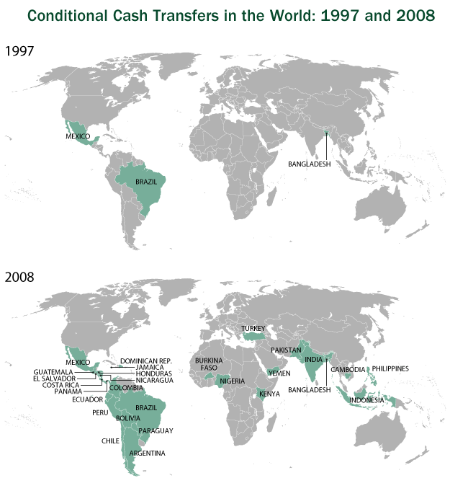

Slide 4
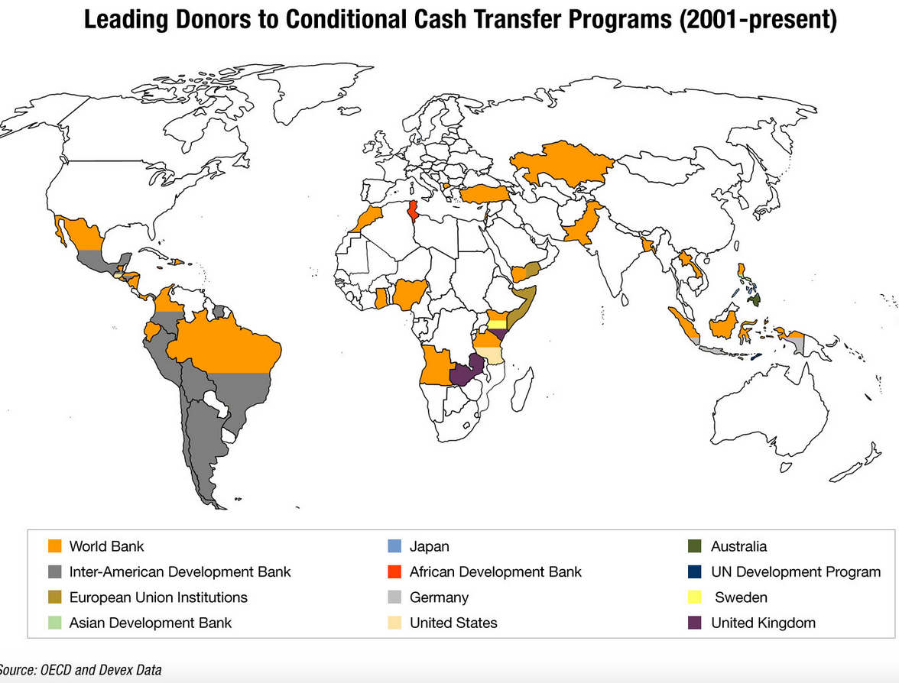

Slide 5
Assumed virtues of demand-side interventions
The limits of classical educational reform
Bypassing the inefficient (and sometimes corrupt) State.
Usually cheaper than supply-side interventions (e.g. cost of CCT in Brazil)
Activating and empowering the poor
Efficiency and equity gains
Notes:
Usually cheaper than supply-side interventions (e.g. cost of CCT in Brazil): Money is only spent if demand reacts (ccts or similar…). Otherwise there is no cost. This doesn’t happen in supply side interventions.
Efficiency and equity gains: Equity in italics since the discourse stresses especially gains associated to the higher capacity to choose for the poor. However, there is no any proof.

Slide 6
Rationality of the actor
What do these agents and policies share? A common understanding of agents’ rationality.
Utility maximizers (costs and benefits)
Single rationality
Actors’ capacity of access to information
Actors’ oriented by the same values
Notes:
Qué es lo que tienen en común estas políticas? Lo que me interesa reflexionar hoy aquí tiene que ver con el tipo de racionalidad que asumen estas políticas. Mi tesis es que la racionalidad que se asume en el diseño, aplicación y evaluación de estas políticas, es una racionalidad instrumental (basada en la capacidad del agente de tomar decisiones en base a cálculos coste/beneficio). La eficacia de estas políticas se presume a partir de una racionalidad instrumental. Cálculo a partir de utilidades únicas, de costes i beneficios. Y se asume esta racionalidad como única (no se contemplan otras racionalidades). La paradoja es que estas políticas, la mayoría dirigidas a los pobres, asumen racionalidad instrumental de clase media blanca.

Slide 7
Instrumental rationality and theory of change in demand side interventions
The voucher makes educational demand to concentrate on good schools, so bad schools will close…
but so many bad schools don’t close.
A school fee is feasible provided that the benefits of investing in education outweigh the costs…
but fees do have an impact on access.
A conditional cash transfer will offset the opportunity costs associated with child labor…
but child labour remains even for beneficiaries of CCTs
Public information on schools’ educational performance will guide school choice…
but many families do not choose school based on performance
Notes:
La racionalidad instrumental está presente en lo que podemos considerar la ‘teoría del cambio’ o la ontología de los programas:
Gracias al voucher la demanda educativa se concentrará en la buenas escuelas y las malas escuelas desaparecerán.
El copago educativo es viable siempre que los beneficios de la inversión superen a los costes
Una transferencia de renta condicionada compensará los costes de oportunidad asociados al trabajo infantil
La información sobre resultados educativos de las escuelas orientará las elecciones escolares.
[Paradoja de la condicionalidad instrumental implícita en estas medidas y políticas, puesto que algunas intervenciones pueden ser casi contradictorias: desde el punto de vista de la racionalidad del actor: la condicionalidad en realidad supone aumir un posible comportamiento no racional del actor, puesto que si los beneficios son superiores a los costes se invertiría en educación de todos modos]
Cuando uno observa la realidad observa que las escuelas malas raramente cierran/que el co-pago supone abandono/que los beneficiarios de CCTs siguen con el trabajo infantil o que los sistemas de información son irrelevantes –en muchos entornos- para la elección de escuela. …

Slide 8
Do these policies work?
Advocates of these policies assure they work even in most of the cases there is mixed evidence and non-conclusive evidence at all.
NO EXCUSES!!!
It is assumed that they work in general terms. The missing question: for whom and under which circumstances these policies work?
The consequences of policy making as if...➔ The effects of non-questioning instrumental rationality (correcting policy imperfections).
Notes:
Sin embargo, nos movemos en un terreno en el que se asegura que estas políticas funcionan. Por qué se puede decir?
Porque hay cierta evidencia,
Porque se mira en términos generales… y en ningún caso se responde a for whom…para quien funcionan…
Lo peor es que a menudo, las decisiones políticas se toman como si… los actores fueran racionales instrumentalmente. La lógica de corregir las imperfecciones de la política pueden pasar por las correcciones parciales (algo la teoria del second best ya desmiente).
Así, si el CCT no consigue eliminar el trabajo infantil quizá se sube la transferencia / si la demanda se mantiene en ciertas escuelas ‘malas’ quizá debe aumentarse la información / si el sistema no absorbe a los alumnos ‘especiales’ genero otro incentivo para que las escuelas absorban a estos alumnos…

Slide 9
Which rationality of the poor?
Notes:
Pregunta genuina entonces… si no todas las racionalidades son iguales ante la política, cómo interpretar la racionalidad de los pobres en su toma de decisiones?
Pueden ser eficaces las políticas si se consideran los agentes con una unica racionalidad?
Pueden ser eficaces las políticas si se considera a todos los pobres por igual? Puede, debe atenderse a su diversidad? Desde qué dimensiones?
Veamos rápidamente cómo se comportan los pobres ante el mercado educativo.

Slide 10
“Listen honey, if you want to see how people spend their money on things they don't need, and don't know much about what they are getting, and buy it even so without thinking ahead, you'd better go study rich folks. If I wasted money like that, I'd be dead”
(an ADC mother of eight, personal communication). (Newton, 1977, p. 50)
Notes:
Debates on rationality of agents, and particularly, on the rationality of the poor, have been at the centre of disciplines such as economics, philosophy, sociology or psychology for a long time. Interestingly, positions have evolved from a simple understanding of the irrational behaviour of the poor, which behaves far from the neoclassical homo economicus, to a recognition that poor’s behaviour might be explained by the specific circumstances under which they live. Highly significant appeared to be Schultz’s expression of ‘poor but efficient’ (Schultz, 1964).
‘Poor but neoclassical’, Esther Duflo.
“a new paradigm ‘poor but neoclassical’, helped define an empirical agenda and structure a vision of the world, even though it often remained implicit in empirical work. While the poor (and the rich) are all perfectly rational, the markets, left to themselves, may not produce an efficient outcome”
However, other interpretative alternatives give us tools to understand why the poor might behave (and respond to incentives) differently than other sectors of society

Slide 11
Criticisms to instrumental rationality
Deficit theory approach:
Insufficient skills to interpret information.
“Disconnected” parents
Bounded rationality:
Economic and social conditions are key to understand responses to incentives.
Boundaries produce a different rationality
“The poor act as poor and the rich act as rich” (Duflo, 2006)
Social class habitus:
Rationalities depend on the class position ➔ Dispositions
Limits but also preferences emanating from class habitus
Different dispositions depending on the position in the field
Notes:
Por supuesto, lo dicho hasta aquí sirve para un contexto extremo de elección racional. Pero llama la atención hasta qué punto las teorías del cambio siguen basándose en la racionalidad instrumental de los actores… En realidad, desde la economía, la filosofía política o la sociología nos encontramos con aproximaciones alternativas a la racionalidad instrumental.
Veamos 3 grandes aproximaciones:
1) La idea de teoría del déficit (información asimétrica entre principal y agente / o falta de capacidad para interpretar información (disconnected parents). Se entendería que las decisiones de los agentes no son RACIONALES (O INSTRUMENTALMENTE RACIONALES). Curiosamente, esta aproximación puede construirse tanto desde la izquierda como desde la derecha. Desde la derecha se señala incapacidad, mientras que desde la izquierda se señala imposibilidad del actor de poder ejercer una decisión racional. En mercados educativos, la crítica de los defensores de la libertad de elección dicen que sus críticos lo que hacen precisamente es infravalorar la capacidad de decisión acertada/adecuada de los actores…
2) La bounded rationality. Los impedimentos objetivos no permiten desarrollar la racionalidad. Lo que deben hacer las políticas es tener en cuenta los impedimentos /obstáculos. Implícitamente, si se suprimen los actores actuarían racionalmente según la teoría espera. Obstáculos objetivos.
3) El habitus de clase. En términos de Bourdieu, las lógicas de acción de los actores son resultado del habitus, de las disposiciones sociales socialmente estructuradas. Para entender los comportamientos de los actores hay que recurrir a observar como las posiciones y los hechos vividos son generadores de unas disposiciones determinadas. En el extremo puede acercarse a la teoría del déficit.

Slide 12
The case of Chile as a ‘genuine’ market
Three types of schools: Public, Subsidized Private, Private >> Easy entrance of providers into the market
Freedom of school choice >> High level of internalization of market mechanisms
Voucher as funding mechanism >> School competition to attract students
Cost-sharing funding in subsidized private schools
Important information instrument: Education Quality Measurement System (SIMCE) >> High level of dissemination
Notes:
Vouchers: School funding according to demand and attendance
Quantitative data, precisely from SIMCE, to test some of the assumptions, and qualitative case study in one the biggest cities in Chile that is Valapariso.
On the basis of this data and the first analysis conducted we will

Slide 13
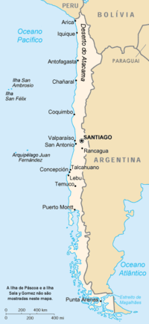
Sample
Quantitative analysis
Valparaíso (Chile)
112 primary schools
Public (39%), Priv. subsidised (53%), Private (8%).
Qualitative analysis
10 primary schools (Public (2), Priv. Subsidised (7), Private (1).
Interviews: headteachers, teachers, families

Slide 14
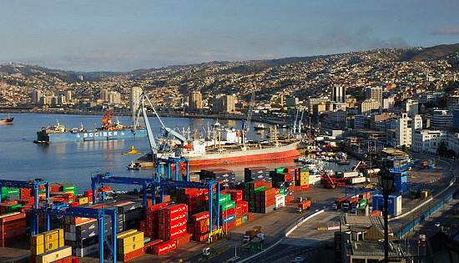
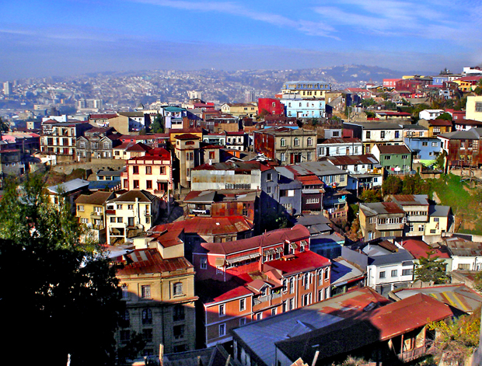
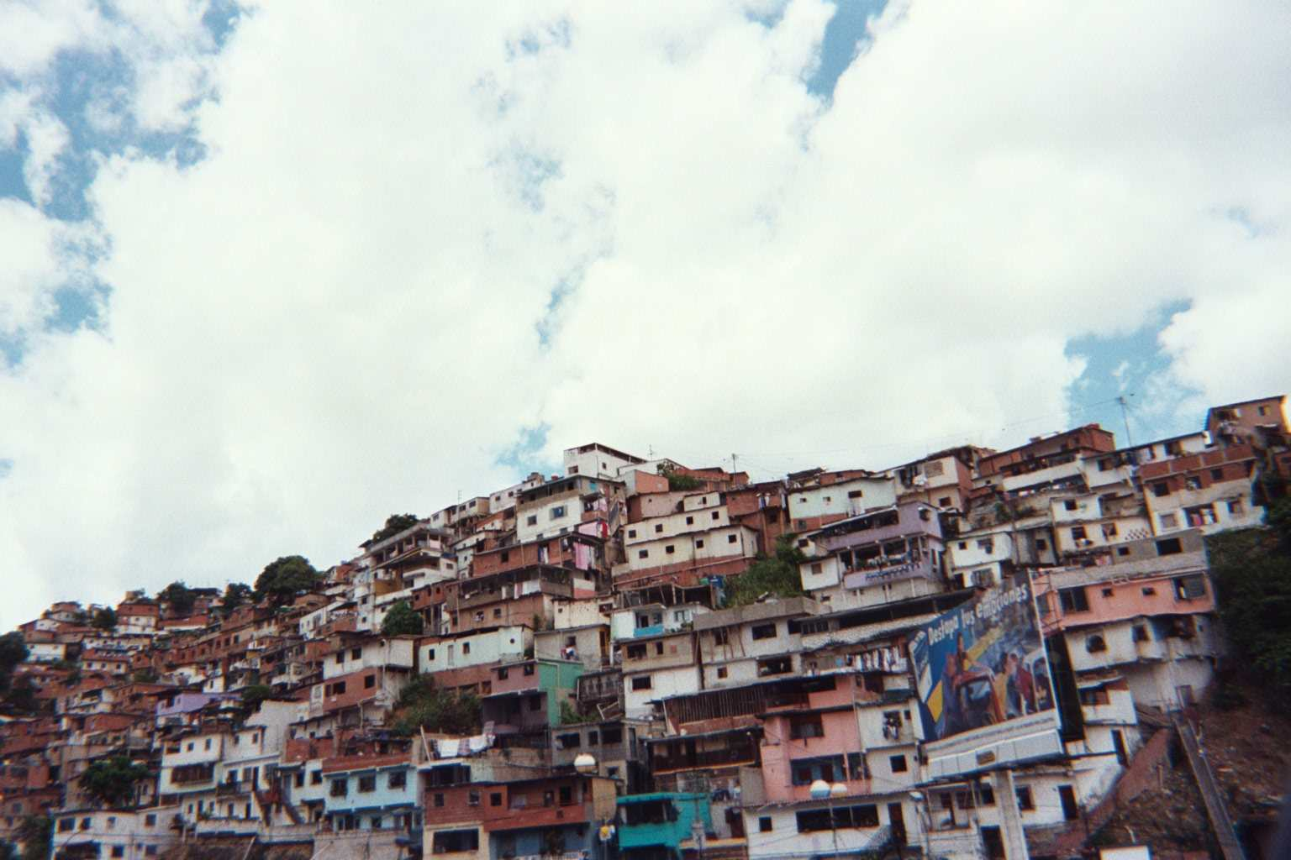
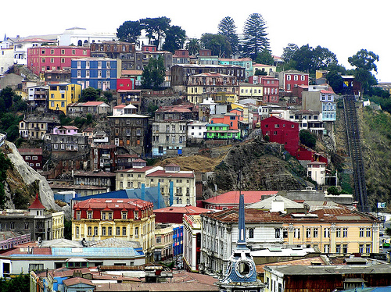

Slide 15
Quantitative methodology
Data base: SIMCE 2011 – 4th grade.
Local education market: Valparaiso
From families’ survey, we take five variables:
Type of provider
Monthly school fee
Student selection practices
Main reason of choice expressed by families
School performance (SIMCE average)

Slide 16
Typologies in the LEM
 | Price | Selection | Choice criteria | Performance | %
Públic
 | Free | No | Distance | Low | 28,2% | 79,4%
 | Free | No | Distance | Average | 25,6%
 | Free | No | Other | Low/Average | 25,6%
Priv. subsidised
 | Free | Yes | Other | Average/High | 13,8% | 68,0%
 | Free | No | Distance/Other | Average | 7,8%
 | Low | Yes | Other | Average/High | 40,8%
 | Average | Yes | Other | Average/High | 5,6%
Private
 | Low | Yes | Distance | Average | 12,5% | 100%
 | Average | Si | Other | Average | 25%
 | High | Yes | Other | High | 62,5%

Slide 17
Map of the education market
Private
High fee, other, high quality
(62,5%)
Average fee, other, average quality (25%)
Priv. Subsidised
Low fee, distance, average quality (12,5%)
Public
Hierarchisation
Average fee, other, average/high quality (5,6%)
Low fee, other, average quality (40,8%)
Free, no selection, average quality (7,8%)
Free, selection, Other, avergae/high quality (13,8%)
Distance, average quality (25,6%)
Segmentation
Other, Low/average quality (25,6%)
Distance, low quality (28,2%)
Notes:
Aquí es presenten les tipologies de manera més visual. Crec que la diapositiva anterior va bé per explicar les diferents tipologies dins del mateix sector però en aquesta queda més clar la jerarquització i a més l’idea de que certes tipologies es té espais comuns.

Slide 18
INTERVIEWED FAMILIES

Slide 19
MAIN ANALYTICAL DIMENSIONS AND CATEGORIES

Slide 20
A typology of school choice patterns of the poor
The priority of educational investment
The search for the adequate school
Critical acceptance and accomodation
The search for security / protection
Reification and absence of choice
Notes:
La prioridad de la invesión educativa: lo más parecido al actor racional instrumental. Manejan información. Un conjunto de familias busca en su segmento posible de mercado el tipo de escuela que permita la mejor inversión educativa. Familias calculadoras en su comportamiento que sienten jugarse la movilidad social en la decisión educativa. El habitus está claramente marcado por el intento de superación de la condición de pobreza vía educación. Buscan escuelas normalmente ‘superiores’ socialmente a las de su condición social, e incluso en ocasiones planifican la inversión educativa a largo plazo (con previsión de cambios estratégicos en el paso a la secundaria, por ejemplo)
La búsqueda de la escuela adecuada: Corresponde al comportamiento en el mercado de las familias que buscan una escuela que se adapte a las necesidades específicas del niño (Asperger, timidez, problemas conductuales). Cierta frustración en que un mercado tan amplio no responda a las necesidades de sus hijos y se convierta en ‘exclusionista’.
Aceptación crítica y acomodación: Electores no especialmente satisfechos con las elecciones realizadas. O satisfecho como ‘plan B’. Suelen haber intentado acceder a otras escuelas pero son rechazados por precio o porque ‘no dan el perfil’. Acaban acomodándose a una elección no del todo satisfactoria. A veces esta elección posteriormente se considera adecuada y son críticos con las escuelas que en su momento habían deseado
4. Seguridad / protección /comunidad/refugio: Un perfil muy abundante. Se busca claramente la escuela que permita huir de aquellas escuelas más “peligrosas” (por desviación de conducta, por bullying, por malas compañías, por ínfima calidad, lesbianismo).
5. Reificación y ausencia de elección: Los más pobres. El mercado no existe para ellos. No buscan, van a parar por criterios de proximidad

Slide 21
Educational investment and social mobility
Distinction
-Is this the school you chose as your first option? Did you checked other schools? - No, I chose it because… I have a school closer to my home but I don’t like it. It’s a municipal school, and I dislike children that go there.
(Parent, Private subsided school, Medium price)
Calculation (checking SIMCE)
“I know education is good here. I checked SIMCE results. And I have compared the school content with other schools and realised that here education is more advanced and children are required to do more things than they are in other schools (Mother, Public school)
Middle-class emulation
“I work in different houses, with Germans, Italians, and I always observe them, and I told myself I will put my daughter in this school when she is the appropriate age” (Mother, Private subsidised)
Power in the demand-side
“[I would leave the school if] the quality of education went down, if I observe that teachers are teaching the same thing for months and there is no progress in content. If this were to happen, I would think of changing the school. Also if I see that the score in the SIMCE goes down, I would consider a change” (Mother, Private subsidised)

Slide 22
The search for the adequate school
Active parents in the education market
“I rejected other schools because I did not get very good references for them. And, because of the number of students enrolled. These were schools with more than one group per course. I needed a smaller school because of my child’s conditions.” (Mother, Public school).
Fighting in an unpleasant market
- Of course, what happened is that my child went to a language school, and then school D placed a lot of obstacles to accepting him, because he went to a language school. And then we came here.
- Did you pass any selection process at school D?
- No, not even that. (Mother, Private subsidised school)
Academic performance is not a priority
- “And did you check SIMCE, do you know what SIMCE is?
- Yes, I know what SIMCE is, but what for?” (Mother, Private subsidised)
School is adequate for the child
“What I like most about this school is that they have integrated him very well. He is not discriminated against at all.” (Mother, Private subsidised)

Slide 23
Critical acceptance and accommodation
Fighting against the limits - Was this your first school choice?
- No, my children (3) studied in another school, in a private subsidised one. I had to change them because the school did not belong to the SEP system, and I could not afford the cost. I had the option to come to this school that is free” (Mother, Private subsidised)
Extremely active parents (permanent willingness to change)
- And once she is here, have you planned to change the school?
- Yes, because... getting back to a more demanding atmosphere, because you need a good middle school to form the basis to go to university. (Mother, Private subsidised)
Critical users
I am very meticulous, and I didn’t like the way the school gave the information. Almost [all the information is given] via internet, I didn’t like that. (Mother, Private subsidised)

Slide 24
The search for security / protection
Valuing care and protection
The most satisfactory aspect of the school is its good atmosphere and care. Up to now he has had no problem with bullying, which is something I am always aware of, and this keeps me calm and confident, knowing he is in a school which has a good atmosphere. (Mother, Private subsidised)
… and discipline
Teachers are very good, very supportive, and I also like the discipline of the school, because whatever happens they call me and let me know.” (Mother, Public school)
…before SIMCE
I know that my daughter should be in another school with better SIMCE results, because we received the SIMCE letter results and the truth is it is quite low in this school, but there is a risk of violence… because my daughter is too quiet, then very quiet children don’t fit in this kind of violent, aggressive, upset time that we are living in today. (Mother, Private subsidised)
Hot knowledge as the main information source
My sister also had their children here, and I know it’s a good school. [...] Children start reading and writing one year before they do in school A.

Slide 25
Reification and absence of choice
Choosing by default
I chose this school because it is cheap and because I asked in other schools and all were expensive. In contrast here, I don’t pay fees and I found it, how to say… I found it tidy and clean, this was my first impression. (Mother, Private subsidised)
Economic boundaries and the value of proximity
Did you search for another school?
I thought about it sometimes, but as I told you there are economic reasons and also having them here it’s easier for me. Everything is close (Mother, Public school)

Slide 26
Discussion
High levels of reflexivity of the poor in the education market
Segmentation and hierarchisation of the market produce a high number of boundaries to school choice.
A bounded choice does not determine a bounded rationality
Alignement and dissonance between preferences and restrictions
Poor’s habitus and conceptions of education quality

Slide 27
Some policy implications
The limits of principal-agent theory.
Not only information asymmetries.
Power is in the supply-side.
Policies that assume as if behaviour in the Theory of change will fail as universally valid policies. No solutions from within.
What works in education… for whom?
Rationalities as a product of limitations and preferences/expectations. The habitus of the poor. Diversity of incentives?
The challenge of integrating diversity in policy making: subjectivity policies.

Slide 28
Thanks for your attention!

