Slide 1


‘Race, class… they can all be a barrier if you choose’
Dr Michela Franceschelli
Prof Karen Evans
Prof Ingrid Schoon
Education and narratives of resilience in Black African (Nigerian and Ghanaian) and Black Caribbean British families

Slide 2
Content
Black African and Black Caribbean: mobility and educational attainment
The research: aims, questions, approach and methods
Results: parenting and education
Discussion: in-depth the research to complement the study of mobility…

Slide 3
Mobility and ethnic gap in attainment
Platt (2005): ONS LS
Strand (2008): LSYP
High concentration of Black Caribbean in working class origins (78%)
So some upward mobility is occurring as expected…
BUT: Black Caribbean remained at higher risk of unemployment (74% higher than for White British)
Ethnic group differences in KS3 attainment are substantial.
Black Caribbean and Black African groups were significantly lower in all three subjects (English, Maths & Science)
Black Caribbean pupils a particularly low mean score in mathematics, relative to all other ethnic groups.

Slide 4
Explanations and conclusions
Platt & Strand more cautious when making conclusions about racism
Gillborn (1990): Teachers’ stereotyping based on disciplinary problem with previous students engenders low expectations about the behaviour and academic potential of Black Caribbean. Pupils are assumed to react to this discrimination by becoming demotivated or confrontational…

Slide 5
Parenting, education, mobility or reproduction?
Education & Aspirations
Mobility or Reproduction
Parenting

Slide 6
The Research
Aim
To understand how parenting is employed to enhance children’s social mobility in the context of Black African (Ghana & Nigeria) and Black Caribbean families
Questions
What characterises parenting in these families? How do parents pass on values, beliefs to their children?
What characterises the experiences in education & aspirations of parents and their teenage children? What are the differences and continuities?

Slide 7
Approach & Conceptual framework
Intergenerational
Narratives
Phoenix and Brannen (2013)

Slide 8
Methods
10 family case studies (N=30) with parents and their teenage children (13-19 years old). Multiple visits in each family (& field-work notes)
Thematic analysis (what: main trends in the data) & Narrative Analysis (how: respondents were making sense and coming to terms with their experiences)
Reflexivity: accessing communities as an outsider
NARRATIVE ANALYSIS
THEMATIC ANALYSIS

Slide 9
Sample
Families | Total: 10 (N=30); 4 Lone parent families
Gender | 10 mothers; 5 fathers & 1 step-father; 1 grandmother; 7 young boys; 6 young girls
Ethncity | Black British African (Nigeria n=2; Ghana n=6) Black British Caribbean (Jamaica; Neiv; Grenada)
Generation | 24 UK born; 3 Born in Ghana;1 born Nigeria; 2 born in Jamaica (1 grandmother)
Income band | 2 families Between £20,000 and £29,000 per year ; 3 Between £30,000 and £39,000 per year; 2 f. Between £60,000 and £99,000 per year; 1 between £40.000 and £59.000; 1 Between c/d £20.000 and£ 39.000 per year; 1 Between f/d £30.000 and £99.000 per years
Mothers' Qualifications | 3 mothers degree; 3 mothers had NVQ L1-3; 1 mother OCR Teaching Qualification; 1 mother Diploma in career guidance; 1 mother studying for accounting; 1 mother studying for a degree. Grandmother diploma nursing;
Fathers' Qualifications | 3 NVQs; 1 degree; 1 RSA accountancy; 1 diploma Civic Engineering
Employment status fathers | 5 full time employment; 1 part-time work
Employment status mothers | 5 full time employment; 1 part time employment; 4 studying

Slide 10
The debate & influences: Class, Race and Parenting
Laureu ‘Unequal Childhoods’ (2003): Parenting and social class as Natural Growth and Concerted Cultivation
Rollock et al: (2014) Intersectionality of Race and Class & CRT
Ethnic and racial socialisation (Iqbal, 2014): Preparation for Bias
Tracy Reynolds (Black fathers)
Brannen Phoenix (2013): narratives and intergenerational

Slide 11
Race or class?
The role of race in children's daily lives was less powerful than I had expected. (…) My data indicate that on the childrearing dynamics studied here, compared with social class, race was less important in children's daily lives. (Laureu, 2003)
‘For almost all parents, race remains present irrespective of class status (Rollock et al, 2015)’

Slide 12
The data
(Education) NARRATIVES OF RESILIENCE
RETROSPECTIVE PARENTING
Notes:
Answer to the 2 research questions
This summarises what is the data
I will also show you how these two ‘areas’ are related to each other

Slide 13
Retrospective parenting: the functions of ‘pasts’ for childrearing
Personal biography
Family history
Cultural heritage, community, migration, Black history
Notes:
INTERGENERATIONAL TRANSMISSION WAS CHARACTERISED BY WHAT WE DEFINED AS RETROSPECTIVE PARENTING
THIS IS TO SAY: TO PASS ON VALUES & BELIEFS PARENTS DRAW ON 3 DIFERENT LEVELS OF PAST
NOT A NEUTRAL LINEAR PAST BUT EMPHASIS ON DIFFICULTIES; STRUGGLES & CHALLENGES
SHOWS HOW PARENTS USE ‘PAST’ TO PASS ON A SENSE OF RESILIENCE
Because I didn’t do (..) so Alina (daughter) is my excuse to re-live my childhood. (…)
I guess if I go up to my parents, they wanted what they never had, never got a chance to go to university, they didn’t get this education, they emigrated here, they started again from the very beginning…
(Lydia, Mother, Black Caribbean)

Slide 14
‘Your past makes you who you are’: biography and family history (Thomas)
Your past makes who you are. And (…) do you know what I mean? So everything you do is a part of how you was grown, and the things you didn’t get. So …. I vowed from a very young age “when my kids want something, they’re going to get it, I’m going to provide it for them.
My mum grew up in Jamaica (…) when my mum and my dad sort of split up erm…there was a time in my mum’s life where she never had anywhere to live. (…) staying in bed and breakfasts. And for me my mum’s always had a difficult…difficult life (…) everything sort of like was a struggle (…), so that’s why I’ve kind of learnt that work hard. So yeah…

Slide 15
His children ….
I think my mum and dad just want me to be….better than they are I guess. (…) They don’t want me to be on the same level or lower than they, (..) they want me to make more money (..) and have a better life than they’ve had. (…) My dad hasn’t achieved his dreams. .(Jason, Son)
It’s not that I feel a responsibility (of keeping the parents together), not at all, I just feel that that’s the way it is. And yeah it’s just what happened. You have babies, you think ‘OK we can’t separate now, we’ve got to do this, this and this’. But yeah I think, yeah. I don’t know, it’s a bit strange really. (Jayla, Daughter)
Notes:
The importance of parents biographies comes back in the children narratives

Slide 16
History and a ‘wider past’
It’s like they almost hide British black history you know. It’s like we appeared during the Windrush but there were no black people before that, you know. Because I said to my son “what do you know about black history” he knew there were slaves. I mean it’s like well…you know there’s more to it than that,. (Cynthia, Black Caribbean mother)
I’m currently studying history for GCSE at school and…I’d like if they educate children on black history. I don’t think children are really knowledgeable about it but…I think my mum’s like on the case to sorting out (Keven, 15 years old boy)

Slide 17
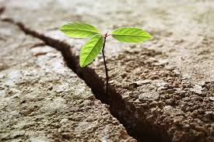
Building up resilience in their children

Slide 18
Parenting in Black African and Black Caribbean British families
Retrospective Parenting
Preparation for Bias
Concerted Cultivation
Aspirations & Meritocracy
NARRATIVES OF RESILIENCE
Gender and Parenting Roles

Slide 19
Building up resilience: Meritocracy and Aspirations
….I mean….I always say to my children there is nothing that you can’t do, if you want to become something you can if you work hard at it (Keira, Mother, Black Caribbean)
Erm…so it was always said in my family that “oh you need to get a good education in order to get a better…better job, better you know opportunity”. Erm…and I think indirectly, you know, it has appealed to me, hence why I now say the same thing to my children. (Keira)

Slide 20
Ambivalences: awareness of barriers & positive outlook to the future
Dominant discourses
Meritocracy Individualism
Personal narratives
Language of struggle and agency

Slide 21
Building up resilience: Preparation for bias
Q: Do you speak about racism and stuff like that with your parents?
A Mmm.
Q What do they say?
A: They say like, what’s it, that you, I, as a black person have to try harder because some people will be racist. So you can’t let them, what’s it, you can’t let them bring you down (…), so you have to try twice as hard as someone else, or something like that.
(Manu, Boy, 14 years old, Black African British)

Slide 22
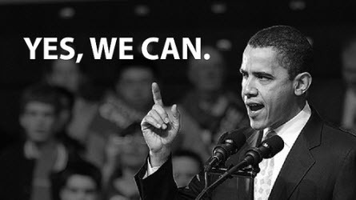
Intergenerational perceptions of racism: the ‘Obama generation’

Slide 23
Enhance children talents so they’ll do their best: Concerted Cultivation
But sometimes you know I do feel for them. But then it gets them to stay focused, you know, instead of them idling around doing nothing, their time is all manageable and very constructive schedules for them, which is very good. Doesn’t just to keep them indoors and…the Play Station (…) We just make them understand that, you know, excessively using them (mobiles; play station etc.) might distract them from their focus, you know, so… (Adwin, Father, Mixed Background)

Slide 24
Gender and family roles: different fatherhoods
So these kids are getting 10 spellings, she’s getting 5 spellings – why is she getting 5 spellings – because they’re saying she’s struggling, she doesn’t understand when they’re reading books. And I said “alright no problem”. So I bought an A3 book, I came home, and I told her the routine was going to be different now (…). So now, “(…) you’re going to be writing each word, spelling it, 15 times, every day (…)”. We (…) started, she moaned, her hand’s hurting her, we went through all of that. She cried…. (Kwame)
I would sell my soul to the highest bidder (…) really just to make sure that I can actually provide for the family (Thomas)
Notes:
MEN AS PROVIDERS BUT ALSO EXAMPLES OF OTHER FATHERHOOD
Kwame speaks about how he he helped his 7 years old daughter to improve with her spelling. She finally improved and doing really well:
So when you turn over and you see that she couldn’t even spell AT, she couldn’t even spell “at” she couldn’t even spell that. And to her spelling like 7 letter words now in the space of, what, a year?
Do you know. Yeah. It’s just totally…it’s totally ama….totally different. I mean the school has said that. And I mean I hope they don’t sit down and take the credit, and they probably will take the credit which I don’t mind because that’s not what I’m interested in, I’m just interested in that she gets an education.
To support his partner who was doing a degree, he took over a lot of the household responsibilities: from making breakfast for the kids; cooking; picking them up and taking them school & involve his teenage stepson with football etc

Slide 25
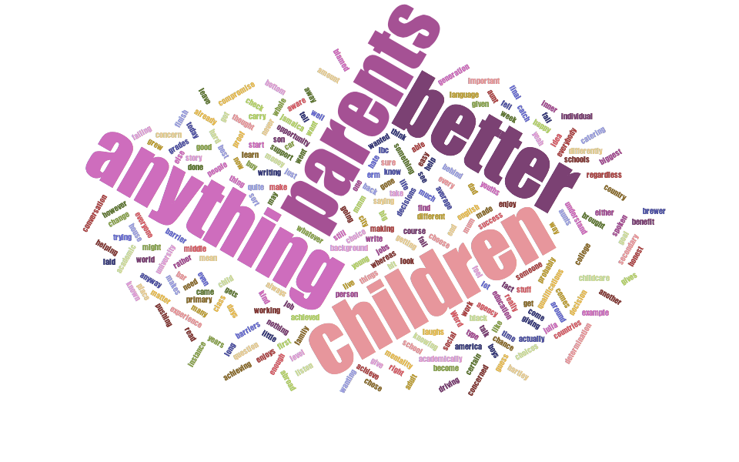
Educational experiences as narratives of resilience

Slide 26
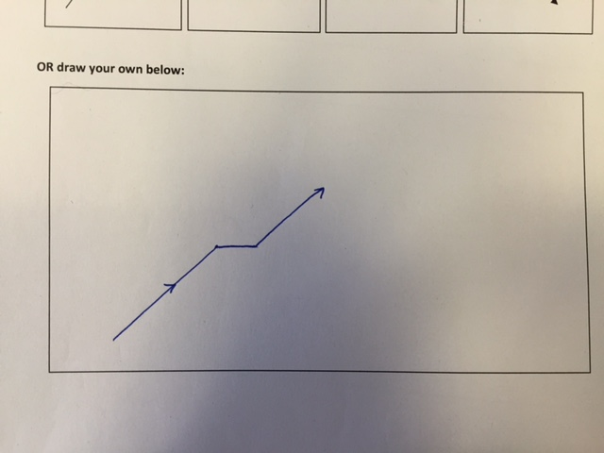
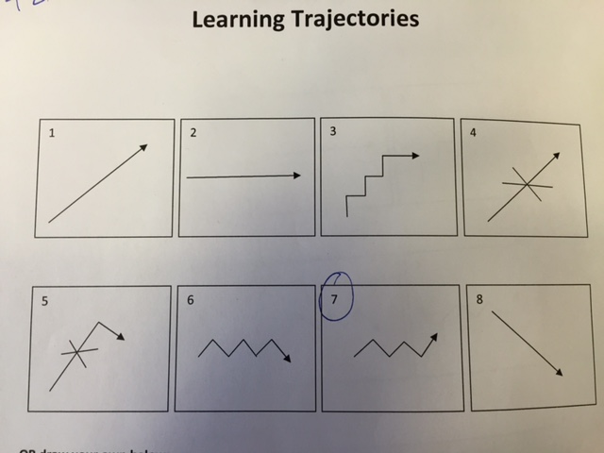
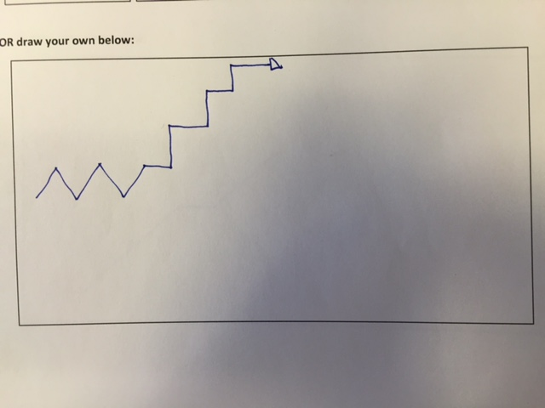
Personal educational journeys: maps
Ross, Father
Lydia, Mother
Alyssa, Daughter

Slide 27
Parents’ resilience
I remember her (headmistress) looking at us (3 black girls) and (…) then she got up and walked to the window with her back to us and said “why would you, people like you, want to go to university, are you planning to be missionaries?”.
(…) Yeah. I remember getting up and walking out. (Lydia, Mother)
Yeah, because with….with the way I grew up, it could have gone any way, because some….if I wasn’t strong enough I could have been in trouble because I wasn’t getting any love from home, and I can imagine if you’re not getting anything you look for it somewhere else (Ross, Father)
Notes:
Mother tells her story of success: going to university, graduation & work
SUCCESS IN EDUCATION OF THE MOTHER
Even those who spoke about educational successes, like Lydia who had a degree from a prestigious university, spoke about them in the ‘language of struggle’ rather than as smooth journeys. Mobilising a sense of agency and challenging the ‘bad fate’ was the underlying characteristic of the ‘narratives of resilience’. Lydia’s family was amongst the wealthiest in the sample. They owned their house in a residential area of an up-and-coming inner London borough. She was running her child-minding business very successfully and her husband was an engineer. They were both born in the UK, but Lydia’s parents were from Grenada whilst her husband was originally from Jamaica. Lydia was a ‘straight A’ student and went to university to study languages however, her account of the transition from GCSE to Upper secondary is quite dramatic:
Her resilience stays in the end of the narrative when she ‘got up and walked out’, which sets out the context for the rest of the educational narrative where she speaks about her academic success as the result of her enduring attitude to stand out to racism, discrimination and any other challenge which could have limited her opportunities
DIFFICULT UPBRINING OF THE FATHER
The husband Ross had a quite difficult relationship with his stepfather and no contact with his biological father. He spoke extensively about his difficult upbringing during the interview even though he only opened up quite explicitly toward the end:
In the case of Ross, his reliance rescued me from a possible bad path but did provide him with a sense of achievement in life

Slide 28
The daughter’s resilience: the effects of racial socialisation and the ‘language of agency’ as struggle
Yeah {laughs}. Well it’s just….I think my life would be perfect if it wasn’t for my school really.
I know a girl called Megan, she’s white, she’s got blue eyes, blonde hair, quite quiet, she’s got kind of a baby voice. (…)…I’m not sure if it’s racist but it’s quite stereotypical that obviously the taller, black girl did it
Because {laughs} when I go into like the fashion industry and I basically achieve what I want to achieve, I will just want to like wave at all the people {laughs} that got me down and thought that I couldn’t do it.
Notes:
Alyssa, Young daughter (14 years old)
Struggling at school, a sense of frustration
Reflecting on why it’s happening to her? Racism
Resilience as struggle and sense of overcoming barriers
Alyssa’s narrative about school is full of terms such as ‘detection’, ‘punishment’, ‘exclusion’ ‘exclusion room’, ‘bullying’, ‘escalating’ and ‘misbehaving’. The school is described full of disciplinary norms and disciplinary procedures. Half way through the interview Alyssa ‘confessed’ she was excluded for one day because of bullying another girl. She insisted she did not do that
There’s a thing called DP slips. (…)And if someone misbehaves you write one to go downstairs. (…) Like…so then someone could basically shout at you {laughs} and give you a detention, which will be co-ordinators 90 minutes if you get DP’d (…)

Slide 29

Structure and agency still open question..
Attempt to explain how parenting may affect children’s life chances
Emphasis on agency comes together with the awareness of structured opportunities and racialised society
Retrospective parenting (drawing on the past) reflects the effort that parents make to teach their children how to overcome barriers

Slide 30
Why did you take part?
I understand about research
It’s therapeutic
It’s time to speak up
I love talking to people
The incentive helped
No one generally cares, it’s nice if someone does
It’s nice that you are asking
I couldn’t say no when I heard your accent on the phone

