Slide 1
Radical futures? Receptivity to extremism and radicalism among young Europeans
LLAKES Youth in Crisis Conference
SOAS, London, 4-5 June 2015
Hilary Pilkington (University of Manchester)

Slide 2
Youth receptivity? The evidence
Perception that the ‘typical extreme-right voter’ is young (Bakić 2009)
But, existing survey data confirm only :
support is weakest among highly educated professionals and greatest among manual workers, small business owners, the unemployed, ‘housewives’ and pensioners;
support is stronger among men than women (Kitschelt 2007).
It is argued that the young are more likely to vote for the extreme right because ‘they compete with immigrants for scarce resources’ (Arzheimer, 2009).
In practice the impact of age on support for the far right varies widely (nationally and regionally):
UK data on support for the BNP and UKIP show that these two parties are, on the contrary, supported disproportionately by those who are over 50 years of age.
In East European countries support among the young is high, mirroring evidence that younger generations are less rather than more tolerant than older generations.
Notes:
The ‘typical extreme-right voter’ in Europe is characterised by Bakić (2009: 201) as ‘a twenty five-year-old unemployed man, with below-average education’ .
In fact, however, the data on whether young people have a particular propensity to support the ‘extreme-right’ is inconclusive.
Kitschelt’s (2007) review of the findings of social survey data to date concludes that, with regard to individual socio-demographic criteria and support for the ‘radical right’, only two facts are incontrovertible:
support is weakest among highly educated professionals and greatest among manual workers, those in small business, the unemployed, ‘housewives’ and pensioners;
and such parties attract more men than women.
The strongest case for heightened receptivity among young people is made by Arzheimer (2009) who proposes that the young will have a greater propensity to vote for the ‘extreme right’ because ‘they compete with immigrants for scarce resources’. Since this conclusion (2009), economic crisis has made resources scarcer.
The evidence we have to date however suggests that the impact of age on support for the far right varies significantly across different national and regional contexts.
The UK data on support for BNP and UKIP, for example, refute Arzheimer’s claim. Goodwin et al (2010) show that of those who had voted for or would vote for the BNP (based on surveys conducted 2002-06) only 11% were under the age of 25, while 36% were over the age of 55. A YouGov poll (March 2014) also showed that 71% of UKIP voters are over the age of 55.
On the other hand, Kovacs (2013) finds that people aged 18-29 represented the largest age group (29%) of Jobbik supporters. This would appear to confirm ESS data which show that the younger generation in East European countries does not follow the West European pattern in being more tolerant than older generations.

Slide 3
Constraints on existing knowledge
Existing literature is based largely on past voting patterns or general population surveys of voting intentions in relation to formally registered political parties.
This constrains our knowledge since groups of the population supporting populist/radical right parties are small and general population surveys also contain a relatively small sample of young people.
Reliable data on the strength of support for a range of populist and radical right political agendas among youth in Europe are thus lacking.
Notes:
The existing literature is based largely on past voting patterns or general population surveys of voting intentions in relation to formally registered (and electorally successful) political parties.
This constrains our knowledge since groups of the population supporting populist/radical right parties are small and general population surveys also contain a relatively small sample of young people.
Reliable data on the strength of support for a range of populist and radical right political agendas among youth in Europe are thus lacking.

Slide 4
MYPLACE: Research context
MYPLACE explores the relationship between political heritage, young people’s current civic and political engagement and activism, and their receptivity to radical or populist agendas. (http://www.fp7-myplace.eu/)
It used a case study approach consisting of 30 locations in 14 European countries. Locations were selected to provide within country contrasts in terms of hypothesised receptivity to radical politics.
Notes:
This presentation draws on the FP7 MYPLACE project (Jume 2011-May 2015)
MYPLACE explores the relationship between political heritage, young people’s current civic and political engagement and activism, and their receptivity to radical or populist agendas. (http://www.fp7-myplace.eu/)
It used a case study approach consisting of 30 locations in 14 European countries. Locations were selected to provide within country contrasts in terms of hypothesised receptivity to radical politics.

Slide 5
Research locations
Notes:
From Georgia to Portugal, Greece to Finland. 16 of 30 locations are post-socialist [including eastern German locations].
n.b. Note that any slippage into talking about countries, should be auto-corrected by listeners to ‘the two locations in the country’.

Slide 6
Extremism and radicalism: Starting points
The working definition of ‘extremism’:
a generalised measure of deviance from the political norm;
a specific tendency to violate democratic procedures;
intolerance to variety and opposition.
It is distinguished from ‘radicalism’, which may require the ‘suspension’ of democracy (in order to institute a new order) while not necessarily being anti-democratic as such.
Both terms have been applied to both right and left. Our concern is primarily with right-wing variants.
‘Radical populist right’: distinguishes parties and movements that remain broadly democratic despite opposing some fundamental values of liberal democracy (e.g. tolerance) and promoting an ideology that combines nativism, authoritarianism, and populism from classic ‘extreme’ or ‘far right’ political parties in (Mudde, 2007: 25-30).
Notes:
In most cases interviewees do not make these distinctions, which means that here I will usually talk about extremism and/or radicalism.

Slide 7
Research Design
MYPLACE employed a mixed method research design including:
Questionnaire survey (N=16,935, target=600 per location) of young people aged 16-25;
Follow up interviews (N=903, target=30 per location) with a sub-sample of these young people;
44 ethnographic studies of youth activism, in 6 thematic clusters;
Ethnographic observation at 18 sites of memory including expert interviews with staff (N=73), focus groups with young people (N=56) and inter-generational interviews (N=180).
Respondents for follow-up interviews were selected from volunteers recruited during the survey.
The cross-national analysis of qualitative interview data employed an adaptation of the meta-ethnographic synthesis approach (Noblit and Hare, 1988).
Notes:
This presentation draws on the survey (WP lead: Gary Pollock, MMU) and follow up interview element of the project (WP lead: Florian Sipos, University of Debrecen) across all 30 locations.
Respondents for follow-up interviews were selected from volunteers recruited during the survey. In making the selection we controlled for gender, ethnicity/nationality, age and education. We used responses to two survey questions to ensure inclusion of contrasting types and intensities of political (non)engagement and levels of (in)tolerance.
The cross-national analysis of qualitative interview data employed an adaptation of the meta-ethnographic synthesis approach (Noblit and Hare, 1988).

Slide 8
Receptivity to extremism/radicalism MYPLACE survey data
The MYPLACE survey is youth-focused and asked:
i) For whom respondents had voted (in last national and local elections), if they had voted);
ii) To which political party (if any) respondents felt ‘close’.
But, the 16-25 years target range meant that many respondents had not yet voted reducing the sample of ‘voters’ for radical right/populist parties
59.1% of respondents reported that they did not ‘feel close to’ any party. The absolute number of those reporting empathy with a far right or populist/radical right party is small.
This interference from broader distrust in political parties suggests understanding receptivity to the far right is better measured by support for ideas rather than parties.
Notes:
In measuring receptivity to extremism/radicalism among youth, in contrast to the population and voting intention surveys I mentioned early, the MYPLACE survey does not suffer from a small sample size for young people.
It asked a number of questions directly about political party support:
for whom respondents had voted (in last national and local elections), if they had voted;
and whether they felt close to any particular political party, and if so which one.
However, the target age range (16-25 years) for respondents means that a significant proportion were too young to have had the opportunity to vote. Thus the number of respondents reporting having voted for a far right populist/radical right party produced such a small number of cases in most locations that the analysis of findings would have no statistical validity.
Moreover, 59.1% of the survey respondents overall did not feel close to any party. The absolute number of those reporting empathy with a far right or populist/radical right party thus is also small.
This interference from the broader distrust in political parties suggests that to enhance our understanding of receptivity to the far right, we need to switch the focus from ‘parties’ to ‘ideas’.

Slide 9
Exceptions to the rule
The exceptions here are in Greece, Finland and Hungary.
Of those who had voted in the last national election in the country:
in Greece 16.7% had voted for Golden Dawn (more than twice the proportion of the general population)
In Finland, 14% had voted for The Finns (5% less than the general population)
In Hungary 27% had voted for Jobbik (12% more than the general population)
Of those reporting they felt close to any party
In Greece 20.5% felt close to Golden Dawn
In Finland 22% felt close to The Finns
In Hungary 47% felt close to Jobbik (although only 19% reported closeness to any party compared to 41% in Greece and 46% in Finland).
Notes:
We will return shortly to this point. First, it is worth considering briefly three country locations where a significant number of respondents did report voting for or closeness to far right or populist/radical right parties. These are locations in Greece, Finland and Hungary.
Voted for radical right/populist party
Greece: 16.7% voted for GD (national elections, 2012). Although more voted for SYRIZA (32.7%).
Finland: 14% of respondents voted (national elections, 2011) for The Finns
Hungary: 27% voted for Jobbik [Movement for a Better Hungary] (national elections, 2010)
Closeness to far right or populist/radical right party
Greece: 41% of respondents felt close to some political party. Of these 20.5% of Greek respondents felt close to GD. Although more felt close to SYRIZA (32.3%)
Finland: 46% of respondents felt close to a political party. 22% of those felt close to The Finns
Hungary: Only 19% of respondents felt close to a political party in Hungary but 47% of those stated that party to be Jobbik
N.b. absolute numbers remain small (for those voting for these parties in the last national election, numbers were 30-40 respondents).

Slide 10
Measuring receptivity: Ideas not parties
Greater robustness is achieved if we seek measures of support not for parties but the ideas they propagate.
Conceptually we adopt here Mudde’s (2007) characterisation of ‘radical populist right’ ideologies as combining: nativism, populism and authoritarianism.
In the MYPLACE survey:
Nativism is measured by: negative attitudes towards minorities, anti-immigration attitudes, welfare chauvinism and exclusionism.
Populism is measured by: cynicism in relation to the current political system.
Authoritarianism is measured by: support for autocratic principles (strong leader and army rule).
Notes:
We gain greater statistical robustness, if we shift the focus of measurement away from voting intentions/political parties towards the ideas associated with those parties. This also allows us to capture a wider range of movements (beyond formal political parties) to whose ideas and activism young people might be receptive
Of course what ideas we focus on raises important conceptual and definitional questions that I noted earlier and of course in each location in our research there are both a range of such parties and their policy foci vary significantly from country to country. For this reason we draw here broadly on Cas Mudde’s characterisation of ‘radical populist right’ ideologies as consisting of a combination of: nativism, populism and authoritarianism.
MYPLACE survey data have measures for all three of these ideologies:
Nativism is measured by: negative attitudes towards minorities, anti-immigration attitudes, welfare chauvinism and exclusionism;
Populism is measured by: cynicism towards the political system.
Authoritarianism is measured by: support for autocratic principles (strong leader and army rule);
I will refer to the first two measures only in this presentation.

Slide 11
Nativism: Restricting immigration
Should [your country] have stricter border controls and visa restrictions to prevent further immigration?
Of the total survey population:
Strongly agree - 16%
Agree - 32%
Neither agree nor disagree - 22%
Disagree - 22%
Strongly disagree - 6%
Notes:
If we take just the anti-immigration question, then we see that of the whole survey sample (n=16,436), just under half (48%) of respondents support the restriction of immigration while just over a quarter (28%) do not want further restrictions.

Slide 12
Nativism by location
On the composite nativism variable, highest levels of receptivity to the radical right are found in locations in the post-socialist countries of Hungary, Slovakia and Russia and also in Greece.
Notes:
Taking the broader composite nativism variable and look at the data by location, we see that locations in the post-socialist countries of Hungary, Slovakia and Russia and also in Greece.
This variable is constructed on the basis of agreement or disagreement with the following statements:
‘Foreigners should not be allowed to buy land in [COUNTRY]’;
[COUNTRY] should have stricter border controls and visa restrictions to prevent further immigration’;
‘When jobs are scarce, employers should give priority to [COUNTRY] people over foreign workers’

Slide 13
Support for extreme/radical right parties and movements
Interview data show support for the extreme/radical right is usually associated with problems of ethnic tension, immigration or ‘threats’ posed by religious minorities.
The desirability of controlling immigration into the country was found predominantly among northern European and Nordic countries.
In countries of the Mediterranean and former socialist countries respondents’ concern was often about the impact on society of emigration rather than immigration.

Slide 14
Anti-immigrant sentiments: Northern Europe
‘You see, I think we should have parties like that [BNP] because things like Polish people and that coming into the country, I can’t get a job sort of thing […] things like that are affecting me and the people who are around me and the place that I live. So of course I’d join a party like that.’ (Chloe, Nuneaton, GB)
The most frequent negative associations with immigrants reflect widespread xenophobic discourse suggesting that immigrants:
‘take our jobs’;
receive undeserved welfare and social benefits;
create cultural tension through non-integration;
demonstrate heightened criminality.
‘It’s totally absurd man. The fact that there are people coming from a war, and then they get here and get a good life, and gain asylum, and then they choose to commit crime. I think that is really bad.’ (Anton, OC, DK)

Slide 15
Other countries: Hostility towards ethnic minorities
A special animosity is reserved for Roma communities (everywhere).
[Roma people] ‘get 500 or 400 Euros every month without doing anything, they sit at home and have 4-5 or more kids and they live off our taxes’ (Marek, Rimavska Sobota, SK)
‘Working doesn’t play a role in Roma culture and so they don’t go to school or anything else. Well they are a heavy burden on society.’ (Riku, PK, FI)
In other countries, concern was less around recent immigrants than long-standing ethnic minority groups perceived to be threatening.
‘I don’t want any of the Hungarian parties ruling in Slovakia, because it is our country’ (Kristina, Rimavska Sobota, SK).
‘[…] when I settled in Riga I had a terrible, terrible hatred towards Russians, well, enormous! I even joined the National Union youth organisation for a while [...]’ (Dana, Rīga, LV)

Slide 16
‘Immigration is a problem, they are right on that, and the question is how you deal with it. I mean the fact that illegal immigrants take jobs away from Greek citizens, or work without paying taxes or even that you are afraid to walk in the centre of Athens, all these are facts and Golden Dawn's views are based on these facts.’ (Mironas, AR, GR)
‘If immigrants would behave according to the norms of this country, everything would be fine and there would be no inequality. If you come here, please, live like we do.’ (Egor, Kupchino, RU)
Exceptions to this rule are Russia and Greece where immigration is also seen as a problem.
Notes:
If we go back to Slide 11 (on immigration measure) we can also see that the two locations in Portugal show high anti-immigration attitudes.

Slide 17
Support for extreme right: Anti-establishment attitudes
‘[…] here in Vic… Well, the neighbourhoods we’ve got, some have got a pretty high concentration of immigration, some problems are generated, they go complain, and they fix it. I understand because they see what there is’. (Berta, Vic, ES)
[…] they [Jobbik] have not lied so far, or it hasn’t been proven. Because they have never been in government, but besides this, they are more authentic, if you look at him, he is more prepared. There are interviews, and other TV programmes, where they are questioned, and he answers immediately, and this comes from him. He is not making it up because it would sound good. […] He does not hide things. (Frici, Sopron, HU)
Support for extreme right parties is also expressed as being a consequence of these parties having proved themselves an effective force in local government or being untainted by political power.
Notes:
However, interview data also suggest support for extreme right parties a consequence of anti-establishment views. This is reflected in views that either:
Support for extreme right parties is justified by the fact these parties having proved themselves an effective force in local government
Or, alternatively, because these parties are untainted by political power.

Slide 18
Support for extreme right: Telling it as it is
‘Extreme right parties are ‘more like us’: ‘they’re mainly made up of general people […]To be fair, to me that’s why they’re listening, they’re not like some fancy fucker who went to Harvard or whatever it is, Oxford, or whatever [...]’ (Barry, Nuneaton, GB)
This suggests young people who feel deceived and excluded by politicians are receptive to strategies of ‘tellling it as it is’ employed by radical populist right parties and movements (Pilkington 2015: 57).

Slide 19
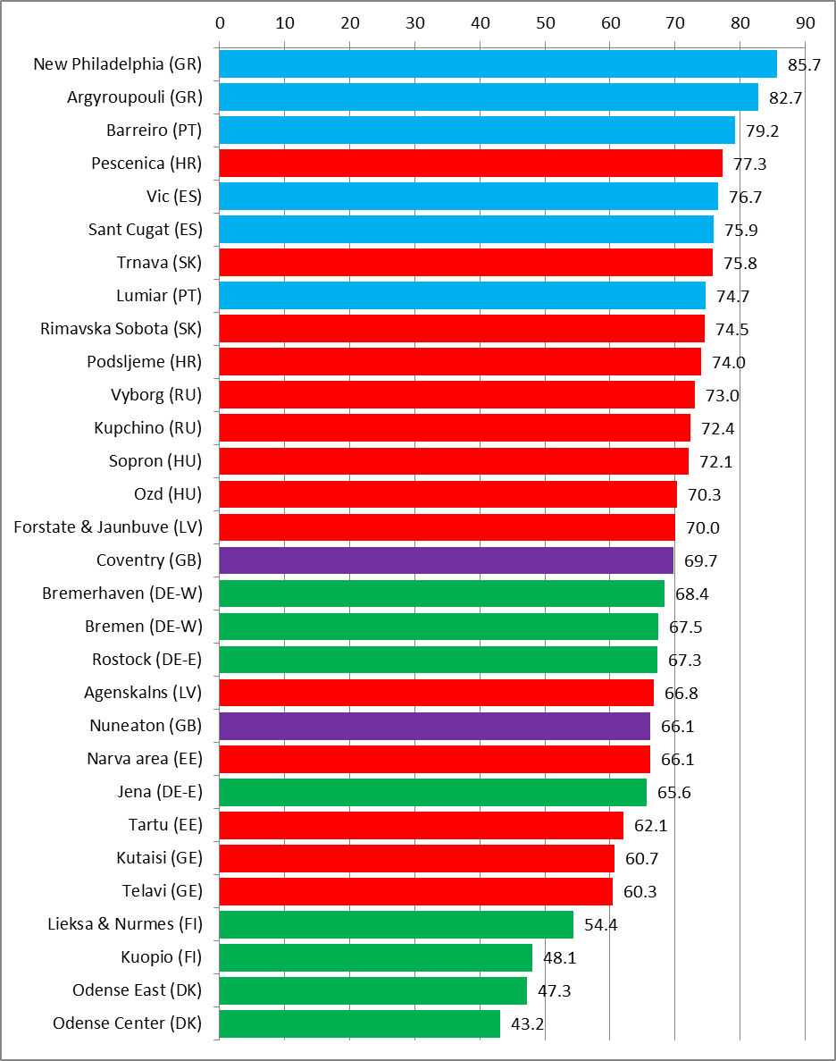
Cynicism: Attitudes towards politicians and politics
Notes:
And the MYPLACE survey confirms what we already know about widespread distrust of political institutions and disavowal of politics and its agents (politicians and political parties).
On the latter question, the MYPLACE survey asked two questions; ‘Politicians are corrupt’ and ‘The rich have too much influence over politics’ which have been combined to create a ‘Cynicism’ variable and have been standardised on a 0 to 100 scale, with 100 representing most cynical.
The overall average for all locations is 69.2 (n=16,018, sd = 21.5). This varies from New Philadelphia (GR) with 85.7 with the highest levels of cynicism to Odense Center (DK), 43.2 with the lowest levels of cynicism.
Locations in Mediterranean countries of Greece, Portugal and Spain are most cynical of politicians and politics.
However universally the levels are relatively high and there is little differentiation across different socio-demographic variables.
The overall average for all locations is 69.2 (n=16,018, sd = 21.5), demonstrating high levels of cynicism towards politicians and politics. This varies from New Philadelphia (GR) with 85.7 with the highest levels of cynicism to Odense Center (DK), 43.2 with the lowest levels of cynicism.
Locations in Mediterranean countries of Greece, Portugal and Spain are most cynical of politicians and politics.

Slide 20
Cynicism and receptivity to populist/radical right
Notes:
However, interrogation of the data show also that that such anti establishment sentiment is as much a feature of left wing as right wing disillusionment.

Slide 21
Support for movements of the extreme left
Mention of radical right wing parties and movements significantly outweighs references to left wing parties in follow-up interviews.
This reflects not greater support for radical right wing agendas but the more frequent association of radical or extreme agendas with the right wing rather than the left.
References are heavily dominated by the Spanish data set and in particular support for the CUP.
In some countries, e.g. Croatia, respondents found it difficult to even imagine what left-wing extremism might look like.
‘I don’t even know what it would mean to be extreme left-wing’ (Barbara, Podsljeme, HR).
Notes:
References are heavily dominated by the Spanish (actually Catalonian since both field sites are towns close to Barcelona) data set and in particular support for the radical left wing and pro-Catalan indpendence party Candidatures d’Unitat Popular (CUP).

Slide 22
Rejection of extremism: right-wing
Explanations of (others’) support for extreme and radical right parties are of two kinds:
individualised (‘stupid’ or ‘racist’ people vote for them);
systemic (support for such parties is a product of economic crisis and the failure of the political system).
Rejection of right wing extremism is related to accusations that such parties and movements were ‘racist’ or exploited anti-immigration or ethnic minority tensions.
‘it does come out of a lack of education, for want of a better word […] I don't think I've ever met an educated racist [laughs].’ (Pam, Coventry, GB)
‘You’re taking advantage of the fear of immigrants to win votes. The strategy is to win votes, and some people have achieved it. But it [PxC] seems like a reactionary party that’s taking advantage of the situation [...]. (Iker, Sant Cugat, ES)

Slide 23
Rejection of extremism: left-wing
The reasons for the rejection of left wing extremism focused rather on:
the reactive and unattainable nature of parties’ policies;
concern about the implications of anti-EU stances;
and the rigid nature of their discourse and inability to collaborate.
‘Well, when the leader of the party [Syriza] is on TV saying that, “When we have power we will eradicate our debt and return to drachma”, that's unattainable. I mean if we remove ourselves from the Eurozone, what will happen to us as a nation?’ (Nadia, AR, GR)
Notes:
Just for contrast – note the difference in reasons for rejecting left-wing extremism.

Slide 24
Rejecting all extremes
Many respondents reject extreme positions of both left and right.
‘I am repelled by the two extremes in the same way. I do not differentiate between them' (Mironas, AR, GR)
‘I do not support radical solutions, because that is not how the problems will be solved. I don’t know any better solution right now. But I do not support extremists.’ (Vladimir, Trnava, SK)
This reflects the findings of the MYPLACE survey.
When asked to place themselves on the political spectrum from left (0) to right (10), respondents tended to cluster around the midway point.
The most extreme left position was 3.2 (Vic, ES) while the most extreme right position was 6.3 (Vyborg, RU) (Pollock et al, 2015: 147)
Notes:
Many respondents reject extreme positions of both left and right. [interview examples]
This reflects the findings of the MYPLACE survey.
When asked to place themselves on the political spectrum from left (0) to right (10), respondents tended to cluster around the midway point.
Moreover, the full range of positions was relatively narrow
The most extreme left position was 3.2 (Vic, ES) while the most extreme right position was 6.3 (Vyborg, RU)

Slide 25
Conclusions
Engagement with ‘extremism’ and ‘radicalism’ is heavily concentrated in a small number of countries. Engagement does not always equate to receptivity (Spain/Georgia).
Both survey and interview data from MYPLACE show greatest receptivity to the radical right in locations in the post-socialist countries of Hungary, Slovakia and Russia and also in Greece.
The extreme right is more visible to young people than the extreme left, although the latter features in interviews in Spain and eastern Germany.
Support for extreme/radical right ideologies and movements is a minority position but views lie on a continuum rather than reflecting a tolerant ‘mainstream’ and a separate and dangerous extremist fringe.
Empathy for the extreme right is usually constructed around concerns over ethnic tension, immigration or ‘threats’ posed by religious minorities. It is also linked to anti-establishment motifs.
Respondents reject extreme right wing parties because they are ‘racist’ or exploit anti-immigration sentiments. They reject left wing extremism as unrealistic and ideologically rigid.
Young people avoid both extremes of the political spectrum when they place themselves on a left-right scale; some explicitly reject all extremes.

