Slide 1
Youth Attitudes towards the Welfare State: Preliminary Evidence from the “Welfare State Under Strain” study
Robert Ford
University of Manchester
Rob.ford@manchester.ac.uk
Presentation to the LLAKES Research Conference, June 2015

Slide 2
Motivation for the study
Geert Wilders, leader Freedom Party (NL):
“Jan and Annie are paying for Achmed and Fatima. The Netherlands have to choose: immigration country or welfare state”
Henk works hard, while Achmed stays in bed”
Ingmaar Goransson, Swedish union negotiator (2006)
“As Sweden gets more divided, it’s more difficult to keep this idea of sharing the pain”
George Osborne, British Chancellor (2012)
“Where is the fairness, we ask, for the shift-worker, leaving home in the dark hours of the early morning, who looks up at the closed blinds of their next door neighbour sleeping off a life on benefits?”

Slide 3
(Some of) what we know already
Differences in public support help explain differences in welfare state policy
Ideology: More egalitarian electorates lead to more generous welfare provision (Belkesaune and Quandango, 2003; Brooks and Manza, 2006)...
....but the institutional framework of welfare “regimes” can in turn influence public attitudes
Support for welfare provision has proved remarkably robust
Welfare states are persistent institutions (Pierson, 2001)...
...and widespread public support seems to be one reason (Manza and Brooks, 2007)
However, diversity does seem to pose particular challenges
“Racialisation” undermines support for welfare provision (Gilens, 2000; Winter, 2008; Harrell et al, 2013)...
...and ethnic division may prevent generous welfare institutions emerging (Alesina and Glaeser, 2004)

Slide 4
(Some of) what we don’t know
Welfare support seems to be robust in the aggregate, but how stable/well formed is it at the individual level?
How do different elements of identity difference interact to influence public attitudes? What role do perceptions of deservingness play?
How open are welfare attitudes to political influence?
Campaigns mobilising economic threats
Campaigns mobilising identity threats
Can public support for European welfare institutions build in more closed, homogenous societies be maintained in the more open, diverse societies of today?

Slide 5
Initial study design
Great Britain
02/2014
N=5,000
06/2014
N=4,000
01/2015
N=5,000
03/2015
N=4,000
05/2015
N=3,200
European Parliament election
General elections
Netherlands
02/2014
N=5,000
06/2014
N=4,000
01/2015
N=5,000
03/2015
N=4,000
05/2015
N=3,200

Slide 6
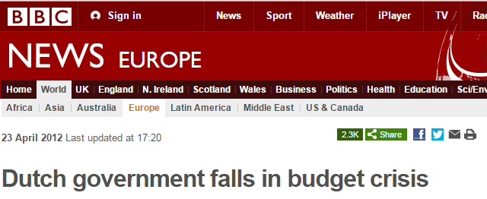
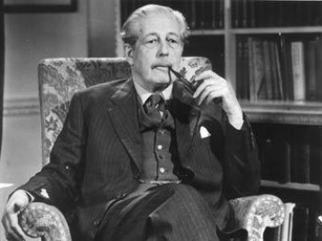
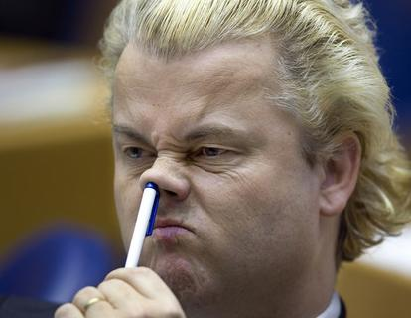
“Events, dear boy, events...”

Slide 7
Final study design
Great Britain
02/2014
N=5,377
06/2014
N=4,673
02/2015
N=5,000
04/2015
N=T.B.C.
06/2015
N=T.B.C.
European Parliament election
General election (GB)
Netherlands
02/2014
N=4,200
06/2014
N=3,200
02/2015
N=T.B.C.
04/2015
N=T.B.C.
Regional elections (NL)

Slide 8
Four initial research questions
Do young adults have different attitudes about the welfare state to older citizens?
Do young adults have different views about the current “austerity” economic climate, and does this influence their views about the welfare state?
Are young adults less likely to discriminate against individual migrant and ethnic minority welfare claimants?
Do young adults have different views about which groups are deserving of government assistance?

Slide 9
Welfare attitudes: measures
Government responsibilities
Support old, disabled, unemployed, provide housing
Government effectiveness
How well does govt perform on four areas above?
Fraud
How frequent are fraudulent claims in these areas?
Outcomes
Does the welfare state (i) prevent poverty (ii) discourage people helping each other (iii) increase immigration (iv) discourage people from taking responsibility (v) make society more equal (vi) integrate ethnic minorities
Normative judgements
(i) moral duty to look after weak (ii) right to protect people from risks beyond their control (iii) sympathy for those in need of welfare

Slide 10
Government responsibility: young want more action on housing, less on pensions, disability

Slide 11
Government effectiveness: young more positive, particularly on support for old, disabled

Slide 12
Fraud: young perceive less fraud (except on pensions, where they perceive more)

Slide 13
Outcomes: young more likely to perceive positive effects from welfare state...

Slide 14
...and less likely to perceive negative effects

Slide 15
Commitment to normative principles of welfare slightly weaker among young

Slide 16
Generation austerity?
Recession and austerity politics of past 7-8 years has impacted disproportionately on young
Negative shift in incomes, job prospects falls most heavily on young
Negative effects from spending changes also tends to hit young harder
Growing housing crisis has impacted post-crash generation disproportionately
Is this disproporationate impact reflected in:
(i) Views about austerity politics
(ii) Views about welfare reform

Slide 17
Generation austerity: measures
Views of overall austerity politics
Support for welfare spending cuts
Support for welfare reform
Perceptions of affordability of welfare state

Slide 18
Views of austerity: young least likely to perceive negative effects, but also least likely to see cuts as necessary

Slide 19
Support for spending cuts: young least keen on spending more on pensions, disability, only group to want housing spend increased

Slide 20
Support for welfare reform: young more supportive of most welfare reforms, except on unemployment

Slide 21
Welfare state affordability: younger voters support spending cuts, but oppose tax rises

Slide 22
Generation diversity?
Under 30s are the most diverse cohort in Britain, and have grown up in the most diverse context
Partly as a result, they tend to be
(i) more accepting of diversity and immigration
(ii) less ethnically nationalist and ethnocentric
Does this extend to their views of the welfare state?
Less likely to discriminate against immigrants and ethnic minorities?

Slide 23
Measures
Welfare chauvinism:
how long should immigrants have to wait to qualify for benefits?
Target group experiments:
How does varying target group impact on views of welfare recipients?

Slide 24
Welfare chauvinism

Slide 25
Target group effects: pensioners

Slide 26
Patterns of discrimination by age for three claimant groups

Slide 27
Conclusions
Young are more positive about welfare state and its effects
Except with regards pensions, where they tend to be more negative
Young have distinct set of views about austerity and its effects:
less likely to perceive negative effects from austerity
more likely to support welfare reform
less likely to support tax increases to maintain welfare
Young have more inclusive and cosmopolitan view of welfare
More willing to extend welfare benefits to migrants after short periods
Discriminate much less between target groups

