Slide 1



Young adults and politics today Disengaged and disaffected or engaged and enraged?
Emerging findings from the Citizenship Education Longitudinal Study (CELS)
Notes:
It’s a pleasure to be here today and to be presenting some of the latest findings from CELS to this audience.
Quite a number of people in this room have been involved in CELS over the years, and it is a pleasure to show you some of the on-going benefits of this work.
In particular, it is an honour to be presenting this work in front of the Right Hon. Mr Blunkett, who not only oversaw the introduction of Citizenship to school curricula, but also provided funding for an evaluation programme that has become a rich and valuable resource for academics and policymakers.
This resource is known as the Citizenship Education Longitudinal Study (CELS), and it has allowed us to follow a group of young people from age 12, when they were the first cohort of young people to have a statutory right to citizenship education during their lower secondary education.
These young people are now youth adults, aged 23, and because of CELS we are able to know a lot more about the evolution of political engagement during the formative transition from adolescence to adulthood. Today we will be drawing on this longitudinal data, as well as cross-sectional data that was collected in the past year by the LLAKES Research Centre.
What we will tel you today is that…

Slide 2
Key messages
Young adults are very distrustful of politicians and vote less than older generations.
But most are still politically engaged and do intend to vote at the next election.
Their political concerns are often different from older adults and they vary by gender and education.
Political engagement grows rapidly from the mid-teens on.
Citizenship education can boost engagement and should continue after 16.

Slide 3
Youth turnout
19% in 2014 EP elections
44% of 18-24 year olds
in 2010 election
Turnout among adults in GB
35% of all UK adults
76% of the over 65s
65% of all GB adults
Sources: Ipsos-Mori (2010) and
Eurobarometer (201)
Notes:
Why are we talking about political engagement among young adults?
Because there has been long-standing concern about the decline in political participation among young adults, and particularly in the area of voting.

Slide 4
Potential to change this in next election?
25% not likely
25% fairly likely
50% very likely to vote
Source: 2025 young people aged 22-29 in England, Scotland and Wales, June-July 2014
Notes:
But in our recent survey of young adults we found that there is great potential to increase on this low turnout.
For example, 50% of young Britons told us that they are ‘very likely’ to vote in the 2015 general election, and a further 25% said that they are ‘fairly likely’ to do so.
While voting intentions do not always translate into turnout on election day, there are other positive indicators that suggest that the ballot box still matters to young people.

Slide 5
The ballot box still matters to young people…
50%
‘It is every adult’s duty to vote in elections’
Source: 2025 young people aged 22-29 in England, Scotland and Wales, June-July 2014
Notes:
This theme also came up again and again in our in-depth interviews.

Slide 6
For young adults in their 20s, voting is still the most common type of political engagement
Source: 2025 young people aged 22-29 in England, Scotland and Wales, June-July 2014
Notes:
Secondly, voting still remains the most common way that young adults engage with the political system.
More young adults report having voted than having participated in any other type of political action (see Figure 1).
Signing petitions is a popular activity, but other than that, only a small minority of young people are taking part in these alternative activities.
Other ways of taking part are emerging, but other than signing petitions, only a small minority of young adults are engaging with politicians, taking part in protests, or starting campaigns.

Slide 7
Many are also interested in politics and talk about political issues with friends and family
Notes:
For example, between 45 and 55% of young adults are using social media to engage with political and civic material, by posting links or comments, or simply ‘liking’ material.
Around 1/3 describe themselves as very interested in politics; 1/3 read a newspaper often/ most days.
44% watch news on TV often/ most days;

Slide 8
What issues are young adults concerned about?
Notes:
So young people are interested in politics. What are they interest in and concerned about?
Well, we asked young adults What is the single most important issue facing the country at the moment?”
The top 5 most mentioned issues were: immigration, unemployment, state of the economy, the NHS and terrorism.
Some overlap with concerns of older adults (age 35+), but also some important differences…. Notably unemployment –
There are also some important differences between young adults in terms of the types of issues they are interested in.

Slide 9
Young women more concerned about immigration and the NHS

Slide 10
Graduates more concerned about the state of the economy, NHS. Early school leavers more concerned about immigration and unemployment.
Notes:
That ESL are concerned about unemployment is perhaps unsurprising, and it came up again and again in our interviews with ESLs.
But these interviews also showed that this was not their only concern.

Slide 11
Young adults in deprived areas + disadvantaged backgrounds not just concerned about unemployment
If a politician knocked on your door tomorrow, what would you tell them they should do to help improve life in your community?
  Practical skills, better qualifications, and routes into work
  Safer communities
  More activities for children and young people
  Services and centres that could bring communities together

Slide 12
Building local communities = the key to re-building trust among this group?
“And if I do see even the slightest of change, then I would consider voting, because then I know there’s somebody actually legitimately trying to help people around my area…”
  (White British male, 23, no qualifications, long-term unemployed)

Slide 13
Adolescence
Adulthood
Growing up political today
Notes:
But CELS not only tell us about young adult’s current attitudes, but also how these have evolved over the course of their adolescence.

Slide 14
As young people grow up, political trust declines markedly…
Notes:
From this we can see that it is not just young adults in deprived areas that have lost faith in politics and politicians.
In fact, over 80% of young people told us the have little or no faith in politicians.
This distrust has increased markedly as the young people have progressed through adolescence and become young adults.
But this growing distrust has not necessarily made young people switch off from politics.

Slide 15
By contrast, interest in voting and in politics increase
Notes:
Participation in other types of political activity (such as taking part in a public demonstration) also increases during this period, but, with the exception of signing petitions, the increases over time are marginal.
This increase in political engagement really starts to take off between the ages of 16 and 20, and suggests that it could be particularly fruitful to provide citizenship education at this point of the educational life-cycle. As it currently stands, there is currently no statutory provision to CE during this phase.
But while there is growing interest, there is also a growing engagement gap…

Slide 16
Growing interest, but also a growing engagement gap
Notes:
If we look at intentions to vote, we can see that more than twice as many young adults with degrees plan to vote than young adults who left at 16 or before.
This gap is apparent even at a very young age, but gets even bigger as they progress through adolescence.

Slide 17
At age 12, interest in politics is actually higher among students who end up leaving school at 16. But the engagement gap emerges by age 16.
Notes:
What is interesting is that if we look at the evolution of political interest, there is some evidence to suggest that this gap is not inevitable.
At age 23 young adults with a degree are three times more likely to say that they are very interested in politics than young adults at left school at 16.
But if we look back at this group’s attitudes at age 12, we can see that it was individuals in this ESL group who were more likely to say they were interested in politics, and it is between the ages of 12 and 16 that this interest declines. This suggests that it may also be a particularly important time to ensure access to quality education and citizenship education.

Slide 18
Can citizenship education boost political engagement among young adults?
Positive attitudes towards civic and political engagement
More likely to believe that they can influence government and effect political change

Slide 19
Most effective when…
Citizenship classes of ≥ 45 minutes per week
Teachers have hands-on role in lesson planning
Learning is formally assessed (e.g. through a GCSE examination)
Citizenship provided regularly throughout the school experiences.

Slide 20
Opportunities to put citizenship into practice
‘Learning by doing’
E.g. School councils, mock elections, debating teams
But also other means

Slide 21
Summary
Voting remains a important means of political engagement
Young people get more interested in politics as they get older and make the transition to adulthood
“Young people” and “young adults” = not a homogenous group
Need to respond to the differences between young citizens, as well as the differences between older and younger voters

Slide 22
Policy implications
Strengthen citizenship education in schools, and ensure that it is continued in post-16 education and training settings.
Continue to support opportunities for learning about citizenship through ‘real life’ practice and ‘active citizenship’.
Notes:
From a comparative perspective, England is unusual in that it does not offer statutory citizenship education after the age 16.

Slide 23
Not just up to schools to educate citizens
Political parties - address issues that are important to young adults
Civil society organisations
For example, get out the vote campaigns
  (Effective) use of social media
  Aim at families, not just young adults

Slide 24
More information
Research brief
  More findings
  More about the data sources
LLAKES website (www.llakes.ac.uk)
Notes:
If you would like to know more about our findings and the data on which it is based, we have a research brief for the audience.
But for now, I would like to pass the floor over to XXX to hear their thoughts on these themes.

Slide 25
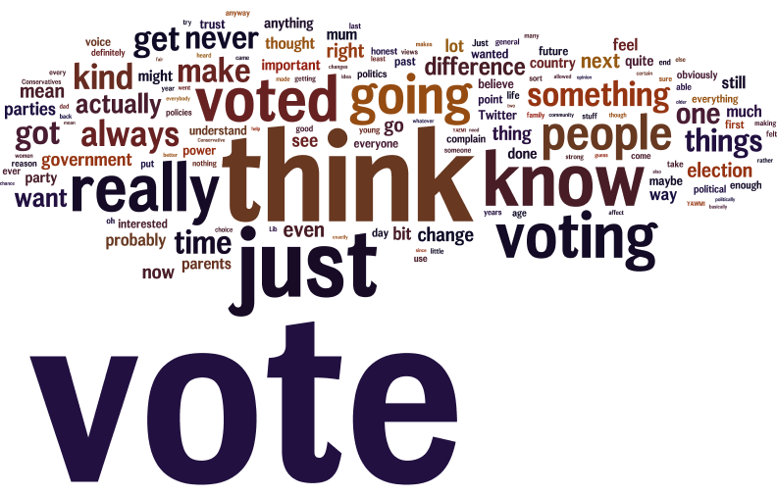
The ballot box still matters to young people…

