Slide 1
Changing and unchanging nature of youth opportunity across three cohorts in China
LLAKES Research Conference on Growing up and Global Austerity
28 June 2016
Dr. Ye Liu
Senior Lecturer at Bath Spa University, UK
y.liu@bathspa.ac.uk

Slide 2
Outline of the Presentation
Research rationale
Research Background
Chinese context
Research design and data analysis
Main findings
Discussion and conclusion

Slide 3
Research Rationale
China has arguably played an important role in the gradual eastward shift in the global economy – a process which has been accentuated by the financial crisis of 2007/8 and ensuing recession in the West (Arrighi, 2007; Jacques, 2012).
Yet we have very little empirical knowledge of the circumstances shaping the opportunities of the new generation of youth in China who represent the fastest growing middle class in the world (Hutton, 2011).

Slide 4
Research Background
The young generations in China have experienced remarkable new opportunities and also growing challenges.
Opportunities:
The Reform and Opening-up since 1978 launched China’s ambitious modernisation programme;
The key to China’s transformation-science and technological innovation-high skill labour (Brown et al., 2010)
The massive expansion of HE (Marginson, 2016)-The output of science and technology outpaced that of Western countries (Brown et al., 2010; Carnoy et al., 2013);
the possibility of professional employment for a larger proportion of youth;

Slide 5
The challenges for Chinese youth
The costs of higher education: the ‘binggui’ policy shifted the costs to individual students and families (Liu, 2013);
While China still benefit from high rates of economic growth, there are nevertheless signs of difficulties of young people translating their opportunities into prosperous life styles:
Affordable housing (the Ant-tribe) (He and Mai, 2015)
Quality of employment (Chan, 2015)
Health insurance (Lu and Wang, 2013)
Pensions (Garcia et al., 2016)
Happiness (CGSS, 2003; 2012)

Slide 6
Existing research on youth opportunity elsewhere
A global picture of the era of uncertainty and risks for the young people in western industrial societies (UK, US, Japan):
Deepening inequality in incomes and wealth (Hills, 2010);
Diminishing social entitlements, and declining political support (Silva, 2013; Willetts, 2010);
Lost civil identity as the mounting debts and austerity measures are taking the toll (Howker and Malik, 2013);
Status discord of the transition from university to the labour market as the traditional graduate jobs have been disappearing (Brinton, 2010; Kosugi, 2008)

Slide 7
The gap of existing research on youth opportunity
Most studies focus the economic crisis and the ensuing austerity measures with the problems for the younger generations, for instance, rising unemployment and underemployment, broken markers of adulthood (marriage) (Green and Zhu, 2010; Silva, 2013).
We have known that the economic crisis prolonged the youth transition into adulthood (Berlin et al. 2010);
Yet we have scant knowledge about the role of state in youth transition in adulthood.

Slide 8
China as a case to examine youth transition
Distinctive characteristics
1) State-led development- market transition from a Socialist society characterised with ‘Modernisation, Stability and Harmony’;
2) State intervention in institutional and cultural changes-the Cultural Revolution, the one-child policy (the end);
3) State-sponsored HE expansion-the ‘world-class’ universities

Slide 9
Existing research on China’s great transformation and the implications on the opportunity structure
1. Elite opportunity: Walder et al. 2015; Walder et al., 2014a; Walder et al., 2014b; Walder et al., 2013
Main argument: the privileges of the Communist Party elites who seized the opportunities during the market reform and the rise of bureaucratic capitalism.
2. Gender and market transition: Cao and Hu, 2007; Ding et al., 2009; Shu, 2005; Hanser, 2005
Main argument: Communist empowerment of women and egalitarian gender equality gave way to market reforms which reinforced traditional patriarchal values in Chinese society; declining employment opportunities for women.

Slide 10
3. Education, Meritocracy and social stratification
Wu and Zhang, 2015; Wu and Song, 2014; Wu, 2010; Liu, 2016
Main argument:
the shift from political affiliation to merit-based social selection;
expansion of ED opportunities for all social groups
but unevenly across different social gradients

Slide 11
Main research questions
What are the patterns of youth transition into adulthood overtime in China ?
How have the patterns shifted over different socioeconomic and political circumstances?
What is the role of the State in youth transitions?

Slide 12
Research design
Youth transition into adulthood is marked by life-course events between 25 and 35 including: 1) higher education, 2) the Chinese Communist Party membership, 3) full-time employment, 4) health insurance, 5) happiness, and 6) house ownership.
Three cohorts.
C1: birth cohorts between 1948 and 1963-youth transition affected by the Cultural Revolution
C2: birth cohorts between 1967 and 1975-youth transition in parallel with the market transition
C3: birth cohorts between 1976 and 1986-youth transition coincident with the HE expansion and China’s further integration into the global economy
Notes:
*

Slide 13
Data-the Chinese General Social Surveys
The Chinese General Social Surveys are the relatively most consistent and reliable large-scale national datasets.
C1: birth cohorts between 1948 and 1963
The total number of 1,629 CGSS (2003).
C2: birth cohorts between 1967 and 1975
The total number of 2,265 CGSS (2003).
C3: birth cohorts between 1976 and 1986
The total number of 1,890 CGSS (2012).

Slide 14
Variables
Relationships between social characteristics and life-course events between 25 and 30 across three selected cohorts.
Independent variables:
1) gender, 2) father’s education, 3) father’s Party membership, 4) father’s socioeconomic status/occupation.
Dependent variables:
1) higher education, 2) the Chinese Communist Party membership, 3) full-time employment, 4) health insurance, 5) happiness and 6) house ownership.

Slide 15
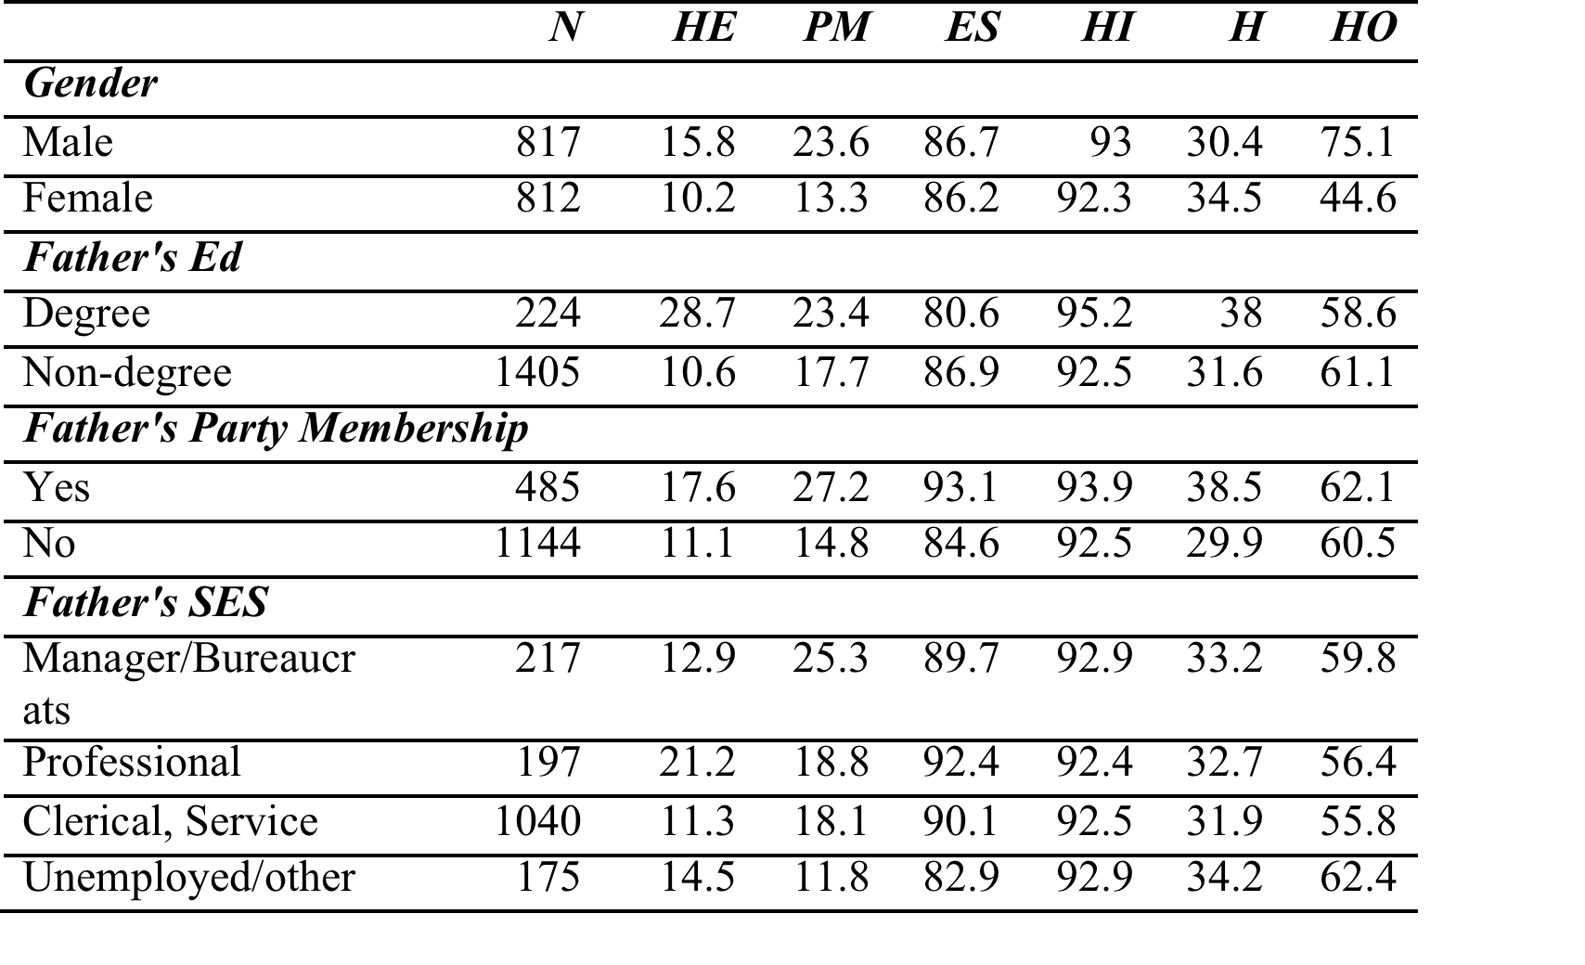
Table 1: Descriptive data of Life-course events in percentage by social characteristics for the Cohort 1
1
Notes:
Source: CGSS (2003)
Note: the samples is weighted.

Slide 16
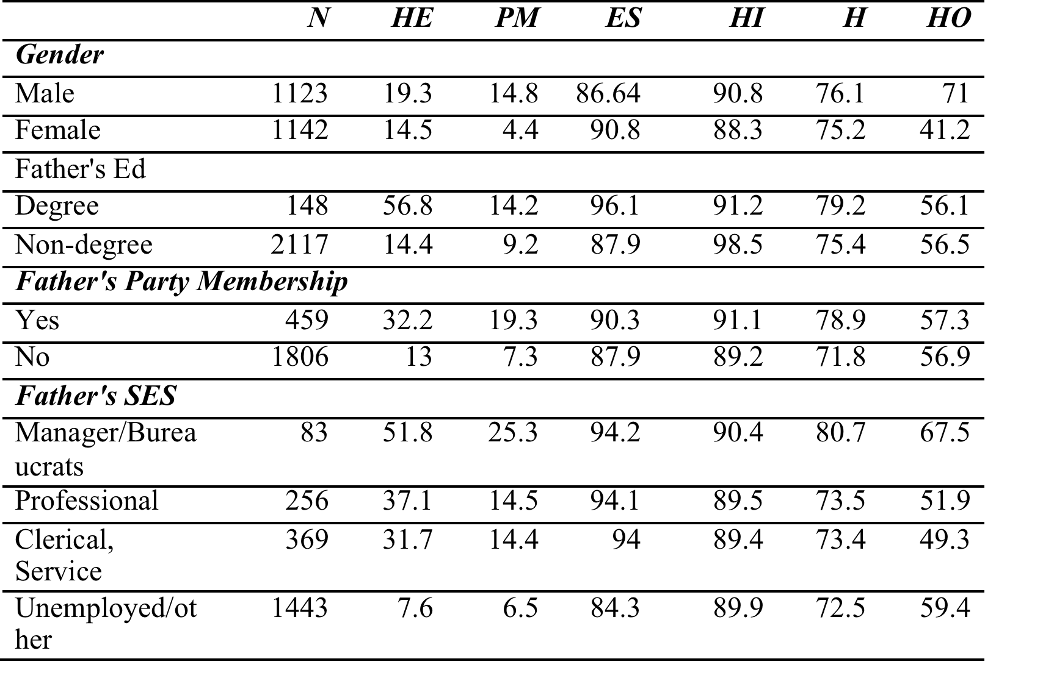
Table 2: Descriptive data of Life-course events in percentage by social characteristics for the Cohort 2 (1966-1976)
1
Notes:
Source: CGSS (2003)
Note: the samples is weighted.

Slide 17
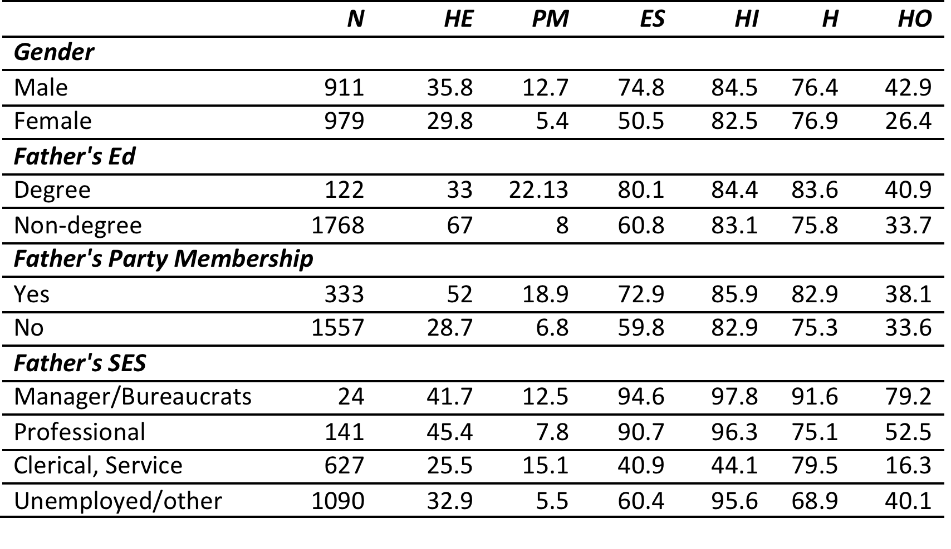
Table 3: Descriptive data of Life-course events in percentage by social characteristics for the Cohort 3
1
Notes:
Source: CGSS (2012)
Note: the samples is weighted.

Slide 18
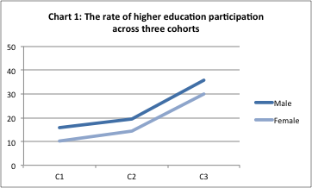
Notes:
Source: CGSS (2003, 2012)

Slide 19
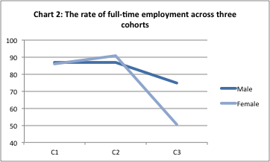
Notes:
Source: CGSS (2003, 2012)

Slide 20
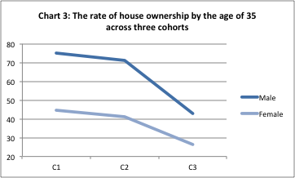
Notes:
Source: CGSS (2003, 2012)

Slide 21
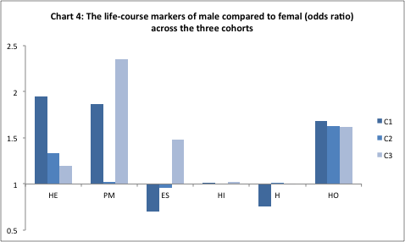
Notes:
Source: CGSS (2003, 2012)

Slide 22
Finding 1: Life-course events by gender across three cohorts
1.1 Consistent male advantage over female in higher education opportunities, obtaining party membership and house ownership;
1.2 Male advantage in higher education opportunities declined significantly from the C1 to C3: (ED and meritocracy arguments)
1.3 Male advantage in employment status increased significantly in the C3 (Gender and market transition arguments)
1.4 Little gender differences in health insurance;
1.5 Women felt happier than men in the C1 (the odds of feeling happy for women were 25% higher than men for the C1): (Gender and market transition arguments)

Slide 23
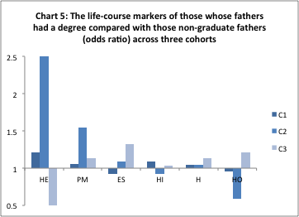
Notes:
Source: CGSS (2003, 2012)

Slide 24
Finding 2:Life-course events between those with graduate fathers and those fathers without a degree across three cohorts
2.1 Evidence of graduate fathers in predicting advantages in the life-course events;
2.2 Most significant advantage of higher education opportunities and obtaining party membership in the C2;

Slide 25
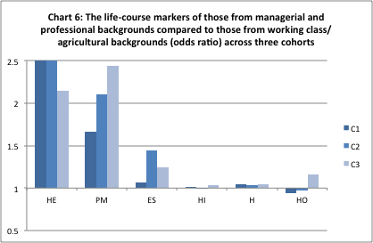

Slide 26
Finding 3: Life-course events between those from managerial/professional backgrounds and those from working class and agricultural families across three cohorts
3.1 Consistent advantages of those from managerial/professional families over those from working class and agricultural backgrounds in higher education opportunities, obtaining party membership and full-time employment: (education and meritocracy arguments)
3.2 the advantage insignificant in health insurance, happiness and house ownership.

Slide 27
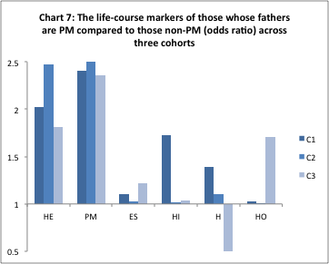
Notes:
Source: CGSS (2003, 2012)

Slide 28
Finding 4: Life-course events between those with Party member fathers and those with non-Party member fathers across three cohorts
4.1 Advantages of those whose fathers are Party members than those without Party member fathers consistently strong in all life-course events, including higher education opportunities, obtaining party membership, full-time employment, health insurance, house ownership and happiness (except for the C2).
4.2 Elite opportunity arguments.

Slide 29
Conclusions
What has changed over three cohorts?
1. Youth opportunity increases in the participation in higher education whilst there is a significant decline in obtaining full-time employment and house ownership;
2. Women are disadvantaged in all measures of opportunities during the market reform;
What remains unchanged?
3. Political capital is most consistent across shift socioeconomic and political circumstances.

Slide 30
Conclusion continued…
4. At the theoretical level, we need to include political capital alongside other indicators to social characteristics in analyzing youth opportunity in China;
5. At the contextual level, the State is the biggest winner during the market transition. On the one hand, the cost of the massive expansion of HE was shifted to individual families. On the other, the meritocratic ideology of social mobility through HE masked the uneven redistribution of economic, political, and social resources among different social groups during the transition.

Slide 31
References
Arrighi G. (2007) Adam Smith in Beijing: Lineages of the Twenty-First Century. Verso.
Berlin, G., Frank, F. Furstenberg, Jr., and Waters, M. C. (2010) Transition to adulthood. The Future of Children 20 (1): 3–18.
Brinton, M. (2011) Lost in Transition: Youth, Education and Work in Post-industrial Japan. Cambridge: Cambridge University Press.
Brown, P., Lauder, H. and Ashton, D. (2010) The Global Auction: The Broken Promises of Education, Jobs and Rewards. New York: Oxford University Press.
Cao, Y. and Hu, C. H. (2007) ‘Gender and Job Mobility in Postsocialist China: A Longitudinal Study of Job Changes in Six Coastal Cities.’ Social Forces, 85 (4): 1535-60.
Chinese General Social Survey (2003, 2012) Chinese General Social Survey-the National Survey Research Center. Bejing: Renmin University. Available from: http://www.chinagss.org/index.php?r=index/researcher

Slide 32
Continued…
Carnoy, M., Loyalka, P., Dobryakova, M., Dossani, R., Froumin, I., Kuhns, K., Tilak, J. B. G., and Wang, R. (2013) University Expansion in a Changing Global Economy: Triumph of the BRICs? Palo Alto, CA: Stanford University Press.
Chan, W. K. (2015) ‘Higher Education and Graduate Employment in China’. High Education Policy, 28 (1): 35-53.
Ding, S., Dong X. Y. and Li, S. (2009) ‘Women's Employment and Family Income Inequality during China's Economic Transition.’ Feminist Economics, 15(3): 163-190.
Garcia, B. C., Hood, J. and Kadet, P. (2016) (eds) Handbook of Welfare in China. Sydney: Edward Elgar Publishing Ltd.
Green, F. and Zhu, Y. (2010) ‘Overqualification, job dissatisfaction, and increasing dispersion in the returns to graduate education’. Oxford Economic Papers, 62(4): 740-763.
Hanser, A. (2005) ‘The Gendered Rice Bowl: The Sexual Politics of Service Work in Urban China.’ Gender and Society, 19 (5):581-600.
He, Y. and Mai, Y. H. (2015) ‘Higher Education Expansion in China and the ‘Ant Tribe’ Problem’. High Education Policy, 28 (3): 333-352.

Slide 33
Continued…
Hills, J. (2010) An anatomy of economic inequality in the UK: Report of the National Equality Panel. London: Government Equalities Office.
Howker, E. and Malik, S. (2010) Jilted Generation: how Britain has bankrupted its youth. London: Icon Books.
Hutton, W. (2011) Them and Us. Changing Britain – Why We Need a Fair Society. London: Little, Brown.
Jacques, M. (2012). When China Rules the World: The End of the Western World and the Birth of a New Global Order. Penguin: London.
Kosugi, R. (2008) Escape from Work: Freelancing Youth and the Challenge to Corporate Japan. Melbourne: Trans Pacific Press.
Liu, Y. (2016) Higher Education, Meritocracy and Inequality in China. Singapore: Springer.
Liu, Y. (2013) ‘Meritocracy and the Gaokao: A survey study of higher education selection and socioeconomic participation in Anhui and Zhejiang.’ British Journal of Sociology of Education, 34 (5-6): 868-887.

Slide 34
Continued..
Marginson S (2016) High Participation Systems of Higher Education. The Journal of Higher Education 87(2): 243-271.
Shu, X. L. (2005) ‘Market Transition and Gender Segregation in Urban China.’ Social Science Quarterly, 86:1300-1323.
Silva, J. M. (2013) Coming up Short: working class adulthood in an age of uncertainty. Oxford: Oxford University Press.
Walder, A. G., Isaacson, A., Lu, Q. (2015). After State Socialism: The Political Origins of Transitional Recessions. American Sociological Review, 80 (2), 444-468.
Walder, A. G. (2014a) China’s Bureaucratic Capitalism: Creating the Corporate Steel Sector. In K. E. Brødsgaard (ed.), Globalization and Public Sector Reform in China (pp.159-176). London: Routledge.
Walder, A. G (2014 b). Elite Opportunity in Transitions from State Socialism. In D. B. Grusky (ed.), Social Stratification: Class, Race and Gender in Sociological Perspective (pp.1110-1115). CO: Westview.

Slide 35
Continued…
Walder, A. G., Luo, T., and Wang, D (2013) Social stratification in transitional economies: property rights and the structure of markets. Theory and Society, 42 (6): 561-588.
Willetts, D. (2010) The Pinch: how the baby boomers took their children’s future-and why they should give it back. London: Atlantic Books.
Wu, X. G. (2010). Economic Transition, School Expansion and Educational Inequality in China, 1990-2000. Research in Social Stratification and Mobility, 28(1), 91-108.
Wu, X. G. and Zhang, Z. (2015) Population Migration and Children's School Enrollments in China, 1990–2005. Social Science Research, 53: 177-190.
Wu, X. G. and Song, S. (2014) Ethnic Stratiﬁcation amid China’s Economic Transition: Evidence from the Xinjiang Uyghur Autonomous Region. Social Science Research, 44, 158-172.

